Slide 1

Network Security Essentials
Fifth Edition
by William Stallings
Lecturer: Benny Hardjono
Notes:
Lecture slides prepared for “Network Security Essentials”, 5/e, by William Stallings, Chapter 7 – “Wireless Network Security”.

Slide 2
Network Security Essentials
Contents
Chapter | Slide No. | Summary
7 | 1-39 | 39
8 | 41 | 78
9 | 80 | 117
10 | 119 | 165
11 | 167 | 202
12 | 204 | 225
Fifth Edition
by William Stallings
Notes:
Lecture slides prepared for “Network Security Essentials”, 5/e, by William Stallings, Chapter 7 – “Wireless Network Security”.

Slide 3
Chapter 7
Wireless Network Security
Notes:
This chapter begins with a general overview of wireless security issues. We then focus
on the relatively new area of mobile device security, examining threats and countermeasures
for mobile devices used in the enterprise. Then, we look at the IEEE 802.11i
standard for wireless LAN security. This standard is part of IEEE 802.11, also referred
to as Wi-Fi. We begin the discussion with an overview of IEEE 802.11, and then we
look in some detail at IEEE 802.11i.

Slide 4
“Investigators have published numerous reports of birds taking turns vocalizing; the bird spoken to gave its full attention to the speaker and never vocalized at the same time, as if the two were holding a conversation.”
“Researchers and scholars who have studied the data on avian communication carefully write (a) the communication code of birds, such as crows, has not been broken by any means; (b) probably all birds have wider vocabularies than anyone realizes; and (c) greater complexity and depth are recognized in avian communication as research progresses.”
—The Human Nature of Birds, Theodore Barber
Notes:
This chapter looks at two important wireless network security schemes. First, we look at the IEEE 802.11i standard for wireless LAN security. The remainder of the chapter is devoted to security standards for Web access from mobile wireless devices, such as cell phones.

Slide 5
Wireless Security
Some of the key factors contributing to the higher security risk of wireless networks compared to wired networks include:
Channel
Wireless networking typically involves broadcast communications, which is far more susceptible to eavesdropping and jamming than wired networks
Wireless networks are also more vulnerable to active attacks that exploit vulnerabilities in communications protocols
Mobility
Wireless devices are far more portable and mobile than wired devices
This mobility results in a number of risks
Resources
Some wireless devices, such as smartphones and tablets, have sophisticated operating systems but limited memory and processing resources with which to counter threats, including denial of service and malware
Accessibility
Some wireless devices, such as sensors and robots, may be left unattended in remote and/or hostile locations
This greatly increases their vulnerability to physical attacks
Notes:
Wireless networks, and the wireless devices that use them, introduce a host of security
problems over and above those found in wired networks. Some of the key factors
contributing to the higher security risk of wireless networks compared to wired
networks include the following [MA10]:
• Channel: Wireless networking typically involves broadcast communications,
which is far more susceptible to eavesdropping and jamming than wired networks.
Wireless networks are also more vulnerable to active attacks that exploit
vulnerabilities in communications protocols.
• Mobility: Wireless devices are, in principal and usually in practice, far more
portable and mobile than wired devices. This mobility results in a number of
risks, described subsequently.
• Resources: Some wireless devices, such as smartphones and tablets, have sophisticated
operating systems but limited memory and processing resources
with which to counter threats, including denial of service and malware.
• Accessibility: Some wireless devices, such as sensors and robots, may be left
unattended in remote and/or hostile locations. This greatly increases their vulnerability
to physical attacks.

Slide 6
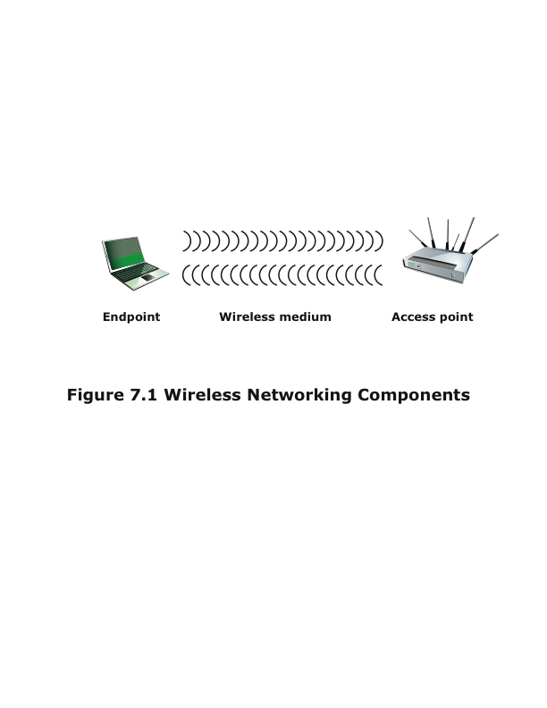
Notes:
In simple terms, the wireless environment consists of three components that
provide point of attack (Figure 7.1). The wireless client can be a cell phone, a
Wi-Fi–enabled laptop or tablet, a wireless sensor, a Bluetooth device, and so on.
The wireless access point provides a connection to the network or service. Examples
of access points are cell towers, Wi-Fi hotspots, and wireless access points to wired
local or wide area networks. The transmission medium, which carries the radio
waves for data transfer, is also a source of vulnerability.

Slide 7
Wireless Network Threats
Accidental association
Company wireless LANs in close proximity may create overlapping transmission ranges
A user intending to connect to one LAN may unintentionally lock on to a wireless access point from a neighboring network
Malicious association
In this situation, a wireless device is configured to appear to be a legitimate access point, enabling the operator to steal passwords from legitimate users and then penetrate a wired network through a legitimate wireless access point
Ad hoc networks
These are peer-to-peer networks between wireless computers with no access point between them
Such networks can pose a security threat due to a lack of a central point of control
Nontraditional networks
Personal network Bluetooth devices, barcode readers, and handheld PDAs pose a security risk in terms of both eavesdropping and spoofing
Identity theft (MAC spoofing)
This occurs when an attacker is able to eavesdrop on network traffic and identify the MAC address of a computer with network privileges
Man-in-the-middle attacks
This attack involves persuading a user and an access point to believe that they are talking to each other when in fact the communication is going through an intermediate attacking device
Wireless networks are particularly vulnerable to such attacks
Denial of service (DoS)
This attack occurs when an attacker continually bombards a wireless access point or some other accessible wireless port with various protocol messages designed to consume system resources
The wireless environment lends itself to this type of attack because it is so easy for the attacker to direct multiple wireless messages at the target
Network injection
This attack targets wireless access points that are exposed to nonfiltered network traffic, such as routing protocol messages or network management messages
Notes:
[CHOI08] lists the following security threats to wireless networks:
• Accidental association: Company wireless LANs or wireless access points to
wired LANs in close proximity (e.g., in the same or neighboring buildings)
may create overlapping transmission ranges. A user intending to connect to
one LAN may unintentionally lock on to a wireless access point from a neighboring
network. Although the security breach is accidental, it nevertheless exposes
resources of one LAN to the accidental user.
• Malicious association: In this situation, a wireless device is configured to appear
to be a legitimate access point, enabling the operator to steal passwords
from legitimate users and then penetrate a wired network through a legitimate
wireless access point.
• Ad hoc networks: These are peer-to-peer networks between wireless computers
with no access point between them. Such networks can pose a security
threat due to a lack of a central point of control.
• Nontraditional networks: Nontraditional networks and links, such as personal
network Bluetooth devices, barcode readers, and handheld PDAs, pose a security
risk in terms of both eavesdropping and spoofing.
• Identity theft (MAC spoofing): This occurs when an attacker is able to eavesdrop
on network traffic and identify the MAC address of a computer with
network privileges.
• Man-in-the middle attacks: This type of attack is described in Chapter 3 in
the context of the Diffie-Hellman key exchange protocol. In a broader sense,
this attack involves persuading a user and an access point to believe that they
are talking to each other when in fact the communication is going through an
intermediate attacking device. Wireless networks are particularly vulnerable
to such attacks.
• Denial of service (DoS): This type of attack is discussed in detail in Chapter 10.
In the context of a wireless network, a DoS attack occurs when an attacker
continually bombards a wireless access point or some other accessible wireless
port with various protocol messages designed to consume system resources.
The wireless environment lends itself to this type of attack, because it is so
easy for the attacker to direct multiple wireless messages at the target.
• Network injection: A network injection attack targets wireless access points
that are exposed to nonfiltered network traffic, such as routing protocol messages
or network management messages. An example of such an attack is
one in which bogus reconfiguration commands are used to affect routers and
switches to degrade network performance.

Slide 8
Securing Wireless Transmissions
The principal threats to wireless transmission are eavesdropping, altering or inserting messages, and disruption
To deal with eavesdropping, two types of countermeasures are appropriate:
Signal-hiding techniques
Turn off SSID broadcasting by wireless access points
Assign cryptic names to SSIDs
Reduce signal strength to the lowest level that still provides requisite coverage
Locate wireless access points in the interior of the building, away from windows and exterior walls
Encryption
Is effective against eavesdropping to the extent that the encryption keys are secured
Notes:
The principal threats to wireless transmission
are eavesdropping, altering or inserting messages, and disruption. To deal with
eavesdropping, two types of countermeasures are appropriate:
• Signal-hiding techniques: Organizations can take a number of measures to
make it more difficult for an attacker to locate their wireless access points,
including turning off service set identifier (SSID) broadcasting by wireless access
points; assigning cryptic names to SSIDs; reducing signal strength to the
lowest level that still provides requisite coverage; and locating wireless access
points in the interior of the building, away from windows and exterior walls.
Greater security can be achieved by the use of directional antennas and of
signal-shielding techniques.
• Encryption: Encryption of all wireless transmission is effective against eavesdropping
to the extent that the encryption keys are secured.
The use of encryption and authentication protocols is the standard method of
countering attempts to alter or insert transmissions.
The methods discussed in Chapter 10 for dealing with DoS apply to wireless
transmissions. Organizations can also reduce the risk of unintentional DoS attacks.
Site surveys can detect the existence of other devices using the same frequency
range, to help determine where to locate wireless access points. Signal strengths can
be adjusted and shielding used in an attempt to isolate a wireless environment from
competing nearby transmissions.

Slide 9
Securing Wireless Access Points
The main threat involving wireless access points is unauthorized access to the network
The principal approach for preventing such access is the IEEE 802.1x standard for port-based network access control
The standard provides an authentication mechanism for devices wishing to attach to a LAN or wireless network
The use of 802.1x can prevent rogue access points and other unauthorized devices from becoming insecure backdoors
Notes:
The main threat involving wireless access
points is unauthorized access to the network. The principal approach for preventing
such access is the IEEE 802.1X standard for port-based network access control. The
standard provides an authentication mechanism for devices wishing to attach to a
LAN or wireless network. The use of 802.1X can prevent rogue access points and
other unauthorized devices from becoming insecure backdoors.
Section 5.3 provides an introduction to 802.1X.

Slide 10
Securing Wireless Networks
Use encryption
Use antivirus, antispyware software and a firewall
Turn off identifier broadcasting
Change the identifier on your router from the default
Change your router’s pre-set password for administration
Allow only specific computers to access your wireless network
Notes:
[CHOI08] recommends the following techniques for
wireless network security:
1. Use encryption. Wireless routers are typically equipped with built-in encryption
mechanisms for router-to-router traffic.
2. Use antivirus and antispyware software, and a firewall. These facilities should
be enabled on all wireless network endpoints.
3. Turn off identifier broadcasting. Wireless routers are typically configured to
broadcast an identifying signal so that any device within range can learn of the
router’s existence. If a network is configured so that authorized devices know
the identity of routers, this capability can be disabled, so as to thwart attackers.
4. Change the identifier on your router from the default. Again, this measure
thwarts attackers who will attempt to gain access to a wireless network using
default router identifiers.
5. Change your router’s pre-set password for administration. This is another prudent
step.
6. Allow only specific computers to access your wireless network. A router can
be configured to only communicate with approved MAC addresses. Of course,
MAC addresses can be spoofed, so this is just one element of a security strategy.

Slide 11

Mobile Device Security
Mobile devices have become an essential element for organizations as part of the overall network infrastructure
Prior to the widespread use of smartphones, network security was based upon clearly defined perimeters that separated trusted internal networks from the untrusted Internet
Due to massive changes, an organization’s networks must now accommodate:
Growing use of new devices
Cloud-based applications
De-perimeterization
External business requirements
Notes:
Prior to the widespread use of smartphones, the dominant paradigm for computer
and network security in organizations was as follows. Corporate IT was tightly controlled.
User devices were typically limited to Windows PCs. Business applications
were controlled by IT and either run locally on endpoints or on physical servers
in data centers. Network security was based upon clearly defined perimeters that
separated trusted internal networks from the untrusted Internet. Today, there have
been massive changes in each of these assumptions. An organization’s networks
must accommodate the following:
• Growing use of new devices: Organizations are experiencing significant growth
in employee use of mobile devices. In many cases, employees are allowed to
use a combination of endpoint devices as part of their day-to-day activities.
• Cloud-based applications: Applications no longer run solely on physical
servers in corporate data centers. Quite the opposite, applications can run
anywhere—on traditional physical servers, on mobile virtual servers, or in the
cloud. Additionally, end users can now take advantage of a wide variety of
cloud-based applications and IT services for personal and professional use.
Facebook can be used for an employee’s personal profiles or as a component
of a corporate marketing campaign. Employees depend upon Skype to speak
with friends abroad or for legitimate business video conferencing. Dropbox
and Box can be used to distribute documents between corporate and personal
devices for mobility and user productivity.
• De-perimeterization: Given new device proliferation, application mobility,
and cloud-based consumer and corporate services, the notion of a static network
perimeter is all but gone. Now there are a multitude of network perimeters
around devices, applications, users, and data. These perimeters have also
become quite dynamic as they must adapt to various environmental conditions
such as user role, device type, server virtualization mobility, network location,
and time-of-day.
• External business requirements: The enterprise must also provide guests,
third-party contractors, and business partners network access using various
devices from a multitude of locations.
The central element in all of these changes is the mobile computing device.
Mobile devices have become an essential element for organizations as part of the
overall network infrastructure. Mobile devices such as smartphones, tablets, and
memory sticks provide increased convenience for individuals as well as the potential
for increased productivity in the workplace. Because of their widespread use and
unique characteristics, security for mobile devices is a pressing and complex issue.
In essence, an organization needs to implement a security policy through a combination
of security features built into the mobile devices and additional security controls
provided by network components that regulate the use of the mobile devices.

Slide 12
Security Threats
Major security concerns for mobile devices:
Lack of physical security controls
The security policy for mobile devices must be based on the assumption that any mobile device may be stolen or at least accessed by a malicious party
Use of untrusted mobile devices
The organization must assume that not all devices are trustworthy
Use of untrusted networks
The security policy must be based on the assumption that the networks between the mobile device and the organization are not trustworthy
Use of untrusted content
Mobile devices may access and use content that other computing devices do not encounter
Use of applications created by unknown parties
It is easy to find and install third-party applications on mobile devices and this poses the risk of installing malicious software
Interaction with other systems
Unless an organization has control of all the devices involved in synchronization, there is considerable risk of the organization’s data being stored in an unsecured location, plus the risk of the introduction of malware
Use of location services
An attacker can use location information to determine where the device and user are located, which may be of use to the attacker
Notes:
Mobile devices need additional, specialized protection measures beyond those
implemented for other client devices, such as desktop and laptop devices that are
used only within the organization’s facilities and on the organization’s networks.
SP 800-14 (Guidelines for Managing and Securing Mobile Devices in the Enterprise ,
July 2012) lists seven major security concerns for mobile devices. We examine each
of these in turn.
Lack of Physical Security Controls
Mobile devices are typically under the complete
control of the user, and are used and kept in a variety of locations outside the
organization’s control, including off premises. Even if a device is required to remain
on premises, the user may move the device within the organization between secure
and nonsecured locations. Thus, theft and tampering are realistic threats.
The security policy for mobile devices must be based on the assumption that
any mobile device may be stolen or at least accessed by a malicious party. The threat
is twofold: A malicious party may attempt to recover sensitive data from the device
itself, or may use the device to gain access to the organization’s resources.
Use of Untrusted Mobile Devices
In addition to company-issued and company controlled
mobile devices, virtually all employees will have personal smartphones
and/or tablets. The organization must assume that these devices are not trustworthy.
That is, the devices may not employ encryption and either the user or a third
party may have installed a bypass to the built-in restrictions on security, operating
system use, and so on.
Use of Untrusted Networks
If a mobile device is used on premises, it can connect
to organization resources over the organization’s own in-house wireless networks.
However, for off-premises use, the user will typically access organizational
resources via Wi-Fi or cellular access to the Internet and from the Internet to the
organization. Thus, traffic that includes an off-premises segment is potentially susceptible
to eavesdropping or man-in-the-middle types of attacks. Thus, the security
policy must be based on the assumption that the networks between the mobile device
and the organization are not trustworthy.
Use of Applications Created by Unknown Parties
By design, it is easy to find
and install third-party applications on mobile devices. This poses the obvious risk of
installing malicious software. An organization has several options for dealing with
this threat, as described subsequently.
Interaction with Other Systems
A common feature found on smartphones and
tablets is the ability to automatically synchronize data, apps, contacts, photos, and
so on with other computing devices and with cloud-based storage. Unless an organization
has control of all the devices involved in synchronization, there is considerable
risk of the organization’s data being stored in an unsecured location, plus the
risk of the introduction of malware.
Use of Untrusted Content
Mobile devices may access and use content that other
computing devices do not encounter. An example is the Quick Response (QR)
code, which is a two-dimensional barcode. QR codes are designed to be captured
by a mobile device camera and used by the mobile device. The QR code translates
to a URL, so that a malicious QR code could direct the mobile device to malicious
Web sites.
Use of Location Services
The GPS capability on mobile devices can be used to
maintain a knowledge of the physical location of the device. While this feature
might be useful to an organization as part of a presence service, it creates security
risks. An attacker can use the location information to determine where the device
and user are located, which may be of use to the attacker.

Slide 13
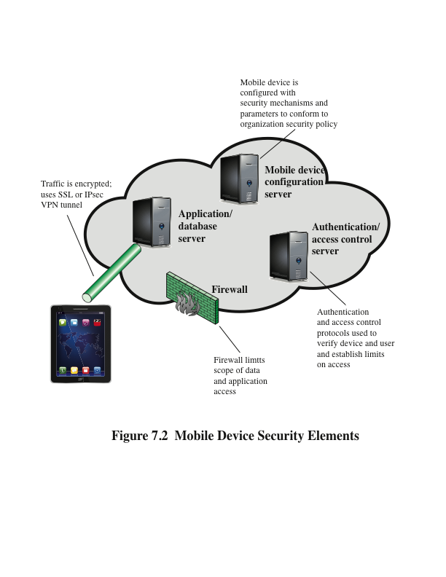
Notes:
With the threats listed in the preceding discussion in mind, we outline the principal
elements of a mobile device security strategy. They fall into three categories: device
security, client/server traffic security, and barrier security (Figure 7.2).
Device Security
A number of organizations will supply mobile devices for employee
use and preconfigure those devices to conform to the enterprise security policy.
However, many organizations will find it convenient or even necessary to adopt a bring-your-
own-device (BYOD) policy that allows the personal mobile devices of employees
to have access to corporate resources. IT managers should be able to inspect each
device before allowing network access. IT will want to establish configuration guidelines
for operating systems and applications. For example, “rooted” or “jail-broken”
devices are not permitted on the network, and mobile devices cannot store corporate
contacts on local storage. Whether a device is owned by the organization or BYOD, the
organization should configure the device with security controls, including the following:
• Enable auto-lock, which causes the device to lock if it has not been used for a
given amount of time, requiring the user to re-enter a four-digit PIN or a password
to re-activate the device.
• Enable password or PIN protection. The PIN or password is needed to unlock
the device. In addition, it can be configured so that e-mail and other data on
the device are encrypted using the PIN or password and can only be retrieved
with the PIN or password.
• Avoid using auto-complete features that remember user names or passwords.
• Enable remote wipe.
• Ensure that SSL protection is enabled, if available.
• Make sure that software, including operating systems and applications, is up
to date.
• Install antivirus software as it becomes available.
• Either sensitive data should be prohibited from storage on the mobile device
or it should be encrypted.
• IT staff should also have the ability to remotely access devices, wipe the device
of all data, and then disable the device in the event of loss or theft.
• The organization may prohibit all installation of third-party applications,
implement white-listing to prohibit installation of all unapproved applications,
or implement a secure sandbox that isolates the organization’s data and
applications from all other data and applications on the mobile device. Any
application that is on an approved list should be accompanied by a digital
signature and a public-key certificate from an approved authority.
• The organization can implement and enforce restrictions on what devices can
synchronize and on the use of cloud-based storage.
• To deal with the threat of untrusted content, security responses can include
training of personnel on the risks inherent in untrusted content and disabling
camera use on corporate mobile devices.
• To counter the threat of malicious use of location services, the security policy
can dictate that such service is disabled on all mobile devices.
Traffic Security
Traffic security is based on the usual mechanisms for encryption
and authentication. All traffic should be encrypted and travel by secure means, such
as SSL or IPv6. Virtual private networks (VPNs) can be configured so that all traffic
between the mobile device and the organization’s network is via a VPN.
A strong authentication protocol should be used to limit the access from the
device to the resources of the organization. Often, a mobile device has a single
device-specific authenticator, because it is assumed that the device has only one
user. A preferable strategy is to have a two-layer authentication mechanism, which
involves authenticating the device and then authenticating the user of the device.
Barrier Security
The organization should have security mechanisms to protect the
network from unauthorized access. The security strategy can also include firewall policies
specific to mobile device traffic. Firewall policies can limit the scope of data and
application access for all mobile devices. Similarly, intrusion detection and intrusion
prevention systems can be configured to have tighter rules for mobile device traffic.

Slide 14
IEEE 802.11 Wireless LAN Overview
IEEE 802 is a committee that has developed standards for a wide range of local area networks (LANs)
In 1990 the IEEE 802 Committee formed a new working group, IEEE 802.11, with a charter to develop a protocol and transmission specifications for wireless LANs (WLANs)
Since that time, the demand for WLANs at different frequencies and data rates has exploded
Notes:
IEEE 802 is a committee that has developed standards for a wide range of local
area networks (LANs). In 1990, the IEEE 802 Committee formed a new working
group, IEEE 802.11, with a charter to develop a protocol and transmission
specifications for wireless LANs (WLANs). Since that time, the demand for
WLANs at different frequencies and data rates has exploded. Keeping pace
with this demand, the IEEE 802.11 working group has issued an ever-expanding
list of standards.

Slide 15
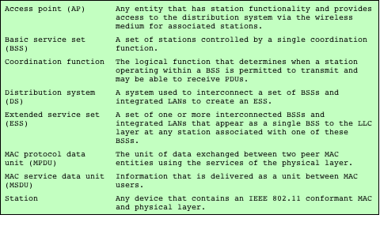
Table 7.1 IEEE 802.11 Terminology
Notes:
Table 7.1 briefly defines key terms used in the IEEE 802.11
standard.

Slide 16
Wi-Fi Alliance
The first 802.11 standard to gain broad industry acceptance was 802.11b
Wireless Ethernet Compatibility Alliance (WECA)
An industry consortium formed in 1999
Subsequently renamed the Wi-Fi (Wireless Fidelity) Alliance
Created a test suite to certify interoperability for 802.11 products
Wi-Fi
The term used for certified 802.11b products
Has been extended to 802.11g products
Wi-Fi5
A certification process for 802.11a products that was developed by the Wi-Fi Alliance
Recently the Wi-Fi Alliance has developed certification procedures for IEEE 802.11 security standards
Referred to as Wi-Fi Protected Access (WPA)
Notes:
The first 802.11 standard to gain broad industry acceptance was 802.11b. Although
802.11b products are all based on the same standard, there is always a concern
whether products from different vendors will successfully interoperate. To meet
this concern, the Wireless Ethernet Compatibility Alliance (WECA), an industry
consortium, was formed in 1999. This organization, subsequently renamed the
Wi-Fi (Wireless Fidelity) Alliance, created a test suite to certify interoperability for
802.11b products. The term used for certified 802.11b products is Wi-Fi . Wi-Fi certification
has been extended to 802.11g products. The Wi-Fi Alliance has also developed
a certification process for 802.11a products, called Wi-Fi5 . The Wi-Fi Alliance
is concerned with a range of market areas for WLANs, including enterprise, home,
and hot spots.
More recently, the Wi-Fi Alliance has developed certification procedures for
IEEE 802.11 security standards, referred to as Wi-Fi Protected Access (WPA). The
most recent version of WPA, known as WPA2, incorporates all of the features of
the IEEE 802.11i WLAN security specification.

Slide 17
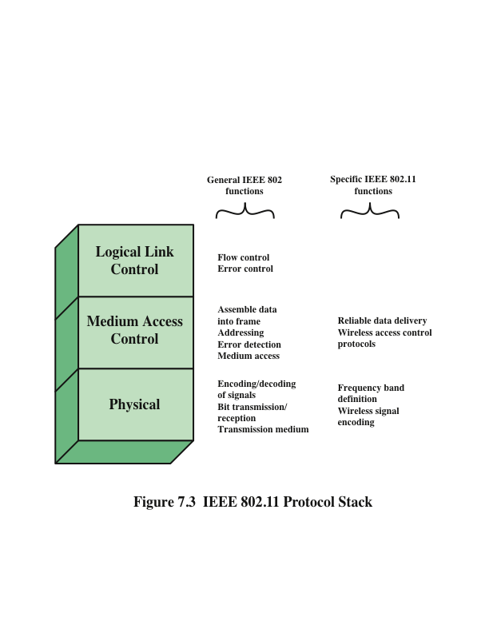
Notes:
Before proceeding, we need to briefly preview the IEEE 802 protocol architecture.
IEEE 802.11 standards are defined within the structure of a layered set of protocols.
This structure, used for all IEEE 802 standards, is illustrated in Figure 7.3.
Physical Layer
The lowest layer of the IEEE 802 reference model is the physical
layer, which includes such functions as encoding/decoding of signals and bit transmission/
reception. In addition, the physical layer includes a specification of the
transmission medium. In the case of IEEE 802.11, the physical layer also defines
frequency bands and antenna characteristics.
Media Access Control
All LANs consist of collections of devices that share the network’s
transmission capacity. Some means of controlling access to the transmission
medium is needed to provide an orderly and efficient use of that capacity. This is
the function of a media access control (MAC) layer. The MAC layer receives data
from a higher-layer protocol, typically the Logical Link Control (LLC) layer, in the
form of a block of data known as the MAC service data unit (MSDU). In general,
the MAC layer performs the following functions:
• On transmission, assemble data into a frame, known as a MAC protocol data
unit (MPDU) with address and error-detection fields.
• On reception, disassemble frame, and perform address recognition and error
detection.
• Govern access to the LAN transmission medium.
Logical Link Control
In most data-link control protocols, the data-link protocol
entity is responsible not only for detecting errors using the CRC, but for recovering
from those errors by retransmitting damaged frames. In the LAN protocol architecture,
these two functions are split between the MAC and LLC layers. The MAC
layer is responsible for detecting errors and discarding any frames that contain errors.
The LLC layer optionally keeps track of which frames have been successfully
received and retransmits unsuccessful frames.

Slide 18
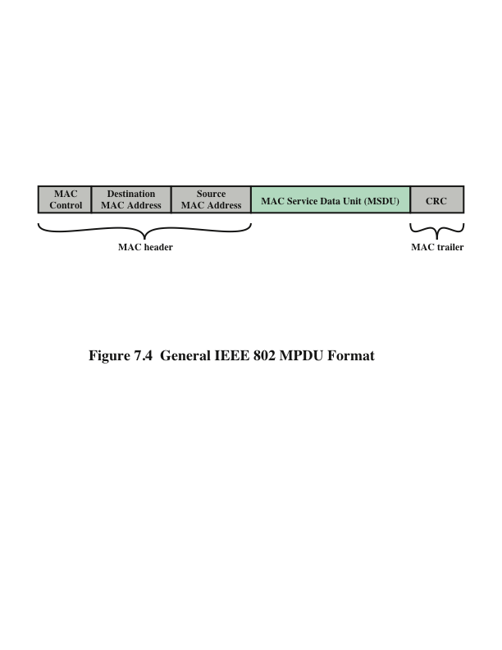
Notes:
The exact format of the MPDU differs somewhat for the various MAC protocols
in use. In general, all of the MPDUs have a format similar to that of Figure 7.4.
The fields of this frame are as follows.
• MAC Control: This field contains any protocol control information needed
for the functioning of the MAC protocol. For example, a priority level could
be indicated here.
• Destination MAC Address: The destination physical address on the LAN for
this MPDU.
• Source MAC Address: The source physical address on the LAN for this
MPDU.
• MAC Service Data Unit: The data from the next higher layer.
• CRC: The cyclic redundancy check field; also known as the Frame Check
Sequence (FCS) field. This is an error-detecting code, such as that which is
used in other data-link control protocols. The CRC is calculated based on the
bits in the entire MPDU. The sender calculates the CRC and adds it to the
frame. The receiver performs the same calculation on the incoming MPDU
and compares that calculation to the CRC field in that incoming MPDU. If the
two values don’t match, then one or more bits have been altered in transit.
The fields preceding the MSDU field are referred to as the MAC header, and
the field following the MSDU field is referred to as the MAC trailer. The header
and trailer contain control information that accompany the data field and that are
used by the MAC protocol.

Slide 19
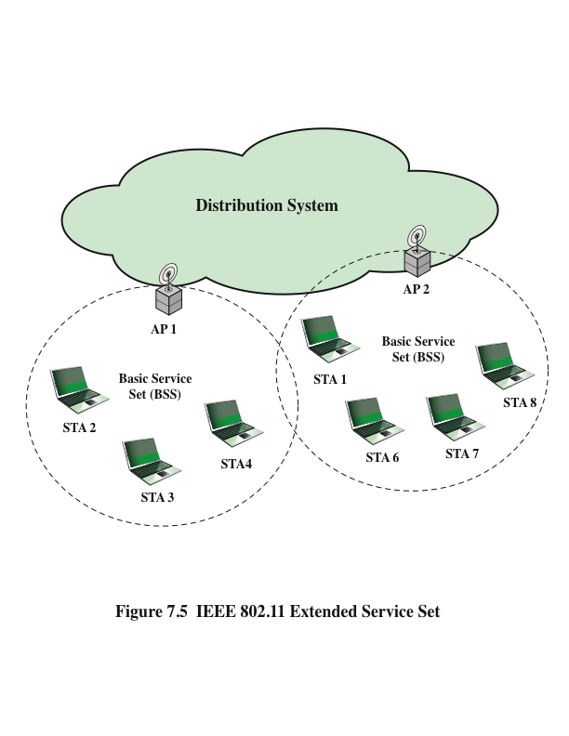
Notes:
Figure 7.5 illustrates the model developed by the 802.11 working group. The smallest
building block of a wireless LAN is a basic service set (BSS) , which consists of
wireless stations executing the same MAC protocol and competing for access to the
same shared wireless medium. A BSS may be isolated, or it may connect to a backbone
distribution system (DS) through an access point (AP) . The AP functions as a
bridge and a relay point. In a BSS, client stations do not communicate directly with
one another. Rather, if one station in the BSS wants to communicate with another
station in the same BSS, the MAC frame is first sent from the originating station to
the AP and then from the AP to the destination station. Similarly, a MAC frame
from a station in the BSS to a remote station is sent from the local station to the AP
and then relayed by the AP over the DS on its way to the destination station. The
BSS generally corresponds to what is referred to as a cell in the literature. The DS
can be a switch, a wired network, or a wireless network.
When all the stations in the BSS are mobile stations that communicate directly
with one another (not using an AP), the BSS is called an independent BSS (IBSS) .
An IBSS is typically an ad hoc network. In an IBSS, the stations all communicate
directly, and no AP is involved.
A simple configuration is shown in Figure 7.5, in which each station belongs
to a single BSS; that is, each station is within wireless range only of other stations
within the same BSS. It is also possible for two BSSs to overlap geographically, so
that a single station could participate in more than one BSS. Furthermore, the association
between a station and a BSS is dynamic. Stations may turn off, come within
range, and go out of range.
An extended service set (ESS) consists of two or more basic service sets interconnected
by a distribution system. The extended service set appears as a single
logical LAN to the logical link control (LLC) level.

Slide 20
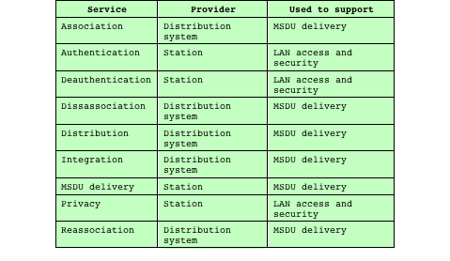
Table 7.2
IEEE 802.11 Services
Notes:
IEEE 802.11 defines nine services that need to be provided by the wireless LAN to
achieve functionality equivalent to that which is inherent to wired LANs. Table 7.2
lists the services and indicates two ways of categorizing them.
1. The service provider can be either the station or the DS. Station services are
implemented in every 802.11 station, including AP stations. Distribution
services are provided between BSSs; these services may be implemented
in an AP or in another special-purpose device attached to the distribution
system.
2. Three of the services are used to control IEEE 802.11 LAN access and confidentiality.
Six of the services are used to support delivery of MSDUs between
stations. If the MSDU is too large to be transmitted in a single MPDU, it may
be fragmented and transmitted in a series of MPDUs.
Following the IEEE 802.11 document, we next discuss the services in an order
designed to clarify the operation of an IEEE 802.11 ESS network. MSDU delivery,
which is the basic service, already has been mentioned. Services related to security
are introduced in Section 7.4.

Slide 21
Distribution of Messages Within a DS
The two services involved with the distribution of messages within a DS are:
Distribution
The primary service used by stations to exchange MPDUs when the MPDUs must traverse the DS to get from a station in one BSS to a station in another BSS
Integration
Enables transfer of data between a station on an IEEE 802.11 LAN and a station on an integrated IEEE 802.x LAN
Takes care of any address translation and media conversion logic required for the exchange of data
Notes:
The two services involved with the distribution
of messages within a DS are distribution and integration. Distribution is
the primary service used by stations to exchange MPDUs when the MPDUs must
traverse the DS to get from a station in one BSS to a station in another BSS. For
example, suppose a frame is to be sent from station 2 (STA 2) to station 7 (STA 7)
in Figure 7.5. The frame is sent from STA 2 to AP 1, which is the AP for this BSS.
The AP gives the frame to the DS, which has the job of directing the frame to the
AP associated with STA 7 in the target BSS. AP 2 receives the frame and forwards
it to STA 7. How the message is transported through the DS is beyond the scope of
the IEEE 802.11 standard.
If the two stations that are communicating are within the same BSS, then the
distribution service logically goes through the single AP of that BSS.
The integration service enables transfer of data between a station on an IEEE
802.11 LAN and a station on an integrated IEEE 802.x LAN. The term integrated
refers to a wired LAN that is physically connected to the DS and whose stations
may be logically connected to an IEEE 802.11 LAN via the integration service. The
integration service takes care of any address translation and media conversion logic
required for the exchange of data.

Slide 22
Association-Related Services
Transition types based on mobility:
No transition
A station of this type is either stationary or moves only within the direct communication range of the communicating stations of a single BSS
BSS transition
This is defined as a station movement from one BSS to another BSS within the same ESS
In this case, delivery of data to the station requires that the addressing capability be able to recognize the new location of the station
ESS transition
This is defined as a station movement from a BSS in one ESS to a BSS within another ESS
Maintenance of upper-layer connections supported by 802.11 cannot be guaranteed
Disruption of service is likely to occur
Notes:
The primary purpose of the MAC layer is to transfer
MSDUs between MAC entities; this purpose is fulfilled by the distribution service.
For that service to function, it requires information about stations within the ESS
that is provided by the association-related services. Before the distribution service
can deliver data to or accept data from a station, that station must be associated .
Before looking at the concept of association, we need to describe the concept of
mobility. The standard defines three transition types, based on mobility:
• No transition: A station of this type is either stationary or moves only
within the direct communication range of the communicating stations of a
single BSS.
• BSS transition: This is defined as a station movement from one BSS to another
BSS within the same ESS. In this case, delivery of data to the station
requires that the addressing capability be able to recognize the new location of
the station.
• ESS transition: This is defined as a station movement from a BSS in one ESS
to a BSS within another ESS. This case is supported only in the sense that
the station can move. Maintenance of upper-layer connections supported by
802.11 cannot be guaranteed. In fact, disruption of service is likely to occur.

Slide 23
Association-Related Services
To deliver a message within a DS, the distribution service needs to know the identity of the AP to which the message should be delivered in order for that message to reach the destination station
Three services relate to a station maintaining an association with the AP within its current BSS:
Association
Establishes an initial association between a station and an AP
Reassociation
Enables an established association to be transferred from one AP to another, allowing a mobile station to move from one BSS to another
Disassociation
A notification from either a station or an AP that an existing association is terminated
Notes:
To deliver a message within a DS, the distribution service needs to know
where the destination station is located. Specifically, the DS needs to know the
identity of the AP to which the message should be delivered in order for that message
to reach the destination station. To meet this requirement, a station must
maintain an association with the AP within its current BSS. Three services relate
to this requirement:
• Association: Establishes an initial association between a station and an AP.
Before a station can transmit or receive frames on a wireless LAN, its identity
and address must be known. For this purpose, a station must establish an association
with an AP within a particular BSS. The AP can then communicate
this information to other APs within the ESS to facilitate routing and delivery
of addressed frames.
• Reassociation: Enables an established association to be transferred from one
AP to another, allowing a mobile station to move from one BSS to another.
• Disassociation: A notification from either a station or an AP that an existing
association is terminated. A station should give this notification before leaving
an ESS or shutting down. However, the MAC management facility protects
itself against stations that disappear without notification.

Slide 24
IEEE 802.11I Wireless LAN Security
There is an increased need for robust security services and mechanisms for wireless LANs
Wired Equivalent Privacy (WEP)
The privacy portion of the 802.11 standard
Contained major weaknesses
Wi-Fi Protected Access (WPA)
A set of security mechanisms that eliminates most 802.11 security issues
Based on the current state of the 802.11i standard
Robust Security Network (RSN)
Final form of the 802.11i standard
Complex
Notes:
There are two characteristics of a wired LAN that are not inherent in a wireless
LAN.
1. In order to transmit over a wired LAN, a station must be physically connected
to the LAN. On the other hand, with a wireless LAN, any station within radio
range of the other devices on the LAN can transmit. In a sense, there is a form
of authentication with a wired LAN in that it requires some positive and presumably
observable action to connect a station to a wired LAN.
2. Similarly, in order to receive a transmission from a station that is part of a
wired LAN, the receiving station also must be attached to the wired LAN.
On the other hand, with a wireless LAN, any station within radio range can
receive. Thus, a wired LAN provides a degree of privacy, limiting reception of
data to stations connected to the LAN.
These differences between wired and wireless LANs suggest the increased
need for robust security services and mechanisms for wireless LANs. The original
802.11 specification included a set of security features for privacy and authentication
that were quite weak. For privacy, 802.11 defined the Wired Equivalent
Privacy (WEP) algorithm. The privacy portion of the 802.11 standard contained
major weaknesses. Subsequent to the development of WEP, the 802.11i task
group has developed a set of capabilities to address the WLAN security issues.
In order to accelerate the introduction of strong security into WLANs, the Wi-Fi
Alliance promulgated Wi-Fi Protected Access (WPA) as a Wi-Fi standard. WPA
is a set of security mechanisms that eliminates most 802.11 security issues and
was based on the current state of the 802.11i standard. The final form of the
802.11i standard is referred to as Robust Security Network (RSN) . The Wi-Fi
Alliance certifies vendors in compliance with the full 802.11i specification under
the WPA2 program.
The RSN specification is quite complex, and occupies 145 pages of the 2012
IEEE 802.11 standard. In this section, we provide an overview.

Slide 25
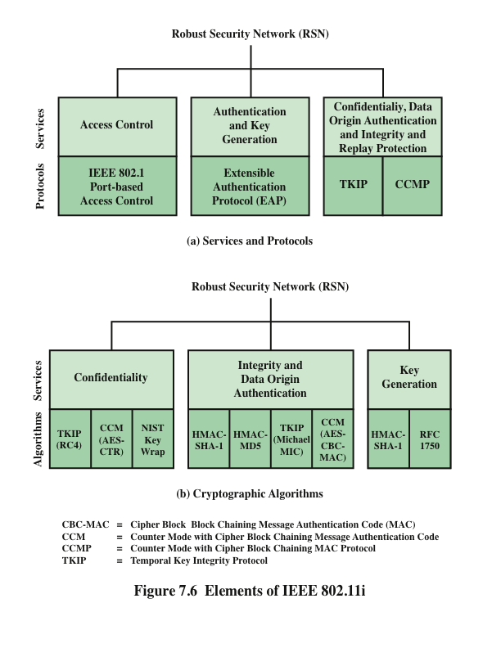
Notes:
The 802.11i RSN security specification defines the following services.
• Authentication: A protocol is used to define an exchange between a user and
an AS that provides mutual authentication and generates temporary keys to
be used between the client and the AP over the wireless link.
• Access control: This function enforces the use of the authentication function,
routes the messages properly, and facilitates key exchange. It can work with a
variety of authentication protocols.
• Privacy with message integrity: MAC-level data (e.g., an LLC PDU) are encrypted
along with a message integrity code that ensures that the data have
not been altered.
Figure 7.6a indicates the security protocols used to support these services,
while Figure 7.6b lists the cryptographic algorithms used for these services.

Slide 26
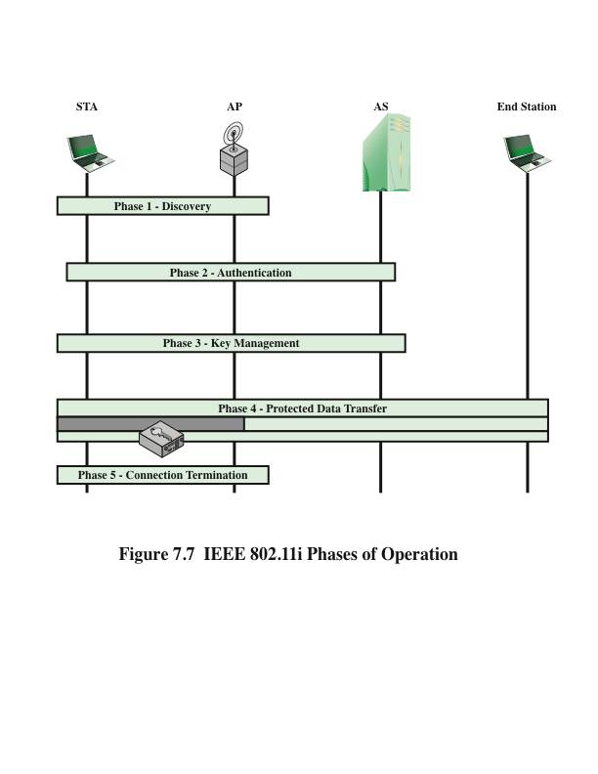
Notes:
The operation of an IEEE 802.11i RSN can be broken down into five distinct phases
of operation. The exact nature of the phases will depend on the configuration and
the end points of the communication. Possibilities include (see Figure 7.5):
1. Two wireless stations in the same BSS communicating via the access point
(AP) for that BSS.
2. Two wireless stations (STAs) in the same ad hoc IBSS communicating directly
with each other.
3. Two wireless stations in different BSSs communicating via their respective
APs across a distribution system.
4. A wireless station communicating with an end station on a wired network via
its AP and the distribution system.
IEEE 802.11i security is concerned only with secure communication between
the STA and its AP. In case 1 in the preceding list, secure communication is assured
if each STA establishes secure communications with the AP. Case 2 is similar, with
the AP functionality residing in the STA. For case 3, security is not provided across
the distribution system at the level of IEEE 802.11, but only within each BSS. Endto-
end security (if required) must be provided at a higher layer. Similarly, in case 4,
security is only provided between the STA and its AP.
With these considerations in mind, Figure 7.7 depicts the five phases of operation
for an RSN and maps them to the network components involved. One new
component is the authentication server (AS). The rectangles indicate the exchange
of sequences of MPDUs. The five phases are defined as follows.
• Discovery: An AP uses messages called Beacons and Probe Responses to advertise
its IEEE 802.11i security policy. The STA uses these to identify an AP
for a WLAN with which it wishes to communicate. The STA associates with
the AP, which it uses to select the cipher suite and authentication mechanism
when the Beacons and Probe Responses present a choice.
• Authentication: During this phase, the STA and AS prove their identities to
each other. The AP blocks non-authentication traffic between the STA and
AS until the authentication transaction is successful. The AP does not participate
in the authentication transaction other than forwarding traffic between
the STA and AS.
• Key generation and distribution: The AP and the STA perform several operations
that cause cryptographic keys to be generated and placed on the AP and
the STA. Frames are exchanged between the AP and STA only.
• Protected data transfer: Frames are exchanged between the STA and the end
station through the AP. As denoted by the shading and the encryption module
icon, secure data transfer occurs between the STA and the AP only; security is
not provided end-to-end.
• Connection termination: The AP and STA exchange frames. During this
phase, the secure connection is torn down and the connection is restored to
the original state.

Slide 27
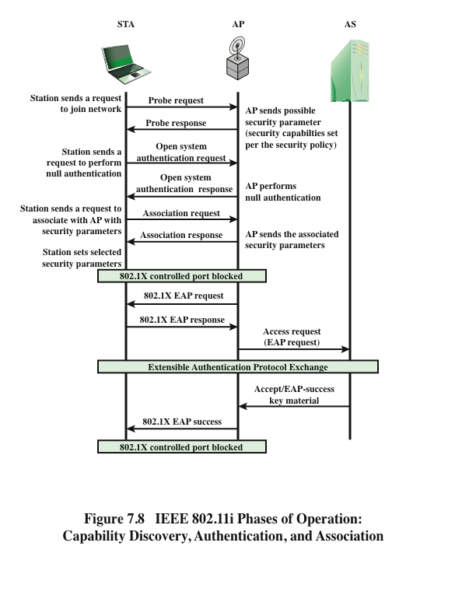
Notes:
We now look in more detail at the RSN phases of operation, beginning with the
discovery phase, which is illustrated in the upper portion of Figure 7.8. The purpose
of this phase is for an STA and an AP to recognize each other, agree on a set
of security capabilities, and establish an association for future communication using
those security capabilities.
Security Capabilities
During this phase, the STA and AP decide on specific techniques
in the following areas:
• Confidentiality and MPDU integrity protocols for protecting unicast traffic
(traffic only between this STA and AP)
• Authentication method
• Cryptography key management approach
Confidentiality and integrity protocols for protecting multicast/broadcast traffic
are dictated by the AP, since all STAs in a multicast group must use the same
protocols and ciphers. The specification of a protocol, along with the chosen key
length (if variable) is known as a cipher suite . The options for the confidentiality and
integrity cipher suite are
• WEP, with either a 40-bit or 104-bit key, which allows backward compatibility
with older IEEE 802.11 implementations
• TKIP
• CCMP
• Vendor-specific methods
The other negotiable suite is the authentication and key management (AKM)
suite, which defines (1) the means by which the AP and STA perform mutual authentication
and (2) the means for deriving a root key from which other keys may
be generated. The possible AKM suites are
• IEEE 802.1X
• Pre-shared key (no explicit authentication takes place and mutual authentication
is implied if the STA and AP share a unique secret key)
• Vendor-specific methods
The discovery phase consists of three exchanges.
• Network and security capability discovery: During this exchange, STAs discover
the existence of a network with which to communicate. The AP either
periodically broadcasts its security capabilities (not shown in figure), indicated
by RSN IE (Robust Security Network Information Element), in a specific
channel through the Beacon frame; or responds to a station’s Probe Request
through a Probe Response frame. A wireless station may discover available
access points and corresponding security capabilities by either passively monitoring
the Beacon frames or actively probing every channel.
• Open system authentication: The purpose of this frame sequence, which
provides no security, is simply to maintain backward compatibility with the
IEEE 802.11 state machine, as implemented in existing IEEE 802.11 hardware.
In essence, the two devices (STA and AP) simply exchange identifiers.
• Association: The purpose of this stage is to agree on a set of security capabilities
to be used. The STA then sends an Association Request frame to the AP.
In this frame, the STA specifies one set of matching capabilities (one
authentication and key management suite, one pairwise cipher suite, and one
group-key cipher suite) from among those advertised by the AP. If there
is no match in capabilities between the AP and the STA, the AP refuses
the Association Request. The STA blocks it too, in case it has associated
with a rogue AP or someone is inserting frames illicitly on its channel. As
shown in Figure 7.8, the IEEE 802.1X controlled ports are blocked, and no
user traffic goes beyond the AP. The concept of blocked ports is explained
subsequently.
As was mentioned, the authentication phase enables mutual authentication between
an STA and an authentication server (AS) located in the DS. Authentication
is designed to allow only authorized stations to use the network and to provide the
STA with assurance that it is communicating with a legitimate network.

Slide 28
IEEE 802.1X Access Control Approach
802.1X uses:
Controlled ports
Allows the exchange of PDUs between a supplicant and other systems on the LAN only if the current state of the supplicant authorizes such an exchange
Uncontrolled ports
Allows the exchange of PDUs between the supplicant and the other AS, regardless of the authentication state of the supplicant
Port-Based Network Access Control
The authentication protocol that is used, the Extensible Authentication Protocol (EAP), is defined in the IEEE 802.1X standard
Notes:
IEEE 802.11i makes use of another standard
that was designed to provide access control functions for LANs. The standard
is IEEE 802.1X, Port-Based Network Access Control. The authentication protocol
that is used, the Extensible Authentication Protocol (EAP), is defined in the
IEEE 802.1X standard. IEEE 802.1X uses the terms supplicant , authenticator , and
authentication server (AS). In the context of an 802.11 WLAN, the first two terms
correspond to the wireless station and the AP. The AS is typically a separate device
on the wired side of the network (i.e., accessible over the DS) but could also reside
directly on the authenticator.
Before a supplicant is authenticated by the AS using an authentication protocol,
the authenticator only passes control or authentication messages between the
supplicant and the AS; the 802.1X control channel is unblocked, but the 802.11 data
channel is blocked. Once a supplicant is authenticated and keys are provided, the
authenticator can forward data from the supplicant, subject to predefined access
control limitations for the supplicant to the network. Under these circumstances,
the data channel is unblocked.
As indicated in Figure 5.5, 802.1X uses the concepts of controlled and uncontrolled
ports. Ports are logical entities defined within the authenticator and refer to
physical network connections. For a WLAN, the authenticator (the AP) may have
only two physical ports: one connecting to the DS and one for wireless communication
within its BSS. Each logical port is mapped to one of these two physical ports.
An uncontrolled port allows the exchange of PDUs between the supplicant and the
other AS, regardless of the authentication state of the supplicant. A controlled port
allows the exchange of PDUs between a supplicant and other systems on the LAN
only if the current state of the supplicant authorizes such an exchange. IEEE 802.1X
is covered in more detail in Chapter 5.
The 802.1X framework, with an upper-layer authentication protocol, fits
nicely with a BSS architecture that includes a number of wireless stations and an AP.
However, for an IBSS, there is no AP. For an IBSS, 802.11i provides a more
complex solution that, in essence, involves pairwise authentication between stations
on the IBSS.

Slide 29
Notes:
The lower part of Figure 7.8 shows the MPDU exchange dictated
by IEEE 802.11 for the authentication phase. We can think of authentication
phase as consisting of the following three phases.
• Connect to AS: The STA sends a request to its AP (the one with which it has
an association) for connection to the AS. The AP acknowledges this request
and sends an access request to the AS.
• EAP exchange: This exchange authenticates the STA and AS to each other. A
number of alternative exchanges are possible, as explained subsequently.
• Secure key delivery: Once authentication is established, the AS generates
a master session key (MSK), also known as the Authentication,
Authorization, and Accounting (AAA) key and sends it to the STA. As
explained subsequently, all the cryptographic keys needed by the STA
for secure communication with its AP are generated from this MSK.
IEEE 802.11i does not prescribe a method for secure delivery of the MSK
but relies on EAP for this. Whatever method is used, it involves the transmission
of an MPDU containing an encrypted MSK from the AS, via
the AP, to the AS.
As mentioned, there are a number of possible EAP exchanges that
can be used during the authentication phase. Typically, the message flow between
STA and AP employs the EAP over LAN (EAPOL) protocol, and the message
flow between the AP and AS uses the Remote Authentication Dial In User Service
(RADIUS) protocol, although other options are available for both STA-to-AP and
AP-to-AS exchanges. [FRAN07] provides the following summary of the authentication
exchange using EAPOL and RADIUS.
1. The EAP exchange begins with the AP issuing an EAP-Request/Identity
frame to the STA.
2. The STA replies with an EAP-Response/Identity frame, which the AP receives
over the uncontrolled port. The packet is then encapsulated in RADIUS over
EAP and passed on to the RADIUS server as a RADIUS-Access-Request
packet.
3. The AAA server replies with a RADIUS-Access-Challenge packet, which is
passed on to the STA as an EAP-Request. This request is of the appropriate
authentication type and contains relevant challenge information.
4. The STA formulates an EAP-Response message and sends it to the AS. The
response is translated by the AP into a Radius-Access-Request with the response
to the challenge as a data field. Steps 3 and 4 may be repeated multiple
times, depending on the EAP method in use. For TLS tunneling methods, it is
common for authentication to require 10 to 20 round trips.
5. The AAA server grants access with a Radius-Access-Accept packet. The AP
issues an EAP-Success frame. (Some protocols require confirmation of the
EAP success inside the TLS tunnel for authenticity validation.) The controlled
port is authorized, and the user may begin to access the network.
Note from Figure 7.8 that the AP controlled port is still blocked to general
user traffic. Although the authentication is successful, the ports remain blocked
until the temporal keys are installed in the STA and AP, which occurs during the
4-Way Handshake.

Slide 30
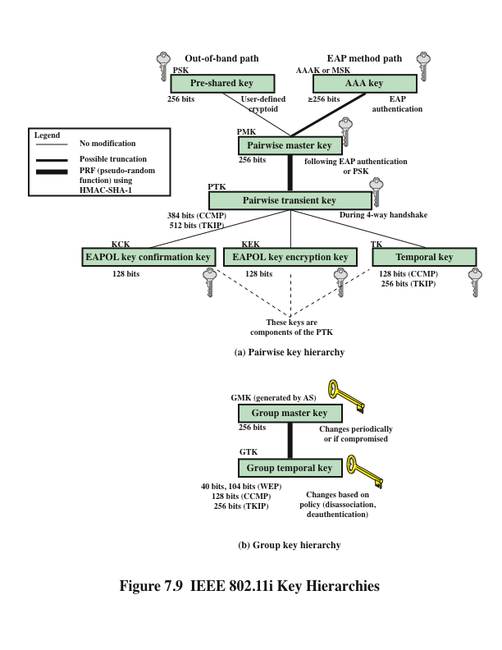
Notes:
During the key management phase, a variety of cryptographic keys are generated
and distributed to STAs. There are two types of keys: pairwise keys used for communication
between an STA and an AP and group keys used for multicast communication.
Figure 7.9, based on [FRAN07], shows the two key hierarchies.

Slide 31
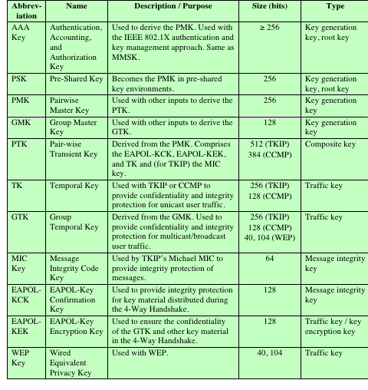
Table 7.3
IEEE 802.11i
Keys for Data Confidentiality
and
Integrity Protocols
Notes:
Table 7.3 defines the individual keys.

Slide 32
Pairwise Keys
Used for communication between a pair of devices, typically between a STA and an AP
These keys form a hierarchy beginning with a master key from which other keys are derived dynamically and used for a limited period of time
Pre-shared key (PSK)
A secret key shared by the AP and a STA and installed in some fashion outside the scope of IEEE 802.11i
Master session key (MSK)
Also known as the AAAK, and is generated using the IEEE 802.1X protocol during the authentication phase
Pairwise master key (PMK)
Derived from the master key
If a PSK is used, then the PSK is used as the PMK; if a MSK is used, then the PMK is derived from the MSK by truncation
Pairwise transient key (PTK)
Consists of three keys to be used for communication between a STA and AP after they have been mutually authenticated
Using the STA and AP addresses in the generation of the PTK provides protection against session hijacking and impersonation; using nonces provides additional random keying material
Notes:
Pairwise keys are used for communication between a pair of devices,
typically between an STA and an AP. These keys form a hierarchy beginning
with a master key from which other keys are derived dynamically and used for a
limited period of time.
At the top level of the hierarchy are two possibilities. A pre-shared key (PSK)
is a secret key shared by the AP and a STA and installed in some fashion outside
the scope of IEEE 802.11i. The other alternative is the master session key (MSK) ,
also known as the AAAK, which is generated using the IEEE 802.1X protocol during
the authentication phase, as described previously. The actual method of key
generation depends on the details of the authentication protocol used. In either case
(PSK or MSK), there is a unique key shared by the AP with each STA with which
it communicates. All the other keys derived from this master key are also unique
between an AP and an STA. Thus, each STA, at any time, has one set of keys, as
depicted in the hierarchy of Figure 7.9a, while the AP has one set of such keys for
each of its STAs.
The pairwise master key (PMK) is derived from the master key. If a PSK is
used, then the PSK is used as the PMK; if a MSK is used, then the PMK is derived
from the MSK by truncation (if necessary). By the end of the authentication phase,
marked by the 802.1X EAP Success message (Figure 7.8), both the AP and the
STA have a copy of their shared PMK.
The PMK is used to generate the pairwise transient key (PTK) , which in fact
consists of three keys to be used for communication between an STA and AP after
they have been mutually authenticated. To derive the PTK, the HMAC-SHA-1
function is applied to the PMK, the MAC addresses of the STA and AP, and nonces
generated when needed. Using the STA and AP addresses in the generation of the
PTK provides protection against session hijacking and impersonation; using nonces
provides additional random keying material.

Slide 33
PTK Parts
The three parts of the PTK are:
EAP Over LAN (EAPOL) Key Confirmation Key (EAPOL-KCK)
Supports the integrity and data origin authenticity of STA-to-AP control frames during operational setup of an RSN
It also performs an access control function: proof-of-possession of the PMK
An entity that possesses the PMK is authorized to use the link
EAPOL Key Encryption Key (EAPOL-KEK)
Protects the confidentiality of keys and other data during some RSN association procedures
Temporal Key (TK)
Provides the actual protection for user traffic
Notes:
The three parts of the PTK are as follows.
EAP Over LAN (EAPOL) Key Confirmation Key (EAPOL-KCK): Supports
the integrity and data origin authenticity of STA-to-AP control frames during
operational setup of an RSN. It also performs an access control function:
proof-of-possession of the PMK. An entity that possesses the PMK is authorized
to use the link.
• EAPOL Key Encryption Key (EAPOL-KEK): Protects the confidentiality of
keys and other data during some RSN association procedures.
• Temporal Key (TK): Provides the actual protection for user traffic.

Slide 34
Group Keys
Group keys are used for multicast communication in which one STA sends MPDUs to multiple STAs
Group master key (GMK)
Key-generating key used with other inputs to derive the GTK
Group temporal key (GTK)
Generated by the AP and transmitted to its associated STAs
IEEE 802.11i requires that its value is computationally indistinguishable from random
Distributed securely using the pairwise keys that are already established
Is changed every time a device leaves the network
Notes:
Group keys are used for multicast communication in which one STA
sends MPDUs to multiple STAs. At the top level of the group key hierarchy is the
group master key (GMK) . The GMK is a key-generating key used with other inputs
to derive the group temporal key (GTK) . Unlike the PTK, which is generated using
material from both AP and STA, the GTK is generated by the AP and transmitted
to its associated STAs. Exactly how this GTK is generated is undefined. IEEE
802.11i, however, requires that its value is computationally indistinguishable from
random. The GTK is distributed securely using the pairwise keys that are already
established. The GTK is changed every time a device leaves the network.

Slide 35
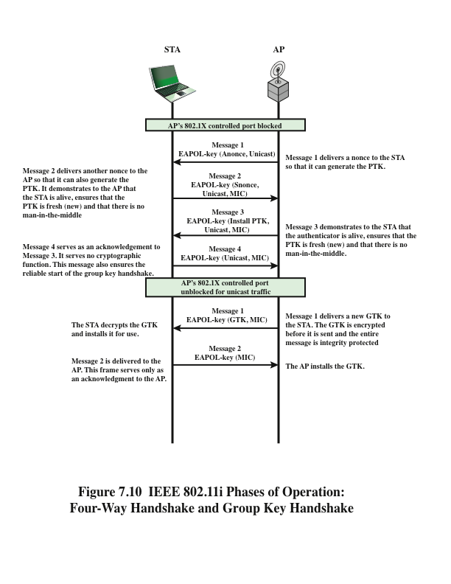
Notes:
The upper part of Figure 7.10 shows the MPDU
exchange
for distributing pairwise keys. This exchange is known as the 4-way handshake .
The STA and AP use this handshake to confirm the existence of the PMK,
verify the selection of the cipher suite, and derive a fresh PTK for the following data
session.

Slide 36
Protected Data Transfer Phase
IEEE 802.11i defines two schemes for protecting data transmitted in 802.11 MPDUs:
Temporal Key Integrity Protocol (TKIP)
Designed to require only software changes to devices that are implemented with WEP
Counter Mode-CBC MAC Protocol (CCMP)
Intended for newer IEEE 802.11 devices that are equipped with the hardware to support this scheme
Provides two services:
Message integrity
Data confidentiality
Notes:
IEEE 802.11i defines two schemes for protecting data transmitted in 802.11 MPDUs:
the Temporal Key Integrity Protocol (TKIP), and the Counter Mode-CBC MAC
Protocol (CCMP).
TKIP is designed to require only software changes to devices that are implemented
with the older wireless LAN security approach called Wired Equivalent
Privacy (WEP). TKIP provides two services:
• Message integrity: TKIP adds a message integrity code (MIC) to the 802.11
MAC frame after the data field. The MIC is generated by an algorithm, called
Michael, that computes a 64-bit value using as input the source and destination
MAC address values and the Data field, plus key material.
• Data confidentiality: Data confidentiality is provided by encrypting the
MPDU plus MIC value using RC4.
The 256-bit TK (Figure 7.9) is employed as follows. Two 64-bit keys are used
with the Michael message digest algorithm to produce a message integrity code.
One key is used to protect STA-to-AP messages, and the other key is used to protect
AP-to-STA messages. The remaining 128 bits are truncated to generate the
RC4 key used to encrypt the transmitted data.
For additional protection, a monotonically increasing TKIP sequence counter
(TSC) is assigned to each frame. The TSC serves two purposes. First, the TSC is
included with each MPDU and is protected by the MIC to protect against replay
attacks. Second, the TSC is combined with the session TK to produce a dynamic encryption
key that changes with each transmitted MPDU, thus making cryptanalysis
more difficult.
CCMP is intended for newer IEEE 802.11 devices that are equipped with
the hardware to support this scheme. As with TKIP, CCMP provides two services:
• Message integrity: CCMP uses the cipher block chaining message authentication
code (CBC-MAC), described in Chapter 3.
• Data confidentiality: CCMP uses the CTR block cipher mode of operation
with AES for encryption. CTR is described in Chapter 2.
The same 128-bit AES key is used for both integrity and confidentiality.
The scheme uses a 48-bit packet number to construct a nonce to prevent replay
attacks.

Slide 37
IEEE 802.11i Pseudorandom Function (PRF)
Used at a number of places in the IEEE 802.11i scheme (to generate nonces, to expand pairwise keys, to generate the GTK)
Best security practice dictates that different pseudorandom number streams be used for these different purposes
Built on the use of HMAC-SHA-1 to generate a pseudorandom bit stream
Notes:
At a number of places in the IEEE 802.11i scheme, a pseudorandom function (PRF)
is used. For example, it is used to generate nonces, to expand pairwise keys, and
to generate the GTK. Best security practice dictates that different pseudorandom
number streams be used for these different purposes. However, for implementation
efficiency, we would like to rely on a single pseudorandom number generator
function.
The PRF is built on the use of HMAC-SHA-1 to generate a pseudorandom
bit stream. Recall that HMAC-SHA-1 takes a message (block of data) and a key of
length at least 160 bits and produces a 160-bit hash value. SHA-1 has the property
that the change of a single bit of the input produces a new hash value with no apparent
connection to the preceding hash value. This property is the basis for pseudorandom
number generation.

Slide 38
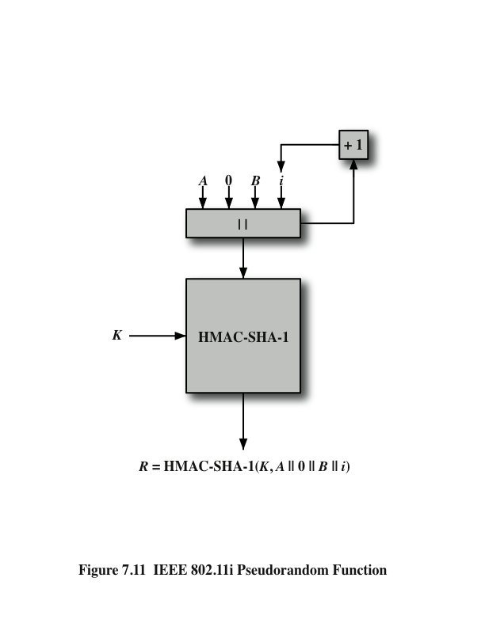
Notes:
Figure 7.11 illustrates the function PRF(K , A , B , Len ).

Slide 39
Summary
IEEE 802.11i wireless LAN security
IEEE 802.11i services
IEEE 802.11i phases of operation
Discovery phase
Authentication phase
Key management phase
Protected data transfer phase
The IEEE 802.11i pseudorandom function
Wireless network security
Network threats
Security measures
Mobile device security
Security threats
Security strategy
IEEE 802.11 wireless LAN overview
Wi-Fi Alliance
IEEE 802 protocol architecture
IEEE 802.11 network components and architectural model
IEEE 802.11 services
Notes:
Chapter 7 summary.

Slide 40
Network Security Essentials
Fifth Edition
by William Stallings
Notes:
Lecture slides prepared for “Network Security Essentials”, 5/e, by William Stallings, Chapter 8 – “Electronic Mail Security”.

Slide 41
Chapter 8
Electronic Mail Security
Notes:
In virtually all distributed environments, electronic mail is the most heavily used
network-based application. Users expect to be able to, and do, send e-mail to others
who are connected directly or indirectly to the Internet, regardless of host operating
system or communications suite. With the explosively growing reliance on e-mail,
there grows a demand for authentication and confidentiality services. Two schemes
stand out as approaches that enjoy widespread use: Pretty Good Privacy (PGP) and
S/MIME. Both are examined in this chapter. The chapter closes with a discussion of
DomainKeys Identified Mail.

Slide 42
“Despite the refusal of VADM Poindexter and LtCol North to appear, the Board's access to other sources of information filled much of this gap. The FBI provided documents taken from the files of the National Security Advisor and relevant NSC staff members, including messages from the PROF system between VADM Poindexter and LtCol North. The PROF messages were conversations by computer, written at the time events occurred and presumed by the writers to be protected from disclosure. In this sense, they provide a first-hand, contemporaneous account of events.”
—The Tower Commission Report to President Reagan on the Iran-Contra Affair, 1987
Notes:
Opening quote.

Slide 43
Pretty Good Privacy (PGP)
Provides a confidentiality and authentication service that can be used for electronic mail and file storage applications
Developed by Phil Zimmermann
Selected the best available cryptographic algorithms as building blocks
Integrated these algorithms into a general-purpose application that is independent of operating system and processor and that is based on a small set of easy-to-use commands
Made the package and its documentation, including the source code, freely available via the Internet, bulletin boards, and commercial networks
Entered into an agreement with a company to provide a fully compatible, low-cost commercial version of PGP
Notes:
PGP is a remarkable phenomenon. Largely the effort of a single person, Phil
Zimmermann, PGP provides a confidentiality and authentication service that can
be used for electronic mail and file storage applications. In essence, Zimmermann
has done the following:
1. Selected the best available cryptographic algorithms as building blocks.
2. Integrated these algorithms into a general-purpose application that is independent
of operating system and processor and that is based on a small set of
easy-to-use commands.
3. Made the package and its documentation, including the source code, freely
available via the Internet, bulletin boards, and commercial networks such as
AOL (America On Line).
4. Entered into an agreement with a company (Viacrypt, now Network
Associates) to provide a fully compatible, low-cost commercial version of PGP.

Slide 44
PGP Growth
It is available free worldwide in versions that run on a variety of platforms
The commercial version satisfies users who want a product that comes with vendor support
It is based on algorithms that have survived extensive public review and are considered extremely secure
It has a wide range of applicability
It was not developed by, nor is it controlled by, any governmental or standards organization
Is now on an Internet standards track, however it still has an aura of an antiestablishment endeavor
Notes:
PGP has grown explosively and is now widely used. A number of reasons can
be cited for this growth.
1. It is available free worldwide in versions that run on a variety of platforms, including
Windows, UNIX, Macintosh, and many more. In addition, the commercial
version satisfies users who want a product that comes with vendor support.
2. It is based on algorithms that have survived extensive public review and are
considered extremely secure. Specifically, the package includes RSA, DSS, and
Diffie-Hellman for public-key encryption; CAST-128, IDEA, and 3DES for
symmetric encryption; and SHA-1 for hash coding.
3. It has a wide range of applicability, from corporations that wish to select and
enforce a standardized scheme for encrypting files and messages to individuals
who wish to communicate securely with others worldwide over the Internet
and other networks.
4. It was not developed by, nor is it controlled by, any governmental or standards
organization. For those with an instinctive distrust of “the establishment,” this
makes PGP attractive.
5. PGP is now on an Internet standards track (RFC 3156; MIME Security with
OpenPGP ). Nevertheless, PGP still has an aura of an antiestablishment
endeavor.

Slide 45
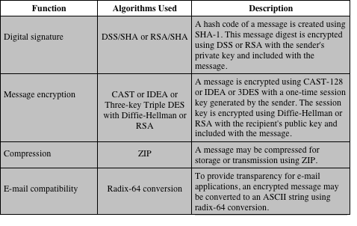
Table 8.1
Summary of PGP Services
Notes:
The actual operation of PGP, as opposed to the management of keys, consists of
four services: authentication, confidentiality, compression, and e-mail compatibility
(Table 8.1).

Slide 46
PGP Authentication
Combination of SHA-1 and RSA provides an effective digital signature scheme
Because of the strength of RSA the recipient is assured that only the possessor of the matching private key can generate the signature
Because of the strength of SHA-1 the recipient is assured that no one else could generate a new message that matches the hash code
As an alternative, signatures can be generated using DSS/SHA-1
Detached signatures are supported
Each person’s signature is independent and therefore applied only to the document
Notes:
The combination of SHA-1 and RSA provides an effective digital signature
scheme. Because of the strength of RSA, the recipient is assured that only the possessor
of the matching private key can generate the signature. Because of the strength
of SHA-1, the recipient is assured that no one else could generate a new message
that matches the hash code and, hence, the signature of the original message.
As an alternative, signatures can be generated using DSS/SHA-1.
Although signatures normally are found attached to the message or file that
they sign, this is not always the case: Detached signatures are supported. A detached
signature may be stored and transmitted separately from the message it signs. This
is useful in several contexts. A user may wish to maintain a separate signature log of
all messages sent or received. A detached signature of an executable program can
detect subsequent virus infection. Finally, detached signatures can be used when
more than one party must sign a document, such as a legal contract. Each person’s
signature is independent and therefore is applied only to the document. Otherwise,
signatures would have to be nested, with the second signer signing both the document
and the first signature, and so on.

Slide 47
PGP Confidentiality
Provided by encrypting messages to be transmitted or to be stored locally as files
In both cases the symmetric encryption algorithm CAST-128 may be used
Alternatively IDEA or 3DES may be used
The 64-bit cipher feedback (CFB) mode is used
As an alternative to the use of RSA for key encryption, PGP uses ElGamal, a variant of Diffie-Hellman that provides encryption/decryption
In PGP each symmetric key is used only once
Although referred to as a session key, it is in reality a one-time key
Session key is bound to the message and transmitted with it
To protect the key, it is encrypted with the receiver’s public key
Notes:
Another basic service provided by PGP is confidentiality, which
is provided by encrypting messages to be transmitted or to be stored locally as
files. In both cases, the symmetric encryption algorithm CAST-128 may be used.
Alternatively, IDEA or 3DES may be used. The 64-bit cipher feedback (CFB)
mode is used.
As always, one must address the problem of key distribution. In PGP, each
symmetric key is used only once. That is, a new key is generated as a random 128-bit
number for each message. Thus, although this is referred to in the documentation
as a session key, it is in reality a one-time key. Because it is to be used only once,
the session key is bound to the message and transmitted with it. To protect the key,
it is encrypted with the receiver’s public key. Figure 8.1b illustrates the sequence.
As an alternative to the use of RSA for key encryption, PGP provides an option
referred to as Diffie-Hellman . As was explained in Chapter 3, Diffie-Hellman
is a key exchange algorithm. In fact, PGP uses a variant of Diffie-Hellman that does
provide encryption/decryption, known as ElGamal.
Several observations may be made. First, to reduce encryption time, the combination
of symmetric and public-key encryption is used in preference to simply
using RSA or ElGamal to encrypt the message directly: CAST-128 and the other
symmetric algorithms are substantially faster than RSA or ElGamal. Second, the
use of the public-key algorithm solves the session-key distribution problem, because
only the recipient is able to recover the session key that is bound to the message.
Note that we do not need a session-key exchange protocol of the type discussed in
Chapter 14, because we are not beginning an ongoing session. Rather, each message
is a one-time independent event with its own key. Furthermore, given the store-andforward
nature of electronic mail, the use of handshaking to assure that both sides
have the same session key is not practical. Finally, the use of one-time symmetric
keys strengthens what is already a strong symmetric encryption approach. Only a
small amount of plaintext is encrypted with each key, and there is no relationship
among the keys. Thus, to the extent that the public-key algorithm is secure, the
entire scheme is secure. To this end, PGP provides the user with a range of key size
options from 768 to 3072 bits (the DSS key for signatures is limited to 1024 bits).

Slide 48
PGP Confidentiality and Authentication
Both services may be used for the same message
First a signature is generated for the plaintext message and prepended to the message
Then the plaintext message plus signature is encrypted using CAST-128 (or IDEA or 3DES) and the session key is encrypted using RSA (or ElGamal)
When both services are used:
The sender first signs the message with its own private key
Then encrypts the message with a session key
And finally encrypts the session key with the recipient’s public key
Notes:
As Figure 8.1c illustrates, both services
may be used for the same message. First, a signature is generated for the plaintext
message and prepended to the message. Then the plaintext message plus signature
is encrypted using CAST-128 (or IDEA or 3DES), and the session key is encrypted
using RSA (or ElGamal). This sequence is preferable to the opposite: encrypting
the message and then generating a signature for the encrypted message. It is generally
more convenient to store a signature with a plaintext version of a message.
Furthermore, for purposes of third-party verification, if the signature is performed
first, a third party need not be concerned with the symmetric key when verifying the
signature.
In summary, when both services are used, the sender first signs the message
with its own private key, then encrypts the message with a session key, and finally
encrypts the session key with the recipient’s public key.

Slide 49
PGP Compression
As a default, PGP compresses the message after applying the signature but before encryption
This has the benefit of saving space both for e-mail transmission and for file storage
The placement of the compression algorithm is critical
Applying the hash function and signature after compression would constrain all PGP implementations to the same version of the compression algorithm
Message encryption is applied after compression to strengthen cryptographic security
The compression algorithm used is ZIP
Notes:
As a default, PGP compresses the message after applying the signature
but before encryption. This has the benefit of saving space both for e-mail
transmission and for file storage.
The placement of the compression algorithm is critical.
1. The signature is generated before compression for two reasons:
a. It is preferable to sign an uncompressed message so that one can store only
the uncompressed message together with the signature for future verification.
If one signed a compressed document, then it would be necessary either
to store a compressed version of the message for later verification or to
recompress the message when verification is required.
b. Even if one were willing to generate dynamically a recompressed message
for verification, PGP’s compression algorithm presents a difficulty. The
algorithm is not deterministic; various implementations of the algorithm
achieve different tradeoffs in running speed versus compression ratio and,
as a result, produce different compressed forms. However, these different
compression algorithms are interoperable because any version of the algorithm
can correctly decompress the output of any other version. Applying
the hash function and signature after compression would constrain all PGP
implementations to the same version of the compression algorithm.
2. Message encryption is applied after compression to strengthen cryptographic
security. Because the compressed message has less redundancy than the original
plaintext, cryptanalysis is more difficult.
The compression algorithm used is ZIP, which is described in Appendix G.

Slide 50
PGP E-mail Compatibility
Many electronic mail systems only permit the use of blocks consisting of ASCII text
To accommodate this restriction, PGP provides the service of converting the raw 8-bit binary stream to a stream of printable ASCII characters
The scheme used for this purpose is radix-64 conversion
Each group of three octets of binary data is mapped into four ASCII characters
This format also appends a CRC to detect transmission errors
Notes:
When PGP is used, at least part of the block to be transmitted
is encrypted. If only the signature service is used, then the message digest is
encrypted (with the sender’s private key). If the confidentiality service is used, the
message plus signature (if present) are encrypted (with a one-time symmetric key).
Thus, part or all of the resulting block consists of a stream of arbitrary 8-bit octets.
However, many electronic mail systems only permit the use of blocks consisting of
ASCII text. To accommodate this restriction, PGP provides the service of converting
the raw 8-bit binary stream to a stream of printable ASCII characters.
The scheme used for this purpose is radix-64 conversion. Each group of three
octets of binary data is mapped into four ASCII characters. This format also appends
a CRC to detect transmission errors. See Appendix 19A for a description.
The use of radix 64 expands a message by 33%. Fortunately, the session key
and signature portions of the message are relatively compact, and the plaintext message
has been compressed. In fact, the compression should be more than enough to
compensate for the radix-64 expansion. For example, [HELD96] reports an average
compression ratio of about 2.0 using ZIP. If we ignore the relatively small signature
and key components, the typical overall effect of compression and expansion of a
file of length X would be 1.33 * 0.5 * X = 0.665 * X . Thus, there is still an overall
compression of about one-third.
One noteworthy aspect of the radix-64 algorithm is that it blindly converts the
input stream to radix-64 format regardless of content, even if the input happens to
be ASCII text. Thus, if a message is signed but not encrypted and the conversion
is applied to the entire block, the output will be unreadable to the casual observer,
which provides a certain level of confidentiality. As an option, PGP can be configured
to convert to radix-64 format only the signature portion of signed plaintext
messages. This enables the human recipient to read the message without using PGP.
PGP would still have to be used to verify the signature.

Slide 51
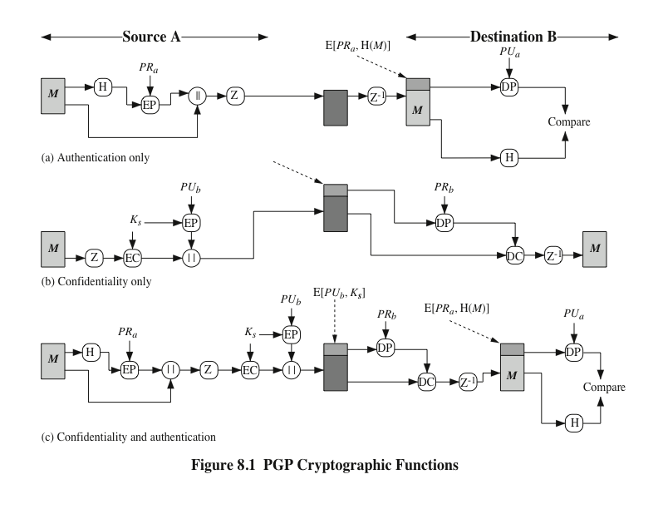
Notes:
Figure 8.1a illustrates the digital signature service provided by
PGP. This is the digital signature scheme discussed in Chapter 4 and illustrated in
Figure 4.5.
To protect the key, it is encrypted with the receiver’s public key. Figure 8.1b illustrates the sequence.
As Figure 8.1c illustrates, both services
may be used for the same message. First, a signature is generated for the plaintext
message and prepended to the message. Then the plaintext message plus signature
is encrypted using CAST-128 (or IDEA or 3DES), and the session key is encrypted
using RSA (or ElGamal). This sequence is preferable to the opposite: encrypting
the message and then generating a signature for the encrypted message. It is generally
more convenient to store a signature with a plaintext version of a message.
Furthermore, for purposes of third-party verification, if the signature is performed
first, a third party need not be concerned with the symmetric key when verifying the
signature.
In summary, when both services are used, the sender first signs the message
with its own private key, then encrypts the message with a session key, and finally
encrypts the session key with the recipient’s public key.

Slide 52
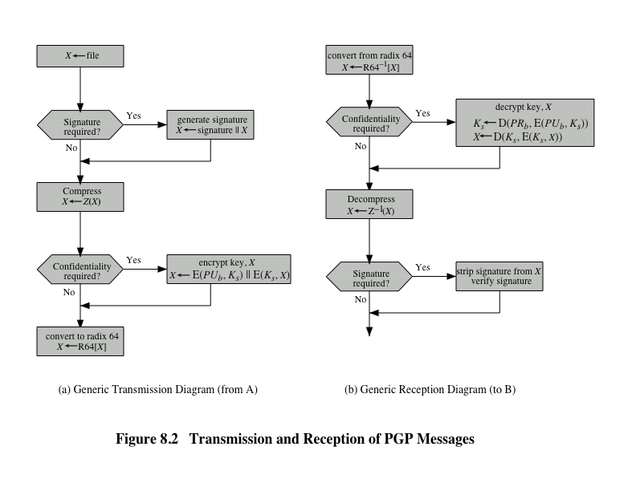
Notes:
Figure 8.2 shows the relationship among the four services so far discussed.
On transmission (if it is required), a signature is generated using a hash code of
the uncompressed plaintext. Then the plaintext (plus signature if present) is compressed.
Next, if confidentiality is required, the block (compressed plaintext or
compressed signature plus plaintext) is encrypted and prepended with the publickey-
encrypted symmetric encryption key. Finally, the entire block is converted to
radix-64 format.
On reception, the incoming block is first converted back from radix-64 format
to binary. Then, if the message is encrypted, the recipient recovers the session key
and decrypts the message. The resulting block is then decompressed. If the message
is signed, the recipient recovers the transmitted hash code and compares it to its
own calculation of the hash code.

Slide 53
Secure/Multipurpose Internet Mail Extension (S/MIME)
A security enhancement to the MIME Internet e-mail format standard based on technology from RSA Data Security
Defined in:
RFCs 3370, 3850, 3851, 3852
Notes:
Secure/Multipurpose Internet Mail Extension (S/MIME) is a security enhancement
to the MIME Internet e-mail format standard based on technology from RSA Data
Security. Although both PGP and S/MIME are on an IETF standards track, it appears
likely that S/MIME will emerge as the industry standard for commercial and
organizational use, while PGP will remain the choice for personal e-mail security
for many users. S/MIME is defined in a number of documents—most importantly
RFCs 3370, 3850, 3851, and 3852.
To understand S/MIME, we need first to have a general understanding of the underlying
e-mail format that it uses, namely MIME. But to understand the significance
of MIME, we need to go back to the traditional e-mail format standard, RFC 822,
which is still in common use. The most recent version of this format specification is
RFC 5322 (Internet Message Format ). Accordingly, this section first provides an introduction
to these two earlier standards and then moves on to a discussion of S/MIME.

Slide 54
RFC 5322
Defines a format for text messages that are sent using electronic mail
Messages are viewed as having an envelope and contents
The envelope contains whatever information is needed to accomplish transmission and delivery
The contents compose the object to be delivered to the recipient
RFC 5322 standard applies only to the contents
The content standard includes a set of header fields that may be used by the mail system to create the envelope
Notes:
RFC 5322 defines a format for text messages that are sent using electronic mail. It
has been the standard for Internet-based text mail messages and remains in common
use. In the RFC 5322 context, messages are viewed as having an envelope and
contents. The envelope contains whatever information is needed to accomplish
transmission and delivery. The contents compose the object to be delivered to the
recipient. The RFC 5322 standard applies only to the contents. However, the content
standard includes a set of header fields that may be used by the mail system to
create the envelope, and the standard is intended to facilitate the acquisition of such
information by programs.
The overall structure of a message that conforms to RFC 5322 is very simple.
A message consists of some number of header lines (the header ) followed by unrestricted
text (the body ). The header is separated from the body by a blank line. Put
differently, a message is ASCII text, and all lines up to the first blank line are assumed
to be header lines used by the user agent part of the mail system.
A header line usually consists of a keyword, followed by a colon, followed by
the keyword’s arguments; the format allows a long line to be broken up into several
lines. The most frequently used keywords are From , To , Subject , and Date .
Another field that is commonly found in RFC 5322 headers is Message-ID .
This field contains a unique identifier associated with this message.

Slide 55
Multipurpose Internet Mail Extensions (MIME)
An extension to the RFC 5322 framework that is intended to address some of the problems and limitations of the use of Simple Mail Transfer Protocol (SMTP)
Is intended to resolve these problems in a manner that is compatible with existing RFC 5322 implementations
The specification is provided in RFCs 2045 through 2049
MIME specification includes the following elements:
Five new message header fields are defined, which may be included in an RFC 5322 header; these fields provide information about the body of the message
A number of content formats are defined, thus standardizing representations that support multimedia electronic mail
Transfer encodings are defined that enable the conversion of any content format into a form that is protected from alteration by the mail system
Notes:
Multipurpose Internet Mail Extension (MIME) is an extension to the RFC 5322
framework that is intended to address some of the problems and limitations of the
use of Simple Mail Transfer Protocol (SMTP), defined in RFC 821, or some other
mail transfer protocol and RFC 5322 for electronic mail.
MIME is intended to resolve these problems in a manner that is compatible
with existing RFC 5322 implementations. The specification is provided in RFCs
2045 through 2049.
The MIME specification includes the following elements.
1. Five new message header fields are defined, which may be included in an
RFC 5322 header. These fields provide information about the body of the
message.
2. A number of content formats are defined, thus standardizing representations
that support multimedia electronic mail.
3. Transfer encodings are defined that enable the conversion of any content format
into a form that is protected from alteration by the mail system.

Slide 56
The Five Header Fields Defined in MIME
MIME-Version
Must have the parameter value 1.0
This field indicates that the message conforms to RFCs 2045 and 2046
Content-Type
Describes the data contained in the body with sufficient detail that the receiving user agent can pick an appropriate agent or mechanism to represent the data to the user or otherwise deal with the data in an appropriate manner
Content-Transfer-Encoding
Indicates the type of transformation that has been used to represent the body of the message in a way that is acceptable for mail transport
Content-ID
Used to identify MIME entities uniquely in multiple contexts
Content-Description
A text description of the object with the body; this is useful when the object is not readable
Notes:
In this subsection, we introduce the five message header fields. The next two
subsections deal with content formats and transfer encodings.
The five header fields defined in MIME are
• MIME-Version: Must have the parameter value 1.0. This field indicates that
the message conforms to RFCs 2045 and 2046.
• Content-Type: Describes the data contained in the body with sufficient detail that
the receiving user agent can pick an appropriate agent or mechanism to represent
the data to the user or otherwise deal with the data in an appropriate manner.
• Content-Transfer-Encoding: Indicates the type of transformation that has
been used to represent the body of the message in a way that is acceptable for
mail transport.
• Content-ID: Used to identify MIME entities uniquely in multiple contexts.
• Content-Description: A text description of the object with the body; this is
useful when the object is not readable (e.g., audio data).
Any or all of these fields may appear in a normal RFC 5322 header. A compliant
implementation must support the MIME-Version, Content-Type, and
Content-Transfer-Encoding fields; the Content-ID and Content-Description fields
are optional and may be ignored by the recipient implementation.

Slide 57
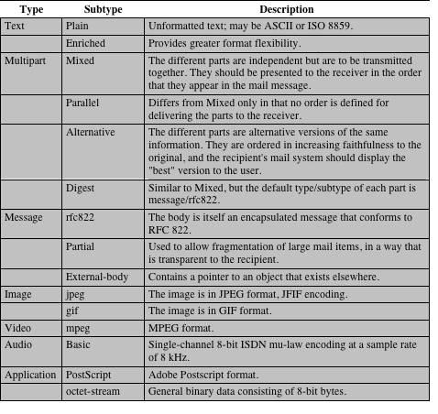
Table 8.2
MIME Content Types
Notes:
The bulk of the MIME specification is concerned with the
definition of a variety of content types. This reflects the need to provide standardized
ways of dealing with a wide variety of information representations in a multimedia
environment.
Table 8.2 lists the content types specified in RFC 2046. There are seven different
major types of content and a total of 15 subtypes. In general, a content type
declares the general type of data, and the subtype specifies a particular format for
that type of data.
For the text type of body, no special software is required to get the full meaning
of the text aside from support of the indicated character set. The primary subtype
is plain text , which is simply a string of ASCII characters or ISO 8859 characters. The
enriched subtype allows greater formatting flexibility.
The multipart type indicates that the body contains multiple, independent
parts. The Content-Type header field includes a parameter (called a boundary) that
defines the delimiter between body parts. This boundary should not appear in any
parts of the message. Each boundary starts on a new line and consists of two hyphens
followed by the boundary value. The final boundary, which indicates the end
of the last part, also has a suffix of two hyphens. Within each part, there may be an
optional ordinary MIME header.
There are four subtypes of the multipart type, all of which have the same overall
syntax. The multipart/mixed subtype is used when there are multiple independent
body parts that need to be bundled in a particular order. For the multipart/
parallel subtype, the order of the parts is not significant. If the recipient’s system is
appropriate, the multiple parts can be presented in parallel. For example, a picture
or text part could be accompanied by a voice commentary that is played while the
picture or text is displayed.
For the multipart/alternative subtype, the various parts are different representations
of the same information.
The multipart/digest subtype is used when each of the body parts is interpreted
as an RFC 5322 message with headers. This subtype enables the construction
of a message whose parts are individual messages. For example, the moderator of a
group might collect e-mail messages from participants, bundle these messages, and
send them out in one encapsulating MIME message.
The message type provides a number of important capabilities in MIME.
The message/rfc822 subtype indicates that the body is an entire message, including
header and body. Despite the name of this subtype, the encapsulated message may
be not only a simple RFC 5322 message but also any MIME message.
The message/partial subtype enables fragmentation of a large message into a
number of parts, which must be reassembled at the destination. For this subtype,
three parameters are specified in the Content-Type: Message/Partial field: an id
common to all fragments of the same message, a sequence number unique to each
fragment, and the total number of fragments.
The message/external-body subtype indicates that the actual data to be conveyed
in this message are not contained in the body. Instead, the body contains the
information needed to access the data. As with the other message types, the message/
external-body subtype has an outer header and an encapsulated message with
its own header. The only necessary field in the outer header is the Content-Type
field, which identifies this as a message/external-body subtype. The inner header is
the message header for the encapsulated message. The Content-Type field in the
outer header must include an access-type parameter, which indicates the method of
access, such as FTP (file transfer protocol).
The application type refers to other kinds of data, typically either uninterpreted
binary data or information to be processed by a mail-based application.

Slide 58
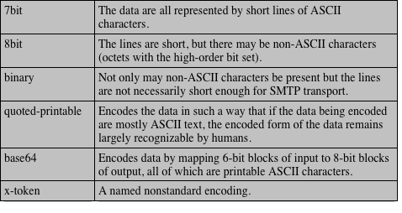
Table 8.3
MIME Transfer Encodings
Notes:
The other major component of the MIME specification,
in addition to content type specification, is a definition of transfer encodings
for message bodies. The objective is to provide reliable delivery across the largest
range of environments.
The MIME standard defines two methods of encoding data. The Content-
Transfer-Encoding field can actually take on six values, as listed in Table 8.3.
However, three of these values (7bit, 8bit, and binary) indicate that no encoding
has been done but provide some information about the nature of the data. For
SMTP transfer, it is safe to use the 7bit form. The 8bit and binary forms may be usable
in other mail transport contexts. Another Content-Transfer-Encoding value is
x-token, which indicates that some other encoding scheme is used for which a name
is to be supplied. This could be a vendor-specific or application-specific scheme.
The two actual encoding schemes defined are quoted-printable and base64. Two
schemes are defined to provide a choice between a transfer technique that is essentially
human readable and one that is safe for all types of data in a way that is
reasonably compact.
The quoted-printable transfer encoding is useful when the data consists largely
of octets that correspond to printable ASCII characters. In essence, it represents
nonsafe characters by the hexadecimal representation of their code and introduces
reversible (soft) line breaks to limit message lines to 76 characters.
The base64 transfer encoding, also known as radix-64 encoding, is a common
one for encoding arbitrary binary data in such a way as to be invulnerable to the
processing by mail-transport programs. It is also used in PGP and is described in
Appendix 19A.

Slide 59

Figure 8.3 Example MIME Message Structure
Notes:
Figure 8.3, taken from RFC 2045, is the outline of a complex
multipart message. The message has five parts to be displayed serially: two
introductory plain text parts, an embedded multipart message, a richtext part, and
a closing encapsulated text message in a non-ASCII character set. The embedded
multipart message has two parts to be displayed in parallel: a picture and an audio
fragment.

Slide 60
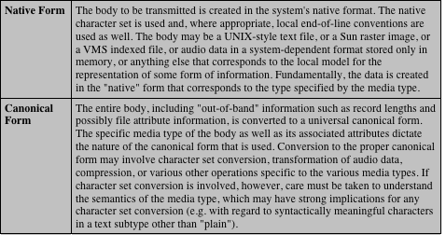
Table 8.4
Native and Canonical Form
Notes:
An important concept in MIME and S/MIME is that of canonical
form. Canonical form is a format, appropriate to the content type, that is standardized
for use between systems. This is in contrast to native form, which is a format
that may be peculiar to a particular system. Table 8.4, from RFC 2049, should help
clarify this matter.

Slide 61
S/MIME Functionality
S/MIME
Consists of encrypted content of any type and encrypted content encryption keys for one or more recipients
Signed data
A digital signature is formed by taking the message digest of the content to be signed and then encrypting that with the private key of the signer
The content plus signature are then encoded using base64 encoding
A signed data message can only be viewed by a recipient with S/MIME capability
Clear-signed data
Only the digital signature is encoded using base64
As a result recipients without S/MIME capability can view the message content, although they cannot verify the signature
Signed and enveloped data
Signed-only and encrypted-only entities may be nested, so that encrypted data may be signed and signed data or clear-signed data may be encrypted
Enveloped data
Notes:
In terms of general functionality, S/MIME is very similar to PGP. Both offer the
ability to sign and/or encrypt messages. In this subsection, we briefly summarize
S/MIME capability. We then look in more detail at this capability by examining
message formats and message preparation.
S/MIME provides the following functions.
• Enveloped data: This consists of encrypted content of any type and encrypted content
encryption keys for one or more recipients.
• Signed data: A digital signature is formed by taking the message digest of
the content to be signed and then encrypting that with the private key of
the signer. The content plus signature are then encoded using base64 encoding.
A signed data message can only be viewed by a recipient with S/MIME
capability.
• Clear-signed data: As with signed data, a digital signature of the content is
formed. However, in this case, only the digital signature is encoded using
base64. As a result, recipients without S/MIME capability can view the message
content, although they cannot verify the signature.
• Signed and enveloped data: Signed-only and encrypted-only entities may be
nested, so that encrypted data may be signed and signed data or clear-signed
data may be encrypted.

Slide 62
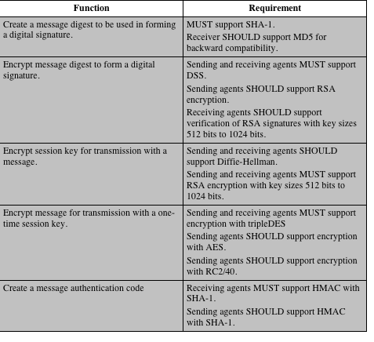
Table 8.5
Cryptographic
Algorithms
Used in
S/MIME
Notes:
Table 8.5 summarizes the cryptographic algorithms
used in S/MIME. S/MIME uses the following terminology taken from RFC 2119
(Key Words for use in RFCs to Indicate Requirement Levels ) to specify the requirement
level:
• MUST: The definition is an absolute requirement of the specification. An implementation
must include this feature or function to be in conformance with
the specification.
• SHOULD: There may exist valid reasons in particular circumstances to ignore
this feature or function, but it is recommended that an implementation include
the feature or function.
S/MIME incorporates three public-key algorithms. The Digital Signature
Standard (DSS) described in Chapter 3 is the preferred algorithm for digital signature.
S/MIME lists Diffie-Hellman as the preferred algorithm for encrypting
session keys; in fact, S/MIME uses a variant of Diffie-Hellman that does provide
encryption/decryption, known as ElGamal (Chapter 10). As an alternative, RSA,
described in Chapter 3, can be used for both signatures and session key encryption.
These are the same algorithms used in PGP and provide a high level of security. For
the hash function used to create the digital signature, the specification requires the
160-bit SHA-1 but recommends receiver support for the 128-bit MD5 for backward
compatibility with older versions of S/MIME. As we discussed in Chapter 3, there
is justifiable concern about the security of MD5, so SHA-1 is clearly the preferred
alternative.
For message encryption, three-key triple DES (tripleDES) is recommended,
but compliant implementations must support 40-bit RC2. The latter is a weak encryption
algorithm but allows compliance with U.S. export controls.
The S/MIME specification includes a discussion of the procedure for deciding
which content encryption algorithm to use. In essence, a sending agent has two
decisions to make. First, the sending agent must determine if the receiving agent is
capable of decrypting using a given encryption algorithm. Second, if the receiving
agent is only capable of accepting weakly encrypted content, the sending agent must
decide if it is acceptable to send using weak encryption. To support this decision
process, a sending agent may announce its decrypting capabilities in order of preference
for any message that it sends out. A receiving agent may store that information
for future use.

Slide 63
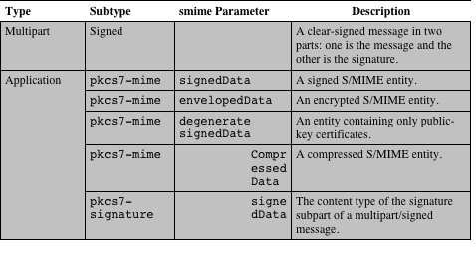
Table 8.6
S/MIME Content Types
Notes:
S/MIME makes use of a number of new MIME content types, which are shown in
Table 8.6. All of the new application types use the designation PKCS. This refers
to a set of public-key cryptography specifications issued by RSA Laboratories and
made available for the S/MIME effort.

Slide 64
Securing a MIME Entity
S/MIME secures a MIME entity with a signature, encryption, or both
The MIME entity is prepared according to the normal rules for MIME message preparation
The MIME entity plus some security-related data, such as algorithm identifiers and certificates, are processed by S/MIME to produce what is known as a PKCS object
A PKCS object is then treated as message content and wrapped in MIME
In all cases the message to be sent is converted to canonical form
Notes:
S/MIME secures a MIME entity with a signature,
encryption, or both. A MIME entity may be an entire message (except for the
RFC 5322 headers), or if the MIME content type is multipart, then a MIME entity
is one or more of the subparts of the message. The MIME entity is prepared according
to the normal rules for MIME message preparation. Then the MIME entity
plus some security-related data, such as algorithm identifiers and certificates, are
processed by S/MIME to produce what is known as a PKCS object. A PKCS object
is then treated as message content and wrapped in MIME (provided with appropriate
MIME headers). This process should become clear as we look at specific objects
and provide examples.
In all cases, the message to be sent is converted to canonical form. In particular,
for a given type and subtype, the appropriate canonical form is used for the
message content. For a multipart message, the appropriate canonical form is used
for each subpart.
The use of transfer encoding requires special attention. For most cases, the
result of applying the security algorithm will be to produce an object that is partially
or totally represented in arbitrary binary data. This will then be wrapped in an
outer MIME message, and transfer encoding can be applied at that point, typically
base64. However, in the case of a multipart signed message (described in more detail
later), the message content in one of the subparts is unchanged by the security
process. Unless that content is 7bit, it should be transfer encoded using base64 or
quoted-printable so that there is no danger of altering the content to which the signature
was applied.

Slide 65
Enveloped Data
The steps for preparing an EnvelopedData MIME are:
Generate a pseudorandom session key for a particular symmetric encryption algorithm
For each recipient, encrypt the session key with the recipient’s public RSA key
For each recipient, prepare a block known as RecipientInfo that contains an identifier of the recipient’s public-key certificate, an identifier of the algorithm used to encrypt the session key, and the encrypted session key
Encrypt the message content with the session key
Notes:
An application/pkcs7-mime subtype is used for one of four
categories of S/MIME processing, each with a unique smime-type parameter. In all
cases, the resulting entity (referred to as an object) is represented in a form known
as Basic Encoding Rules (BER), which is defined in ITU-T Recommendation
X.209. The BER format consists of arbitrary octet strings and is therefore binary
data. Such an object should be transfer encoded with base64 in the outer MIME
message. We first look at envelopedData.
The steps for preparing an envelopedData MIME entity are
1. Generate a pseudorandom session key for a particular symmetric encryption
algorithm (RC2/40 or triple DES).
2. For each recipient, encrypt the session key with the recipient’s public RSA key.
3. For each recipient, prepare a block known as RecipientInfo that contains
an identifier of the recipient’s public-key certificate, an identifier of the algorithm
used to encrypt the session key, and the encrypted session key.
4. Encrypt the message content with the session key.
The RecipientInfo blocks followed by the encrypted content constitute
the envelopedData . This information is then encoded into base64.
To recover the encrypted message, the recipient first strips off the base64 encoding.
Then the recipient’s private key is used to recover the session key. Finally,
the message content is decrypted with the session key.

Slide 66
Signed Data
Select a message digest algorithm (SHA or MD5)
Compute the message digest (hash function) of the content to be signed
Encrypt the message digest with the signer’s private key
Prepare a block known as SignerInfo that contains the signer’s public-key certificate, an identifier of the message digest algorithm, an identifier of the algorithm used to encrypt the message digest, and the encrypted message digest
The steps for preparing a SignedData MIME are:
Notes:
The signedData smime-type can be used with one or more signers.
For clarity, we confine our description to the case of a single digital signature. The
steps for preparing a signedData MIME entity are
1. Select a message digest algorithm (SHA or MD5).
2. Compute the message digest (hash function) of the content to be signed.
3. Encrypt the message digest with the signer’s private key.
4. Prepare a block known as SignerInfo that contains the signer’s public-key
certificate, an identifier of the message digest algorithm, an identifier of the algorithm
used to encrypt the message digest, and the encrypted message digest.
The signedData entity consists of a series of blocks, including a message
digest algorithm identifier, the message being signed, and SignerInfo . The
signedData entity may also include a set of public-key certificates sufficient to
constitute a chain from a recognized root or top-level certification authority to the
signer. This information is then encoded into base64.
To recover the signed message and verify the signature, the recipient first
strips off the base64 encoding. Then the signer’s public key is used to decrypt the
message digest. The recipient independently computes the message digest and compares
it to the decrypted message digest to verify the signature.

Slide 67
Clear Signing
Achieved using the multipart content type with a signed subtype
This signing process does not involve transforming the message to be signed
Recipients with MIME capability but not S/MIME capability are able to read the incoming message
Notes:
Clear signing is achieved using the multipart content type with a signed
subtype. As was mentioned, this signing process does not involve transforming the
message to be signed, so that the message is sent “in the clear.” Thus, recipients with
MIME capability but not S/MIME capability are able to read the incoming message.
A multipart/signed message has two parts. The first part can be any MIME
type but must be prepared so that it will not be altered during transfer from source
to destination. This means that if the first part is not 7bit, then it needs to be encoded
using base64 or quoted-printable. Then this part is processed in the same
manner as signedData , but in this case an object with signedData format is
created that has an empty message content field. This object is a detached signature.
It is then transfer encoded using base64 to become the second part of the multipart/
signed message. This second part has a MIME content type of application and a
subtype of pkcs7-signature.

Slide 68
S/MIME Certificate Processing
S/MIME uses public-key certificates that conform to version 3 of X.509
The key-management scheme used by S/MIME is in some ways a hybrid between a strict X.509 certification hierarchy and PGP’s web of trust
S/MIME managers and/or users must configure each client with a list of trusted keys and with certificate revocation lists
The responsibility is local for maintaining the certificates needed to verify incoming signatures and to encrypt outgoing messages
The certificates are signed by certification authorities
Notes:
S/MIME uses public-key certificates that conform to version 3 of X.509 (see
Chapter 4). The key-management scheme used by S/MIME is in some ways a hybrid
between a strict X.509 certification hierarchy and PGP’s web of trust. As with
the PGP model, S/MIME managers and/or users must configure each client with a
list of trusted keys and with certificate revocation lists. That is, the responsibility is
local for maintaining the certificates needed to verify incoming signatures and to
encrypt outgoing messages. On the other hand, the certificates are signed by certification
authorities.

Slide 69
User Agent Role
Key generation
The user of some related administrative utility must be capable of generating separate Diffie-Hellman and DSS key pairs and should be capable of generating RSA key pairs
A user agent should generate RSA key pairs with a length in the range of 768 to 1024 bits and must not generate a length of less than 512 bits
Registration
A user’s public key must be registered with a certification authority in order to receive an X.509 public-key certificate
Certificate storage and retrieval
A user requires access to a local list of certificates in order to verify incoming signatures and to encrypt outgoing messages
An S/MIME user has several key-management functions to perform:
Notes:
An S/MIME user has several key-management functions to
perform.
• Key generation: The user of some related administrative utility (e.g., one associated
with LAN management) MUST be capable of generating separate
Diffie-Hellman and DSS key pairs and SHOULD be capable of generating
RSA key pairs. Each key pair MUST be generated from a good source of
nondeterministic random input and be protected in a secure fashion. A user
agent SHOULD generate RSA key pairs with a length in the range of 768 to
1024 bits and MUST NOT generate a length of less than 512 bits.
• Registration: A user’s public key must be registered with a certification authority
in order to receive an X.509 public-key certificate.
• Certificate storage and retrieval: A user requires access to a local list of certificates
in order to verify incoming signatures and to encrypt outgoing messages.
Such a list could be maintained by the user or by some local administrative
entity on behalf of a number of users.

Slide 70
VeriSign Certificates
VeriSign provides a certification authority (CA) service that is intended to be compatible with S/MIME and a variety of other applications
Issues X.509 certificates with the product name VeriSign Digital ID
At a minimum, each Digital ID contains:
Owner’s public key
Owner’s name or alias
Expiration date of the Digital ID
Serial number of the Digital ID
Name of the certification authority that issued the Digital ID
Digital signature of the certification authority that issued the Digital ID
Notes:
There are several companies that provide certification authority
(CA) services. For example, Nortel has designed an enterprise CA solution
and can provide S/MIME support within an organization. There are a number
of Internet-based CAs, including VeriSign, GTE, and the U.S. Postal Service. Of
these, the most widely used is the VeriSign CA service, a brief description of which
we now provide.
VeriSign provides a CA service that is intended to be compatible with
S/MIME and a variety of other applications. VeriSign issues X.509 certificates
with the product name VeriSign Digital ID. As of early 1998, over 35,000 commercial
Web sites were using VeriSign Server Digital IDs, and over a million
consumer Digital IDs had been issued to users of Netscape and Microsoft
browsers.
The information contained in a Digital ID depends on the type of Digital ID
and its use. At a minimum, each Digital ID contains
• Owner’s public key
• Owner’s name or alias
• Expiration date of the Digital ID
• Serial number of the Digital ID
• Name of the certification authority that issued the Digital ID
• Digital signature of the certification authority that issued the Digital ID
Digital IDs can also contain other user-supplied information, including
• Address
• E-mail address
• Basic registration information (country, zip code, age, and gender)

Slide 71
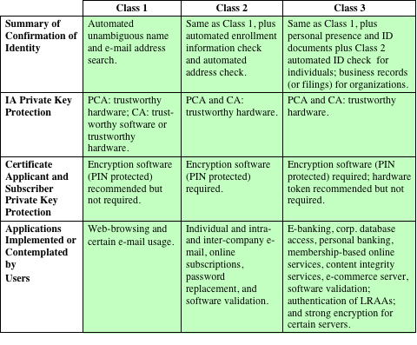
Table 8.7
VeriSign Public-Key Certificate Classes
IA Issuing Authority
CA Certification Authority
PCA VeriSign public primary certification authority
PIN Personal Identification Number
LRAA Local Registration Authority Administrator
Notes:
VeriSign provides three levels, or classes, of security for public-key certificates,
as summarized in Table 8.7. A user requests a certificate online at VeriSign’s
Web site or other participating Web sites. Class 1 and Class 2 requests are processed
on line, and in most cases take only a few seconds to approve. Briefly, the following
procedures are used.
• For Class 1 Digital IDs, VeriSign confirms the user’s e-mail address by sending
a PIN and Digital ID pick-up information to the e-mail address provided
in the application.
• For Class 2 Digital IDs, VeriSign verifies the information in the application
through an automated comparison with a consumer database in addition to
performing all of the checking associated with a Class 1 Digital ID. Finally,
confirmation is sent to the specified postal address alerting the user that a
Digital ID has been issued in his or her name.
• For Class 3 Digital IDs, VeriSign requires a higher level of identity assurance.
An individual must prove his or her identity by providing notarized credentials
or applying in person.

Slide 72
Enhanced Security Services
Three enhanced security services have been proposed in an Internet draft:
Signed receipt
Returning a signed receipt provides proof of delivery to the originator of a message and allows the originator to demonstrate to a third party that the recipient received the message
Security labels
A set of security information regarding the sensitivity of the content that is protected by S/MIME encapsulation
Secure mailing lists
An S/MIME Mail List Agent (MLA) can take a single incoming message, perform the recipient-specific encryption for each recipient, and forward the message
Notes:
As of this writing, three enhanced security services have been proposed in an
Internet draft. The details of these may change, and additional services may be
added. The three services are
• Signed receipts: A signed receipt may be requested in a SignedData object.
Returning a signed receipt provides proof of delivery to the originator of a
message and allows the originator to demonstrate to a third party that the recipient
received the message. In essence, the recipient signs the entire original
message plus the original (sender’s) signature and appends the new signature
to form a new S/MIME message.
• Security labels: A security label may be included in the authenticated attributes
of a SignedData object. A security label is a set of security information
regarding the sensitivity of the content that is protected by S/MIME encapsulation.
The labels may be used for access control, by indicating which users are
permitted access to an object. Other uses include priority (secret, confidential,
restricted, and so on) or role based, describing which kind of people can see
the information (e.g., patient’s health-care team, medical billing agents, etc.).
• Secure mailing lists: When a user sends a message to multiple recipients, a certain
amount of per-recipient processing is required, including the use of each
recipient’s public key. The user can be relieved of this work by employing the
services of an S/MIME Mail List Agent (MLA). An MLA can take a single
incoming message, perform the recipient-specific encryption for each recipient,
and forward the message. The originator of a message need only send the
message to the MLA with encryption performed using the MLA’s public key.

Slide 73
DomainKeys Identified Mail (DKIM)
A specification for cryptographically signing e-mail messages, permitting a signing domain to claim responsibility for a message in the mail stream
Message recipients can verify the signature by querying the signer’s domain directly to retrieve the appropriate public key and can thereby confirm that the message was attested to by a party in possession of the private key for the signing domain
Proposed Internet Standard RFC 4871
Has been widely adopted by a range of e-mail providers and Internet Service Providers (ISPs)
Notes:
DomainKeys Identified Mail (DKIM) is a specification for cryptographically signing
e-mail messages, permitting a signing domain to claim responsibility for a message
in the mail stream. Message recipients (or agents acting in their behalf) can verify
the signature by querying the signer’s domain directly to retrieve the appropriate
public key and thereby can confirm that the message was attested to by a party in
possession of the private key for the signing domain. DKIM is a proposed Internet
Standard (RFC 4871: DomainKeys Identified Mail (DKIM) Signatures ). DKIM has
been widely adopted by a range of e-mail providers, including corporations, government
agencies, gmail, yahoo, and many Internet Service Providers (ISPs).

Slide 74
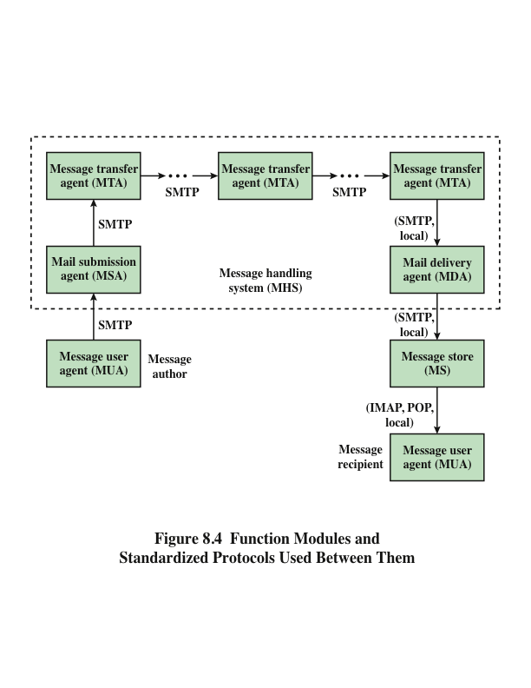
Notes:
To understand the operation of DKIM, it is useful to have a basic grasp of the
Internet mail architecture, which is currently defined in RFC 5598. This subsection
provides an overview of the basic concepts.
At its most fundamental level, the Internet mail architecture consists of a
user world in the form of Message User Agents (MUA), and the transfer world, in
the form of the Message Handling Service (MHS), which is composed of Message
Transfer Agents (MTA). The MHS accepts a message from one user and delivers
it to one or more other users, creating a virtual MUA-to-MUA exchange environment.
This architecture involves three types of interoperability. One is directly between
users: messages must be formatted by the MUA on behalf of the message
author so that the message can be displayed to the message recipient by the destination
MUA. There are also interoperability requirements between the MUA and the
MHS—first when a message is posted from an MUA to the MHS and later when
it is delivered from the MHS to the destination MUA. Interoperability is required
among the MTA components along the transfer path through the MHS.
Figure 8.4 illustrates the key components of the Internet mail architecture,
which include the following.
• Message User Agent (MUA): Operates on behalf of user actors and user applications.
It is their representative within the e-mail service. Typically, this
function is housed in the user’s computer and is referred to as a client e-mail
program or a local network e-mail server. The author MUA formats a message
and performs initial submission into the MHS via a MSA. The recipient
MUA processes received mail for storage and/or display to the recipient user.
• Mail Submission Agent (MSA): Accepts the message submitted by an MUA
and enforces the policies of the hosting domain and the requirements of
Internet standards. This function may be located together with the MUA or
as a separate functional model. In the latter case, the Simple Mail Transfer
Protocol (SMTP) is used between the MUA and the MSA.
• Message Transfer Agent (MTA): Relays mail for one application-level hop.
It is like a packet switch or IP router in that its job is to make routing assessments
and to move the message closer to the recipients. Relaying is performed
by a sequence of MTAs until the message reaches a destination MDA. An
MTA also adds trace information to the message header. SMTP is used between
MTAs and between an MTA and an MSA or MDA.
• Mail Delivery Agent (MDA): Responsible for transferring the message from
the MHS to the MS.
• Message Store (MS): An MUA can employ a long-term MS. An MS can be
located on a remote server or on the same machine as the MUA. Typically,
an MUA retrieves messages from a remote server using POP (Post Office
Protocol) or IMAP (Internet Message Access Protocol).
Two other concepts need to be defined. An administrative management
domain (ADMD) is an Internet e-mail provider. Examples include a department
that operates a local mail relay (MTA), an IT department that operates an enterprise
mail relay, and an ISP that operates a public shared e-mail service. Each
ADMD can have different operating policies and trust-based decision making. One
obvious example is the distinction between mail that is exchanged within an organization
and mail that is exchanged between independent organizations. The rules for
handling the two types of traffic tend to be quite different.
The Domain Name System (DNS) is a directory lookup service that provides
a mapping between the name of a host on the Internet and its numerical address.

Slide 75
E-mail Threats
RFC 4684 (Analysis of Threats Motivating DomainKeys Identified Mail)
Describes the threats being addressed by DKIM in terms of the characteristics, capabilities, and location of potential attackers
Characterized on three levels of threat:
At the low end are attackers who simply want to send e-mail that a recipient does not want to receive
The next level are professional senders of bulk spam mail and often operate as commercial enterprises and send messages on behalf of third parties
The most sophisticated and financially motivated senders of messages are those who stand to receive substantial financial benefit, such as from an e-mail based fraud scheme
Notes:
RFC 4686 characterizes the range of attackers on a spectrum of
three levels of threat.
1. At the low end are attackers who simply want to send e-mail that a recipient
does not want to receive. The attacker can use one of a number of commercially
available tools that allow the sender to falsify the origin address of
messages. This makes it difficult for the receiver to filter spam on the basis of
originating address or domain.
2. At the next level are professional senders of bulk spam mail. These attackers
often operate as commercial enterprises and send messages on behalf of third
parties. They employ more comprehensive tools for attack, including Mail
Transfer Agents (MTAs) and registered domains and networks of compromised
computers (zombies) to send messages and (in some cases) to harvest
addresses to which to send.
3. The most sophisticated and financially motivated senders of messages are
those who stand to receive substantial financial benefit, such as from an
E-mail-based fraud scheme. These attackers can be expected to employ all of
the above mechanisms and additionally may attack the Internet infrastructure
itself, including DNS cache-poisoning attacks and IP routing attacks.

Slide 76
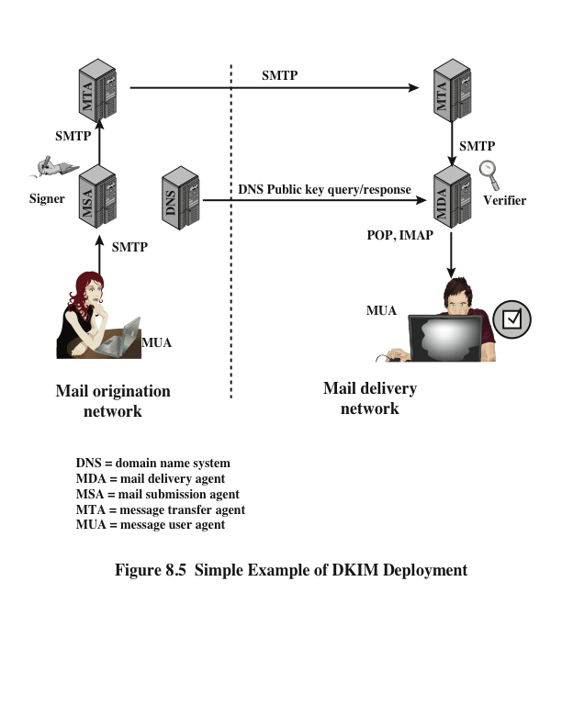
Notes:
DKIM is designed to provide an e-mail authentication technique that is transparent
to the end user. In essence, a user’s e-mail message is signed by a private key of the
administrative domain from which the e-mail originates. The signature covers all of
the content of the message and some of the RFC 5322 message headers. At the receiving
end, the MDA can access the corresponding public key via a DNS and verify
the signature, thus authenticating that the message comes from the claimed administrative
domain. Thus, mail that originates from somewhere else but claims to come
from a given domain will not pass the authentication test and can be rejected. This
approach differs from that of S/MIME and PGP, which use the originator’s private
key to sign the content of the message. The motivation for DKIM is based on the
following reasoning.
1. S/MIME depends on both the sending and receiving users employing S/MIME.
For almost all users, the bulk of incoming mail does not use S/MIME, and the
bulk of the mail the user wants to send is to recipients not using S/MIME.
2. S/MIME signs only the message content. Thus, RFC 5322 header information
concerning origin can be compromised.
3. DKIM is not implemented in client programs (MUAs) and is therefore transparent
to the user; the user need take no action.
4. DKIM applies to all mail from cooperating domains.
5. DKIM allows good senders to prove that they did send a particular message
and to prevent forgers from masquerading as good senders.
Figure 8.5 is a simple example of the operation of DKIM. We begin with a
message generated by a user and transmitted into the MHS to an MSA that is within
the user’s administrative domain. An e-mail message is generated by an e-mail client
program. The content of the message, plus selected RFC 5322 headers, is signed
by the e-mail provider using the provider’s private key. The signer is associated
with a domain, which could be a corporate local network, an ISP, or a public e-mail
facility such as gmail. The signed message then passes through the Internet via a
sequence of MTAs. At the destination, the MDA retrieves the public key for the
incoming signature and verifies the signature before passing the message on to the
destination e-mail client. The default signing algorithm is RSA with SHA-256. RSA
with SHA-1 also may be used.

Slide 77
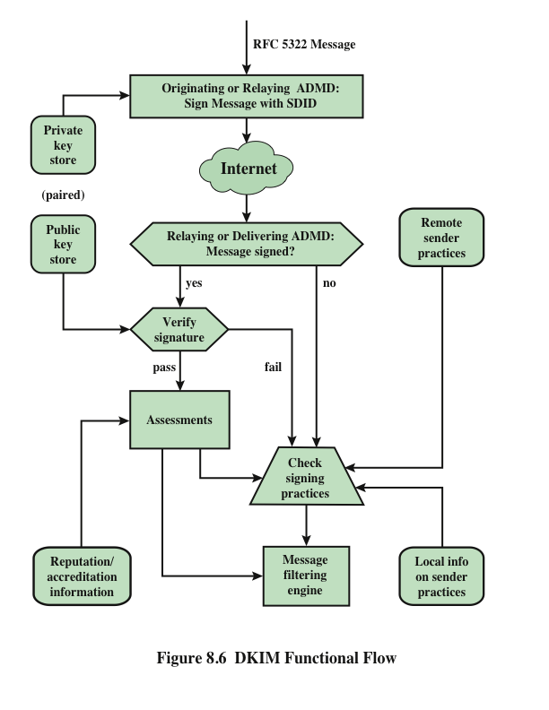
Notes:
Figure 8.6 provides a more detailed look at the elements of DKIM operation. Basic
message processing is divided between a signing Administrative Management Domain
(ADMD) and a verifying ADMD. At its simplest, this is between the originating ADMD
and the delivering ADMD, but it can involve other ADMDs in the handling path.
Signing is performed by an authorized module within the signing ADMD and
uses private information from a Key Store. Within the originating ADMD, this
might be performed by the MUA, MSA, or an MTA. Verifying is performed by
an authorized module within the verifying ADMD. Within a delivering ADMD,
verifying might be performed by an MTA, MDA, or MUA. The module verifies
the signature or determines whether a particular signature was required. Verifying
the signature uses public information from the Key Store. If the signature passes,
reputation information is used to assess the signer and that information is passed
to the message filtering system. If the signature fails or there is no signature using
the author’s domain, information about signing practices related to the author can
be retrieved remotely and/or locally, and that information is passed to the message
filtering system. For example, if the sender (e.g., gmail) uses DKIM but no DKIM
signature is present, then the message may be considered fraudulent.
The signature is inserted into the RFC 5322 message as an additional header
entry, starting with the keyword Dkim-Signature . You can view examples from
your own incoming mail by using the View Long Headers (or similar wording)
option for an incoming message.
Before a message is signed, a process known as canonicalization is performed
on both the header and body of the RFC 5322 message. Canonicalization is necessary
to deal with the possibility of minor changes in the message made en route,
including character encoding, treatment of trailing white space in message lines, and
the “folding” and “unfolding” of header lines. The intent of canonicalization is to
make a minimal transformation of the message (for the purpose of signing; the message
itself is not changed, so the canonicalization must be performed again by the
verifier) that will give it its best chance of producing the same canonical value at the
receiving end. DKIM defines two header canonicalization algorithms (“simple” and
“relaxed”) and two for the body (with the same names). The simple algorithm tolerates
almost no modification, while the relaxed tolerates common modifications.
The signature includes a number of fields. Each field begins with a tag consisting
of a tag code followed by an equals sign and ends with a semicolon.

Slide 78
Summary
Pretty good privacy
Notation
Operational description
DomainKeys Identified Mail
Internet mail architecture
E-mail threats
DKIM strategy
DKIM functional flow
S/MIME
RFC 5322
Multipurpose Internet mail extensions
S/MIME functionality
S/MIME messages
S/MIME certification processing
Enhanced security services
Notes:
Chapter 8 summary.

Slide 79
Network Security Essentials
Fifth Edition
by William Stallings
Notes:
Lecture slides prepared for “Network Security Essentials”, 5/e, by William Stallings, Chapter 9 – “IP Security”.

Slide 80
Chapter 9
IP Security
Notes:
There are application-specific security mechanisms for a number of application
areas, including electronic mail (S/MIME, PGP), client/server (Kerberos), Web access
(Secure Sockets Layer), and others. However, users have security concerns that
cut across protocol layers. For example, an enterprise can run a secure, private IP
network by disallowing links to untrusted sites, encrypting packets that leave the
premises, and authenticating packets that enter the premises. By implementing security
at the IP level, an organization can ensure secure networking not only for
applications that have security mechanisms but also for the many security-ignorant
applications.
IP-level security encompasses three functional areas: authentication, confidentiality,
and key management. The authentication mechanism assures that a received
packet was, in fact, transmitted by the party identified as the source in the packet
header. In addition, this mechanism assures that the packet has not been altered in
transit. The confidentiality facility enables communicating nodes to encrypt messages
to prevent eavesdropping by third parties. The key management facility is concerned
with the secure exchange of keys.

Slide 81
“If a secret piece of news is divulged by a spy before the time is ripe, he must be put to death, together with the man to whom the secret was told.”
—The Art of War,
Sun Tzu
Notes:
We begin this chapter with an overview of IP security (IPsec) and an introduction
to the IPsec architecture. We then look at each of the three functional areas in
detail. Appendix D reviews Internet protocol.

Slide 82
IP Security Overview
RFC 1636
“Security in the Internet Architecture”
Issued in 1994 by the Internet Architecture Board (IAB)
Identifies key areas for security mechanisms
Need to secure the network infrastructure from unauthorized monitoring and control of network traffic
Need to secure end-user-to-end-user traffic using authentication and encryption mechanisms
IAB included authentication and encryption as necessary security features in the next generation IP (IPv6)
The IPsec specification now exists as a set of Internet standards
Notes:
In 1994, the Internet Architecture Board (IAB) issued a report titled “Security in
the Internet Architecture” (RFC 1636). The report identified key areas for security
mechanisms. Among these were the need to secure the network infrastructure from
unauthorized monitoring and control of network traffic and the need to secure end-user-
to-end-user traffic using authentication and encryption mechanisms.
To provide security, the IAB included authentication and encryption as necessary
security features in the next-generation IP, which has been issued as IPv6.
Fortunately, these security capabilities were designed to be usable both with the
current IPv4 and the future IPv6. This means that vendors can begin offering these
features now, and many vendors now do have some IPsec capability in their products.
The IPsec specification now exists as a set of Internet standards.

Slide 83
Applications of IPsec
IPsec provides the capability to secure communications across a LAN, private and public WANs, and the Internet
Principal feature of IPsec is that it can encrypt and/or authenticate all traffic at the IP level
Thus all distributed applications (remote logon, client/server, e-mail, file transfer, Web access) can be secured
Examples include:
Secure branch office connectivity over the Internet
Secure remote access over the Internet
Establishing extranet and intranet connectivity with partners
Enhancing electronic commerce security
Notes:
IPsec provides the capability to secure communications across a LAN, across private
and public WANs, and across the Internet. Examples of its use include:
• Secure branch office connectivity over the Internet: A company can build a
secure virtual private network over the Internet or over a public WAN. This
enables a business to rely heavily on the Internet and reduce its need for private
networks, saving costs and network management overhead.
• Secure remote access over the Internet: An end user whose system is equipped
with IP security protocols can make a local call to an Internet Service Provider
(ISP) and gain secure access to a company network. This reduces the cost of
toll charges for traveling employees and telecommuters.
• Establishing extranet and intranet connectivity with partners: IPsec can be
used to secure communication with other organizations, ensuring authentication
and confidentiality and providing a key exchange mechanism.
• Enhancing electronic commerce security: Even though some Web and electronic
commerce applications have built-in security protocols, the use of IPsec
enhances that security. IPsec guarantees that all traffic designated by the network
administrator is both encrypted and authenticated, adding an additional
layer of security to whatever is provided at the application layer.
The principal feature of IPsec that enables it to support these varied applications
is that it can encrypt and/or authenticate all traffic at the IP level. Thus, all
distributed applications (including remote logon, client/server, e-mail, file transfer,
Web access, and so on) can be secured.

Slide 84
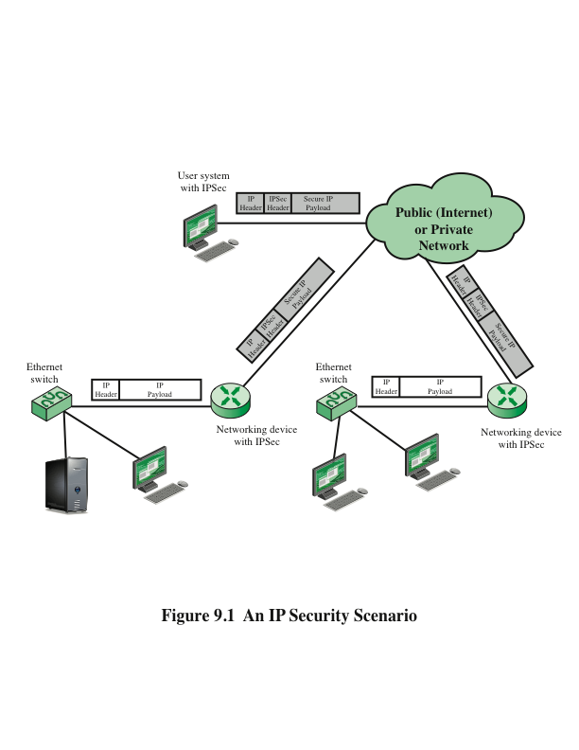
Notes:
Figure 9.1 is a typical scenario of IPsec usage. An organization maintains
LANs at dispersed locations. Nonsecure IP traffic is conducted on each LAN. For
traffic offsite, through some sort of private or public WAN, IPsec protocols are used.
These protocols operate in networking devices, such as a router or firewall, that
connect each LAN to the outside world. The IPsec networking device will typically
encrypt and compress all traffic going into the WAN and decrypt and decompress
traffic coming from the WAN; these operations are transparent to workstations and
servers on the LAN. Secure transmission is also possible with individual users who
dial into the WAN. Such user workstations must implement the IPsec protocols to
provide security.

Slide 85
Benefits of IPSec
Some of the benefits of IPsec:
When IPsec is implemented in a firewall or router, it provides strong security that can be applied to all traffic crossing the perimeter
Traffic within a company or workgroup does not incur the overhead of security-related processing
IPsec in a firewall is resistant to bypass if all traffic from the outside must use IP and the firewall is the only means of entrance from the Internet into the organization
IPsec is below the transport layer (TCP, UDP) and so is transparent to applications
There is no need to change software on a user or server system when IPsec is implemented in the firewall or router
IPsec can be transparent to end users
There is no need to train users on security mechanisms, issue keying material on a per-user basis, or revoke keying material when users leave the organization
IPsec can provide security for individual users if needed
This is useful for offsite workers and for setting up a secure virtual subnetwork within an organization for sensitive applications
Notes:
Some of the benefits of IPsec:
• When IPsec is implemented in a firewall or router, it provides strong security
that can be applied to all traffic crossing the perimeter. Traffic within
a company or workgroup does not incur the overhead of security-related
processing.
• IPsec in a firewall is resistant to bypass if all traffic from the outside must use
IP and the firewall is the only means of entrance from the Internet into the
organization.
• IPsec is below the transport layer (TCP, UDP) and so is transparent to applications.
There is no need to change software on a user or server system when
IPsec is implemented in the firewall or router. Even if IPsec is implemented in
end systems, upper-layer software, including applications, is not affected.
• IPsec can be transparent to end users. There is no need to train users on security
mechanisms, issue keying material on a per-user basis, or revoke keying
material when users leave the organization.
• IPsec can provide security for individual users if needed. This is useful for offsite
workers and for setting up a secure virtual subnetwork within an organization
for sensitive applications.

Slide 86
Routing Applications
IPsec can play a vital role in the routing architecture required for internetworking
IPsec can assure that:
A router advertisement comes from an authorized router
A router seeking to establish or maintain a neighbor relationship with a router in another routing domain is an authorized router
A redirect message comes from the router to which the initial IP packet was sent
A routing update is not forged
Notes:
In addition to supporting end users and protecting premises systems and networks,
IPsec can play a vital role in the routing architecture required for internetworking.
[HUIT98] lists the following examples of the use of IPsec. IPsec can assure that
• A router advertisement (a new router advertises its presence) comes from an
authorized router.
• A neighbor advertisement (a router seeks to establish or maintain a neighbor
relationship with a router in another routing domain) comes from an authorized
router.
• A redirect message comes from the router to which the initial IP packet was sent.
• A routing update is not forged.
Without such security measures, an opponent can disrupt communications or
divert some traffic. Routing protocols such as Open Shortest Path First (OSPF) should
be run on top of security associations between routers that are defined by IPsec.

Slide 87
IPsec Documents
Covers the general concepts, security requirements, definitions, and mechanisms defining IPsec technology
The current specification is RFC4301, Security Architecture for the Internet Protocol
Authentication Header (AH)
An extension header to provide message authentication
The current specification is RFC 4302, IP Authentication Header
Encapsulating Security Payload (ESP)
Consists of an encapsulating header and trailer used to provide encryption or combined encryption/authentication
The current specification is RFC 4303, IP Encapsulating Security Payload (ESP)
A collection of documents describing the key management schemes for use with IPsec
The main specification is RFC 5996, Internet Key Exchange (IKEv2) Protocol, but there are a number of related RFCs
Cryptographic algorithms
This category encompasses a large set of documents that define and describe cryptographic algorithms for encryption, message authentication, pseudorandom functions (PRFs), and cryptographic key exchange
Other
There are a variety of other IPsec-related RFCs, including those dealing with security policy and management information base (MIB) content
Architecture
Internet Key Exchange (IKE)
Notes:
IPsec encompasses three functional areas: authentication, confidentiality, and key
management. The totality of the IPsec specification is scattered across dozens of
RFCs and draft IETF documents, making this the most complex and difficult to
grasp of all IETF specifications. The best way to grasp the scope of IPsec is to consult
the latest version of the IPsec document roadmap, which as of this writing is RFC
6071 [IP Security (IPsec) and Internet Key Exchange (IKE) Document Roadmap ,
February 2011]. The documents can be categorized into the following groups.
• Architecture: Covers the general concepts, security requirements, definitions,
and mechanisms defining IPsec technology. The current specification is RFC
4301, Security Architecture for the Internet Protocol .
• Authentication Header (AH): AH is an extension header to provide message
authentication. The current specification is RFC 4302, IP Authentication
Header . Because message authentication is provided by ESP, the use of AH
is deprecated. It is included in IPsecv3 for backward compatibility but should
not be used in new applications. We do not discuss AH in this chapter.
• Encapsulating Security Payload (ESP): ESP consists of an encapsulating
header and trailer used to provide encryption or combined encryption/authentication.
The current specification is RFC 4303, IP Encapsulating Security
Payload (ESP) .
• Internet Key Exchange (IKE): This is a collection of documents describing the
key management schemes for use with IPsec. The main specification is RFC
5996, Internet Key Exchange (IKEv2) Protocol , but there are a number of
related RFCs.
• Cryptographic algorithms: This category encompasses a large set of documents
that define and describe cryptographic algorithms for encryption, message authentication,
pseudorandom functions (PRFs), and cryptographic key exchange.
• Other: There are a variety of other IPsec-related RFCs, including those dealing
with security policy and management information base (MIB) content.

Slide 88
IPsec Services
IPsec provides security services at the IP layer by enabling a system to:
Select required security protocols
Determine the algorithm(s) to use for the service(s)
Put in place any cryptographic keys required to provide the requested services
RFC 4301 lists the following services:
Access control
Connectionless integrity
Data origin authentication
Rejection of replayed packets (a form of partial sequence integrity)
Confidentiality (encryption)
Limited traffic flow confidentiality
Notes:
IPsec provides security services at the IP layer by enabling a system to select required
security protocols, determine the algorithm(s) to use for the service(s), and
put in place any cryptographic keys required to provide the requested services. Two
protocols are used to provide security: an authentication protocol designated by the
header of the protocol, Authentication Header (AH); and a combined encryption/
authentication protocol designated by the format of the packet for that protocol,
Encapsulating Security Payload (ESP). RFC 4301 lists the following services:
• Access control
• Connectionless integrity
• Data origin authentication
• Rejection of replayed packets (a form of partial sequence integrity)
• Confidentiality (encryption)
• Limited traffic flow confidentiality

Slide 89
Transport and Tunnel Modes
Transport Mode
Provides protection primarily for upper-layer protocols
Examples include a TCP or UDP segment or an ICMP packet
Typically used for end-to-end communication between two hosts
ESP in transport mode encrypts and optionally authenticates the IP payload but not the IP header
AH in transport mode authenticates the IP payload and selected portions of the IP header
Tunnel Mode
Provides protection to the entire IP packet
Used when one or both ends of a security association (SA) are a security gateway
A number of hosts on networks behind firewalls may engage in secure communications without implementing IPsec
ESP in tunnel mode encrypts and optionally authenticates the entire inner IP packet, including the inner IP header
AH in tunnel mode authenticates the entire inner IP packet and selected portions of the outer IP header
Notes:
Both AH and ESP support two modes of use: transport and tunnel mode. The operation
of these two modes is best understood in the context of a description of ESP,
which is covered in Section 9.3. Here we provide a brief overview.
Transport mode provides protection primarily for upper-layer
protocols. That is, transport mode protection extends to the payload of an IP packet.
Examples include a TCP or UDP segment or an ICMP packet, all of which operate
directly above IP in a host protocol stack. Typically, transport mode is used for endto-
end communication between two hosts (e.g., a client and a server, or two workstations).
When a host runs AH or ESP over IPv4, the payload is the data that normally
follow the IP header. For IPv6, the payload is the data that normally follow both the
IP header and any IPv6 extensions headers that are present, with the possible exception
of the destination options header, which may be included in the protection.
ESP in transport mode encrypts and optionally authenticates the IP payload
but not the IP header. AH in transport mode authenticates the IP payload and selected
portions of the IP header.
Tunnel mode provides protection to the entire IP packet. To achieve
this, after the AH or ESP fields are added to the IP packet, the entire packet plus
security fields is treated as the payload of new outer IP packet with a new outer IP
header. The entire original, inner, packet travels through a tunnel from one point of
an IP network to another; no routers along the way are able to examine the inner IP
header. Because the original packet is encapsulated, the new, larger packet may have
totally different source and destination addresses, adding to the security. Tunnel
mode is used when one or both ends of a security association (SA) are a security
gateway, such as a firewall or router that implements IPsec. With tunnel mode, a
number of hosts on networks behind firewalls may engage in secure communications
without implementing IPsec. The unprotected packets generated by such hosts
are tunneled through external networks by tunnel mode SAs set up by the IPsec
software in the firewall or secure router at the boundary of the local network.
ESP in tunnel mode encrypts and optionally authenticates the entire inner IP
packet, including the inner IP header. AH in tunnel mode authenticates the entire
inner IP packet and selected portions of the outer IP header.

Slide 90
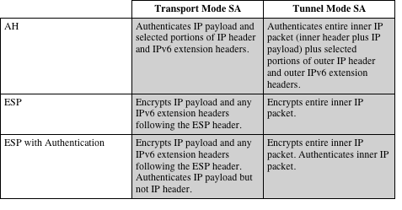
Table 9.1
Tunnel Mode and Transport Mode Functionality
Notes:
Table 9.1 summarizes transport and tunnel mode functionality.

Slide 91
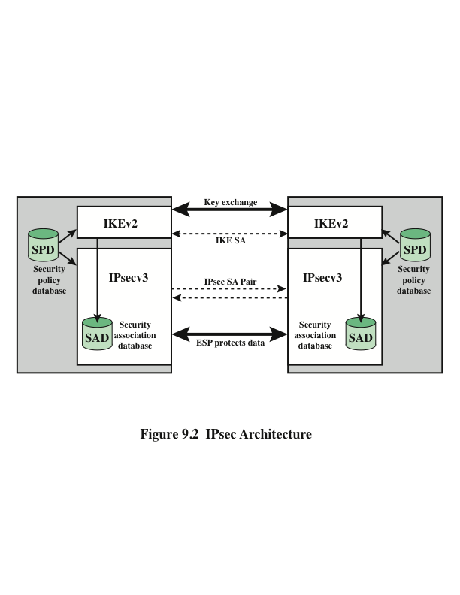
Notes:
Fundamental to the operation of IPsec is the concept of a security policy applied
to each IP packet that transits from a source to a destination. IPsec policy is determined
primarily by the interaction of two databases, the security association
database (SAD) and the security policy database (SPD) . This section provides an
overview of these two databases and then summarizes their use during IPsec operation.
Figure 9.2 illustrates the relevant relationships.

Slide 92
Security Association (SA)
Uniquely identified by three parameters:
A one-way logical connection between a sender and a receiver that affords security services to the traffic carried on it
In any IP packet, the SA is uniquely identified by the Destination Address in the IPv4 or IPv6 header and the SPI in the enclosed extension header (AH or ESP)
Security Parameters Index (SPI)
A 32-bit unsigned integer assigned to this SA and having local significance only
IP Destination Address
Address of the destination endpoint of the SA, which may be an end-user system or a network system such as a firewall or router
Security protocol identifier
Indicates whether the association is an AH or ESP security association
Notes:
A key concept that appears in both the authentication and confidentiality mechanisms
for IP is the security association (SA). An association is a one-way logical
connection between a sender and a receiver that affords security services to the traffic
carried on it. If a peer relationship is needed for two-way secure exchange, then
two security associations are required.
A security association is uniquely identified by three parameters.
• Security Parameters Index (SPI): A 32-bit unsigned integer assigned to this
SA and having local significance only. The SPI is carried in AH and ESP headers
to enable the receiving system to select the SA under which a received
packet will be processed.
• IP Destination Address: This is the address of the destination endpoint of the
SA, which may be an end-user system or a network system such as a firewall
or router.
• Security Protocol Identifier: This field from the outer IP header indicates
whether the association is an AH or ESP security association.
Hence, in any IP packet, the security association is uniquely identified by the
Destination Address in the IPv4 or IPv6 header and the SPI in the enclosed extension
header (AH or ESP).

Slide 93
Security Association Database (SAD)
Defines the parameters associated with each SA
Normally defined by the following parameters in a SAD entry:
Security parameter index
Sequence number counter
Sequence counter overflow
Anti-replay window
AH information
ESP information
Lifetime of this security association
IPsec protocol mode
Path MTU
Notes:
In each IPsec implementation, there is a nominal Security Association Database
that defines the parameters associated with each SA. A security association is normally
defined by the following parameters in an SAD entry.
• Security Parameter Index: A 32-bit value selected by the receiving end of an
SA to uniquely identify the SA. In an SAD entry for an outbound SA, the SPI
is used to construct the packet’s AH or ESP header. In an SAD entry for an
inbound SA, the SPI is used to map traffic to the appropriate SA.
• Sequence Number Counter: A 32-bit value used to generate the Sequence
Number field in AH or ESP headers, described in Section 20.3 (required for
all implementations).
• Sequence Counter Overflow: A flag indicating whether overflow of the
Sequence Number Counter should generate an auditable event and prevent
further transmission of packets on this SA (required for all implementations).
• Anti-Replay Window: Used to determine whether an inbound AH or ESP
packet is a replay, described in Section 20.3 (required for all implementations).
• AH Information: Authentication algorithm, keys, key lifetimes, and related
parameters being used with AH (required for AH implementations).
• ESP Information: Encryption and authentication algorithm, keys, initialization
values, key lifetimes, and related parameters being used with ESP
(required for ESP implementations).
• Lifetime of this Security Association: A time interval or byte count after
which an SA must be replaced with a new SA (and new SPI) or terminated,
plus an indication of which of these actions should occur (required for all
implementations).
• IPsec Protocol Mode: Tunnel, transport, or wildcard.
• Path MTU: Any observed path maximum transmission unit (maximum size of
a packet that can be transmitted without fragmentation) and aging variables
(required for all implementations).
The key management mechanism that is used to distribute keys is coupled to
the authentication and privacy mechanisms only by way of the Security Parameters
Index (SPI). Hence, authentication and privacy have been specified independent of
any specific key management mechanism.
IPsec provides the user with considerable flexibility in the way in which IPsec
services are applied to IP traffic. As we will see later, SAs can be combined in a
number of ways to yield the desired user configuration. Furthermore, IPsec provides
a high degree of granularity in discriminating between traffic that is afforded
IPsec protection and traffic that is allowed to bypass IPsec, as in the former case
relating IP traffic to specific SAs.

Slide 94
Security Policy Database (SPD)
The means by which IP traffic is related to specific SAs
Contains entries, each of which defines a subset of IP traffic and points to an SA for that traffic
In more complex environments, there may be multiple entries that potentially relate to a single SA or multiple SAs associated with a single SPD entry
Each SPD entry is defined by a set of IP and upper-layer protocol field values called selectors
These are used to filter outgoing traffic in order to map it into a particular SA
Notes:
The means by which IP traffic is related to specific SAs (or no SA in the case of
traffic allowed to bypass IPsec) is the nominal Security Policy Database (SPD). In
its simplest form, an SPD contains entries, each of which defines a subset of IP traffic
and points to an SA for that traffic. In more complex environments, there may
be multiple entries that potentially relate to a single SA or multiple SAs associated
with a single SPD entry. The reader is referred to the relevant IPsec documents for
a full discussion.
Each SPD entry is defined by a set of IP and upper-layer protocol field values,
called selectors . In effect, these selectors are used to filter outgoing traffic in order
to map it into a particular SA. Outbound processing obeys the following general
sequence for each IP packet.
1. Compare the values of the appropriate fields in the packet (the selector fields)
against the SPD to find a matching SPD entry, which will point to zero or
more SAs.
2. Determine the SA if any for this packet and its associated SPI.
Do the required IPsec processing (i.e., AH or ESP processing).

Slide 95
SPD Entries
The following selectors determine an SPD entry:
Remote IP address
This may be a single IP address, an enumerated list or range of addresses, or a wildcard (mask) address
The latter two are required to support more than one destination system sharing the same SA
Local IP address
This may be a single IP address, an enumerated list or range of addresses, or a wildcard (mask) address
The latter two are required to support more than one source system sharing the same SA
Next layer protocol
The IP protocol header includes a field that designates the protocol operating over IP
Name
A user identifier from the operating system
Not a field in the IP or upper-layer headers but is available if IPsec is running on the same operating system as the user
Local and remote ports
These may be individual TCP or UDP port values, an enumerated list of ports, or a wildcard port
Notes:
The following selectors determine an SPD entry:
• Remote IP Address: This may be a single IP address, an enumerated list or
range of addresses, or a wildcard (mask) address. The latter two are required
to support more than one destination system sharing the same SA (e.g., behind
a firewall).
• Local IP Address: This may be a single IP address, an enumerated list or range
of addresses, or a wildcard (mask) address. The latter two are required to support
more than one source system sharing the same SA (e.g., behind a firewall).
• Next Layer Protocol: The IP protocol header (IPv4, IPv6, or IPv6 Extension)
includes a field (Protocol for IPv4, Next Header for IPv6 or IPv6 Extension)
that designates the protocol operating over IP. This is an individual protocol
number, ANY, or for IPv6 only, OPAQUE. If AH or ESP is used, then this IP
protocol header immediately precedes the AH or ESP header in the packet.
• Name: A user identifier from the operating system. This is not a field in the IP
or upper-layer headers but is available if IPsec is running on the same operating
system as the user.
• Local and Remote Ports: These may be individual TCP or UDP port values,
an enumerated list of ports, or a wildcard port.

Slide 96
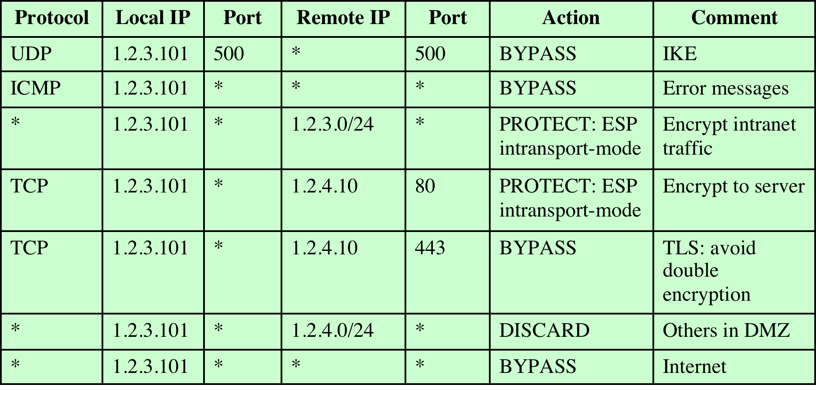
Table 9.2
Host SPD Example
Notes:
Table 9.2 provides an example of an SPD on a host system (as opposed to
a network system such as a firewall or router). This table reflects the following
configuration: A local network configuration consists of two networks. The
basic corporate network configuration has the IP network number 1.2.3.0/24.
The local configuration also includes a secure LAN, often known as a DMZ,
that is identified as 1.2.4.0/24. The DMZ is protected from both the outside
world and the rest of the corporate LAN by firewalls. The host in this example
has the IP address 1.2.3.10, and it is authorized to connect to the server 1.2.4.10
in the DMZ.
The entries in the SPD should be self-explanatory. For example, UDP port
500 is the designated port for IKE. Any traffic from the local host to a remote host
for purposes of an IKE exchange bypasses the IPsec processing.

Slide 97
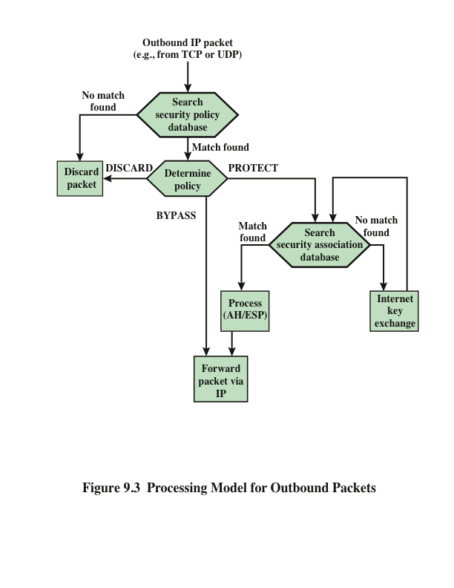
Notes:
Figure 9.3 highlights the main elements of IPsec processing
for outbound traffic. A block of data from a higher layer, such as TCP, is passed
down to the IP layer and an IP packet is formed, consisting of an IP header and an
IP body. Then the following steps occur:
1. IPsec searches the SPD for a match to this packet.
2. If no match is found, then the packet is discarded and an error message is
generated.
3. If a match is found, further processing is determined by the first matching
entry in the SPD. If the policy for this packet is DISCARD, then the packet is
discarded. If the policy is BYPASS, then there is no further IPsec processing;
the packet is forwarded to the network for transmission.
4. If the policy is PROTECT, then a search is made of the SAD for a matching
entry. If no entry is found, then IKE is invoked to create an SA with the appropriate
keys and an entry is made in the SA.
5. The matching entry in the SAD determines the processing for this packet.
Either encryption, authentication, or both can be performed, and either transport
or tunnel mode can be used. The packet is then forwarded to the network
for transmission.

Slide 98
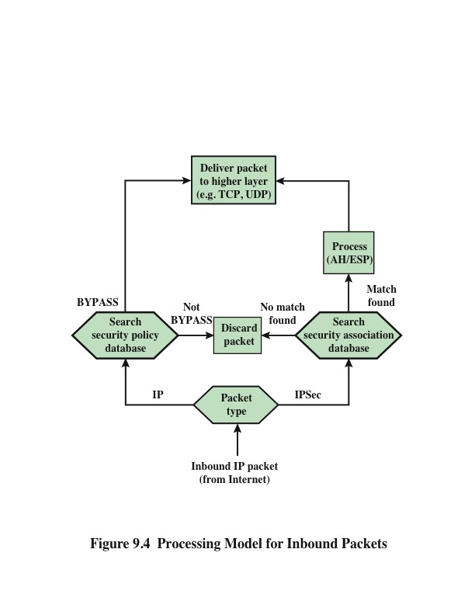
Notes:
Figure 9.4 highlights the main elements of IPsec processing for
inbound traffic. An incoming IP packet triggers the IPsec processing.

Slide 99
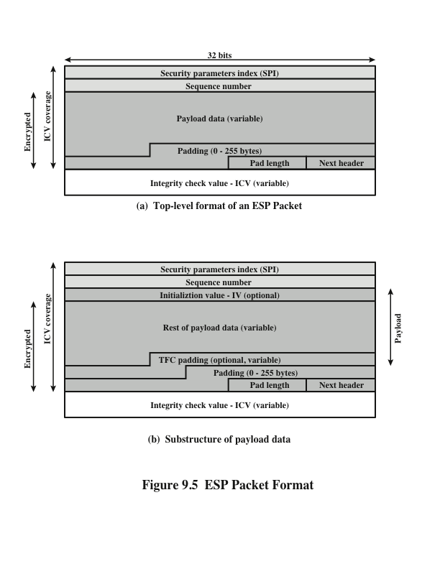
Notes:
Figure 9.5a shows the top-level format of an ESP packet. It contains the following
fields.
• Security Parameters Index (32 bits): Identifies a security association.
• Sequence Number (32 bits): A monotonically increasing counter value; this
provides an anti-replay function, as discussed for AH.
• Payload Data (variable): This is a transport-level segment (transport mode)
or IP packet (tunnel mode) that is protected by encryption.
• Padding (0–255 bytes): The purpose of this field is discussed later.
• Pad Length (8 bits): Indicates the number of pad bytes immediately preceding
this field.
• Next Header (8 bits): Identifies the type of data contained in the payload data
field by identifying the first header in that payload (e.g., an extension header
in IPv6, or an upper-layer protocol such as TCP).
• Integrity Check Value (variable): A variable-length field (must be an integral
number of 32-bit words) that contains the Integrity Check Value computed
over the ESP packet minus the Authentication Data field.
When any combined mode algorithm is employed, the algorithm itself is expected
to return both decrypted plaintext and a pass/fail indication for the integrity
check. For combined mode algorithms, the ICV that would normally appear at the
end of the ESP packet (when integrity is selected) may be omitted. When the ICV
is omitted and integrity is selected, it is the responsibility of the combined mode
algorithm to encode within the Payload Data an ICV-equivalent means of verifying
the integrity of the packet.
Two additional fields may be present in the payload (Figure 9.5b). An initialization
value (IV) , or nonce, is present if this is required by the encryption or
authenticated encryption algorithm used for ESP. If tunnel mode is being used, then
the IPsec implementation may add traffic flow confidentiality (TFC) padding after
the Payload Data and before the Padding field, as explained subsequently.

Slide 100
Encapsulating Security Payload (ESP)
Used to encrypt the Payload Data, Padding, Pad Length, and Next Header fields
If the algorithm requires cryptographic synchronization data then these data may be carried explicitly at the beginning of the Payload Data field
An optional ICV field is present only if the integrity service is selected and is provided by either a separate integrity algorithm or a combined mode algorithm that uses an ICV
ICV is computed after the encryption is performed
This order of processing facilitates reducing the impact of DoS attacks
Because the ICV is not protected by encryption, a keyed integrity algorithm must be employed to compute the ICV
The Padding field serves several purposes:
If an encryption algorithm requires the plaintext to be a multiple of some number of bytes, the Padding field is used to expand the plaintext to the required length
Used to assure alignment of Pad Length and Next Header fields
Additional padding may be added to provide partial traffic-flow confidentiality by concealing the actual length of the payload
Notes:
The Payload Data, Padding, Pad Length, and Next Header fields are encrypted by
the ESP service. If the algorithm used to encrypt the payload requires cryptographic
synchronization data, such as an initialization vector (IV), then these data may be
carried explicitly at the beginning of the Payload Data field. If included, an IV is
usually not encrypted, although it is often referred to as being part of the ciphertext.
The ICV field is optional. It is present only if the integrity service is selected
and is provided by either a separate integrity algorithm or a combined mode algorithm
that uses an ICV. The ICV is computed after the encryption is performed.
This order of processing facilitates rapid detection and rejection of replayed or
bogus packets by the receiver prior to decrypting the packet, hence potentially
reducing the impact of denial of service (DoS) attacks. It also allows for the possibility
of parallel processing of packets at the receiver that is decryption can take
place in parallel with integrity checking. Note that because the ICV is not protected
by encryption, a keyed integrity algorithm must be employed to compute
the ICV.
The Padding field serves several purposes:
• If an encryption algorithm requires the plaintext to be a multiple of some
number of bytes (e.g., the multiple of a single block for a block cipher), the
Padding field is used to expand the plaintext (consisting of the Payload Data,
Padding, Pad Length, and Next Header fields) to the required length.
• The ESP format requires that the Pad Length and Next Header fields be right
aligned within a 32-bit word. Equivalently, the ciphertext must be an integer
multiple of 32 bits. The Padding field is used to assure this alignment.
• Additional padding may be added to provide partial traffic-flow confidentiality
by concealing the actual length of the payload.

Slide 101
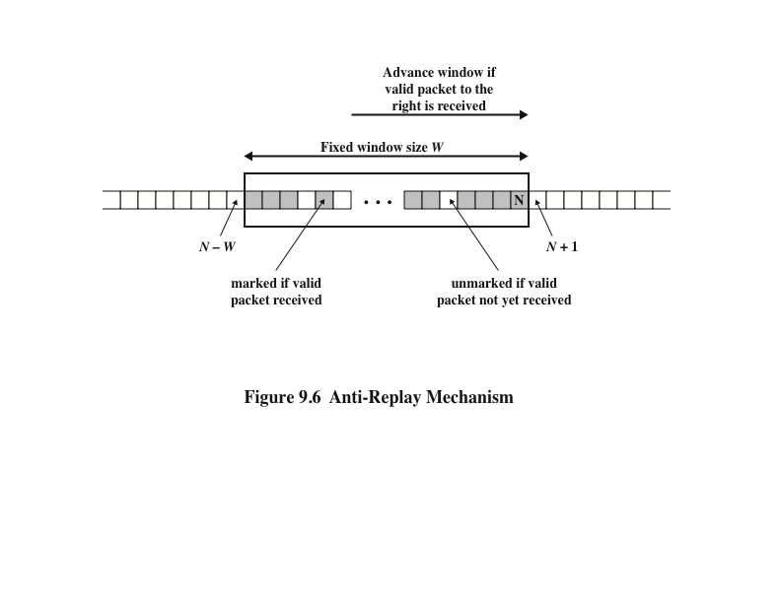
Notes:
A replay attack is one in which an attacker obtains a copy of an authenticated
packet and later transmits it to the intended destination. The receipt of duplicate,
authenticated IP packets may disrupt service in some way or may have some other
undesired consequence. The Sequence Number field is designed to thwart such attacks.
First, we discuss sequence number generation by the sender, and then we
look at how it is processed by the recipient.
When a new SA is established, the sender initializes a sequence number
counter to 0. Each time that a packet is sent on this SA, the sender increments the
counter and places the value in the Sequence Number field. Thus, the first value
to be used is 1. If anti-replay is enabled (the default), the sender must not allow
the sequence number to cycle past 2³² - 1 back to zero. Otherwise, there would
be multiple valid packets with the same sequence number. If the limit of 2³² - 1
is reached, the sender should terminate this SA and negotiate a new SA with a
new key.
Because IP is a connectionless, unreliable service, the protocol does not
guarantee that packets will be delivered in order and does not guarantee that all
packets will be delivered. Therefore, the IPsec authentication document dictates
that the receiver should implement a window of size W , with a default of W = 64.
The right edge of the window represents the highest sequence number, N , so far
received for a valid packet. For any packet with a sequence number in the range from
N - W + 1 to N that has been correctly received (i.e., properly authenticated), the
corresponding slot in the window is marked (Figure 9.6). Inbound processing proceeds
as follows when a packet is received:
1. If the received packet falls within the window and is new, the MAC is checked.
If the packet is authenticated, the corresponding slot in the window is marked.
2. If the received packet is to the right of the window and is new, the MAC is
checked. If the packet is authenticated, the window is advanced so that this
sequence number is the right edge of the window, and the corresponding slot
in the window is marked.
3. If the received packet is to the left of the window or if authentication fails, the
packet is discarded; this is an auditable event.

Slide 102
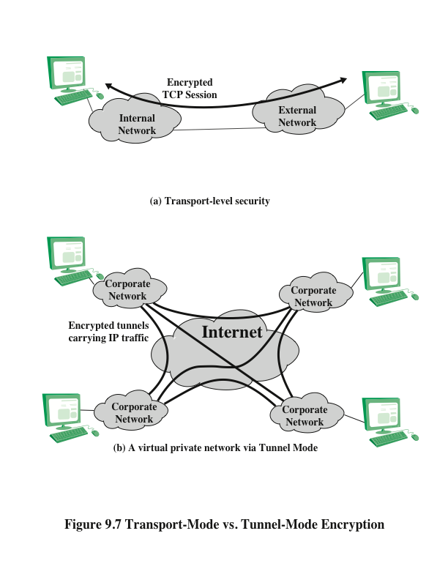
Notes:
Figure 9.7 shows two ways in which the IPsec ESP service can be used. In the
upper part of the figure, encryption (and optionally authentication) is provided directly
between two hosts. Figure 20.7b shows how tunnel mode operation can be
used to set up a virtual private network . In this example, an organization has four
private networks interconnected across the Internet. Hosts on the internal networks
use the Internet for transport of data but do not interact with other Internet-based
hosts. By terminating the tunnels at the security gateway to each internal network,
the configuration allows the hosts to avoid implementing the security capability.
The former technique is supported by a transport mode SA, while the latter technique
uses a tunnel mode SA.
In this section, we look at the scope of ESP for the two modes. The considerations
are somewhat different for IPv4 and IPv6. We use the packet formats of
Figure 9.8a as a starting point.

Slide 103
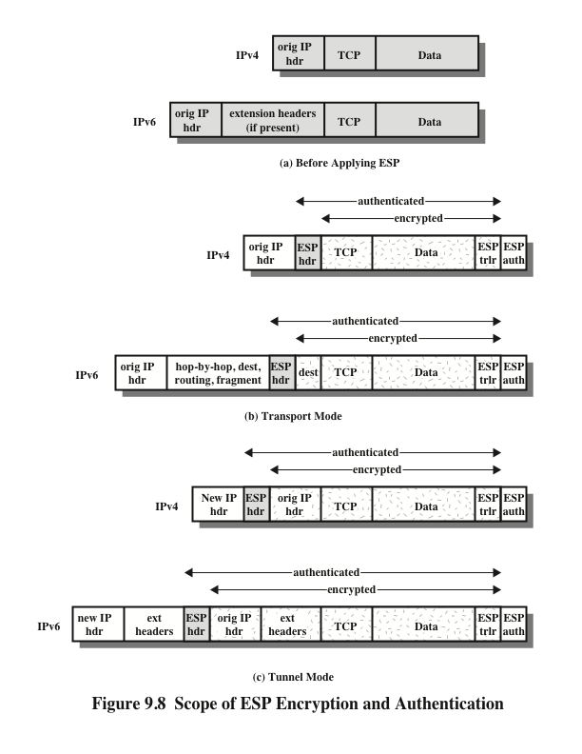
Notes:
Transport mode ESP is used to encrypt and optionally authenticate
the data carried by IP (e.g., a TCP segment), as shown in Figure 9.8b.
For this mode using IPv4, the ESP header is inserted into the IP packet immediately
prior to the transport-layer header (e.g., TCP, UDP, ICMP), and an ESP
trailer (Padding, Pad Length, and Next Header fields) is placed after the IP packet.
If authentication is selected, the ESP Authentication Data field is added after the
ESP trailer. The entire transport-level segment plus the ESP trailer are encrypted.
Authentication covers all of the ciphertext plus the ESP header.
In the context of IPv6, ESP is viewed as an end-to-end payload; that is, it is
not examined or processed by intermediate routers. Therefore, the ESP header appears
after the IPv6 base header and the hop-by-hop, routing, and fragment extension
headers. The destination options extension header could appear before or after
the ESP header, depending on the semantics desired. For IPv6, encryption covers
the entire transport-level segment plus the ESP trailer plus the destination options
extension header if it occurs after the ESP header. Again, authentication covers the
ciphertext plus the ESP header.
Transport mode operation may be summarized as follows.
1. At the source, the block of data consisting of the ESP trailer plus the entire
transport-layer segment is encrypted and the plaintext of this block is replaced
with its ciphertext to form the IP packet for transmission. Authentication is
added if this option is selected.
2. The packet is then routed to the destination. Each intermediate router needs
to examine and process the IP header plus any plaintext IP extension headers
but does not need to examine the ciphertext.
3. The destination node examines and processes the IP header plus any plaintext
IP extension headers. Then, on the basis of the SPI in the ESP header, the
destination node decrypts the remainder of the packet to recover the plaintext
transport-layer segment.
Transport mode operation provides confidentiality for any application that
uses it, thus avoiding the need to implement confidentiality in every individual application.
One drawback to this mode is that it is possible to do traffic analysis on
the transmitted packets.
Tunnel mode ESP is used to encrypt an entire IP packet
(Figure 9.8c). For this mode, the ESP header is prefixed to the packet and then the
packet plus the ESP trailer is encrypted. This method can be used to counter traffic
analysis.
Because the IP header contains the destination address and possibly source
routing directives and hop-by-hop option information, it is not possible simply to
transmit the encrypted IP packet prefixed by the ESP header. Intermediate routers
would be unable to process such a packet. Therefore, it is necessary to encapsulate
the entire block (ESP header plus ciphertext plus Authentication Data, if present)
with a new IP header that will contain sufficient information for routing but not for
traffic analysis.
Whereas the transport mode is suitable for protecting connections between
hosts that support the ESP feature, the tunnel mode is useful in a configuration that
includes a firewall or other sort of security gateway that protects a trusted network
from external networks. In this latter case, encryption occurs only between an external
host and the security gateway or between two security gateways. This relieves
hosts on the internal network of the processing burden of encryption and simplifies
the key distribution task by reducing the number of needed keys. Further, it thwarts
traffic analysis based on ultimate destination.

Slide 104
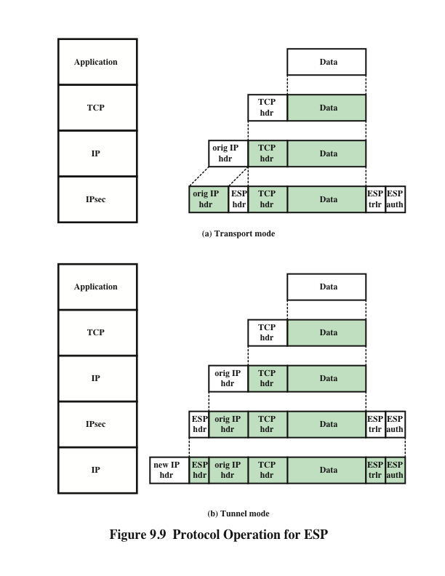
Notes:
Figure 9.9 shows the protocol architecture for the two modes.

Slide 105
Combining Security Associations
An individual SA can implement either the AH or ESP protocol but not both
Security association bundle
Refers to a sequence of SAs through which traffic must be processed to provide a desired set of IPsec services
The SAs in a bundle may terminate at different endpoints or at the same endpoint
May be combined into bundles in two ways:
Transport adjacency
Refers to applying more than one security protocol to the same IP packet without invoking tunneling
This approach allows for only one level of combination
Iterated tunneling
Refers to the application of multiple layers of security protocols effected through IP tunneling
This approach allows for multiple levels of nesting
Notes:
An individual SA can implement either the AH or ESP protocol but not both.
Sometimes a particular traffic flow will call for the services provided by both AH
and ESP. Further, a particular traffic flow may require IPsec services between
hosts and, for that same flow, separate services between security gateways, such as
firewalls. In all of these cases, multiple SAs must be employed for the same traffic
flow to achieve the desired IPsec services. The term security association bundle refers
to a sequence of SAs through which traffic must be processed to provide a desired
set of IPsec services. The SAs in a bundle may terminate at different endpoints
or at the same endpoints.
Security associations may be combined into bundles in two ways:
• Transport adjacency: Refers to applying more than one security protocol to
the same IP packet without invoking tunneling. This approach to combining
AH and ESP allows for only one level of combination; further nesting yields
no added benefit since the processing is performed at one IPsec instance: the
(ultimate) destination.
• Iterated tunneling: Refers to the application of multiple layers of security protocols
effected through IP tunneling. This approach allows for multiple levels
of nesting, since each tunnel can originate or terminate at a different IPsec site
along the path.
The two approaches can be combined, for example, by having a transport SA between
hosts travel part of the way through a tunnel SA between security gateways.
One interesting issue that arises when considering SA bundles is the order in
which authentication and encryption may be applied between a given pair of endpoints
and the ways of doing so.

Slide 106
ESP with Authentication Option
In this approach, the first user applies ESP to the data to be protected and then appends the authentication data field
For both cases authentication applies to the ciphertext rather than the plaintext
Transport mode ESP
Authentication and encryption apply to the IP payload delivered to the host, but the IP header is not protected
Tunnel mode ESP
Authentication applies to the entire IP packet delivered to the outer IP destination address and authentication is performed at that destination
The entire inner IP packet is protected by the privacy mechanism for delivery to the inner IP destination
Notes:
Encryption and authentication can be combined in order to transmit an IP packet
that has both confidentiality and authentication between hosts. We look at several
approaches.
This approach is illustrated in Figure 9.8.
In this approach, the user first applies ESP to the data to be protected and then
appends the authentication data field. There are actually two subcases:
• Transport mode ESP: Authentication and encryption apply to the IP payload
delivered to the host, but the IP header is not protected.
• Tunnel mode ESP: Authentication applies to the entire IP packet delivered
to the outer IP destination address (e.g., a firewall), and authentication is performed
at that destination. The entire inner IP packet is protected by the privacy
mechanism for delivery to the inner IP destination.
For both cases, authentication applies to the ciphertext rather than the plaintext.

Slide 107
Transport Adjacency
Another way to apply authentication after encryption is to use two bundled transport SAs, with the inner being an ESP SA and the outer being an AH SA
In this case ESP is used without its authentication option
Encryption is applied to the IP payload
AH is then applied in transport mode
Advantage of this approach is that the authentication covers more fields
Disadvantage is the overhead of two SAs versus one SA
Notes:
Another way to apply authentication after encryption is to
use two bundled transport SAs, with the inner being an ESP SA and the outer being
an AH SA. In this case, ESP is used without its authentication option. Because the
inner SA is a transport SA, encryption is applied to the IP payload. The resulting
packet consists of an IP header (and possibly IPv6 header extensions) followed
by an ESP. AH is then applied in transport mode, so that authentication covers
the ESP plus the original IP header (and extensions) except for mutable fields.
The advantage of this approach over simply using a single ESP SA with the ESP
authentication option is that the authentication covers more fields, including the
source and destination IP addresses. The disadvantage is the overhead of two SAs
versus one SA.

Slide 108
Transport-Tunnel Bundle
The use of authentication prior to encryption might be preferable for several reasons:
It is impossible for anyone to intercept the message and alter the authentication data without detection
It may be desirable to store the authentication information with the message at the destination for later reference
One approach is to use a bundle consisting of an inner AH transport SA and an outer ESP tunnel SA
Authentication is applied to the IP payload plus the IP header
The resulting IP packet is then processed in tunnel mode by ESP
The result is that the entire authenticated inner packet is encrypted and a new outer IP header is added
Notes:
The use of authentication prior to encryption might
be preferable for several reasons. First, because the authentication data are protected
by encryption, it is impossible for anyone to intercept the message and alter
the authentication data without detection. Second, it may be desirable to store the
authentication information with the message at the destination for later reference.
It is more convenient to do this if the authentication information applies to the unencrypted
message; otherwise the message would have to be reencrypted to verify
the authentication information.
One approach to applying authentication before encryption between two hosts
is to use a bundle consisting of an inner AH transport SA and an outer ESP tunnel
SA. In this case, authentication is applied to the IP payload plus the IP header (and
extensions) except for mutable fields. The resulting IP packet is then processed in
tunnel mode by ESP; the result is that the entire, authenticated inner packet is encrypted
and a new outer IP header (and extensions) is added.

Slide 109
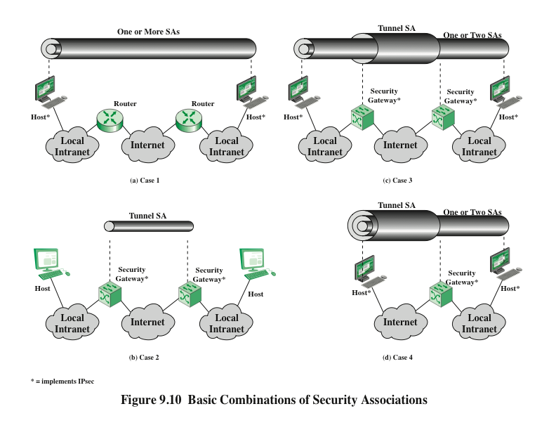
Notes:
The IPsec Architecture document lists four examples of combinations of SAs that
must be supported by compliant IPsec hosts (e.g., workstation, server) or security
gateways (e.g., firewall, router). These are illustrated in Figure 9.10. The lower
part of each case in the figure represents the physical connectivity of the elements;
the upper part represents logical connectivity via one or more nested SAs. Each SA
can be either AH or ESP. For host-to-host SAs, the mode may be either transport
or tunnel; otherwise it must be tunnel mode.

Slide 110
Internet Key Exchange
The key management portion of IPsec involves the determination and distribution of secret keys
A typical requirement is four keys for communication between two applications
Transmit and receive pairs for both integrity and confidentiality
The IPsec Architecture document mandates support for two types of key management:
Manual
A system administrator manually configures each system with its own keys and with the keys of other communicating systems
This is practical for small, relatively static environments
Automated
Enables the on-demand creation of keys for SAs and facilitates the use of keys in a large distributed system with an evolving configuration
Notes:
The key management portion of IPsec involves the determination and distribution
of secret keys. A typical requirement is four keys for communication
between two applications: transmit and receive pairs for both integrity and confidentiality.
The IPsec Architecture document mandates support for two types of
key management:
• Manual: A system administrator manually configures each system with its own
keys and with the keys of other communicating systems. This is practical for
small, relatively static environments.
• Automated: An automated system enables the on-demand creation of keys
for SAs and facilitates the use of keys in a large distributed system with an
evolving configuration.

Slide 111
ISAKMP/Oakley
The default automated key management protocol of IPsec
Consists of:
Oakley Key Determination Protocol
A key exchange protocol based on the Diffie-Hellman algorithm but providing added security
Generic in that it does not dictate specific formats
Internet Security Association and Key Management Protocol (ISAKMP)
Provides a framework for Internet key management and provides the specific protocol support, including formats, for negotiation of security attributes
Consists of a set of message types that enable the use of a variety of key exchange algorithms
Notes:
The default automated key management protocol for IPsec is referred to as
ISAKMP/Oakley and consists of the following elements:
• Oakley Key Determination Protocol: Oakley is a key exchange protocol
based on the Diffie-Hellman algorithm but providing added security. Oakley
is generic in that it does not dictate specific formats.
• Internet Security Association and Key Management Protocol (ISAKMP):
ISAKMP provides a framework for Internet key management and provides
the specific protocol support, including formats, for negotiation of security
attributes.
ISAKMP by itself does not dictate a specific key exchange algorithm; rather,
ISAKMP consists of a set of message types that enable the use of a variety of key
exchange algorithms. Oakley is the specific key exchange algorithm mandated for
use with the initial version of ISAKMP.
In IKEv2, the terms Oakley and ISAKMP are no longer used, and there
are significant differences from the use of Oakley and ISAKMP in IKEv1.
Nevertheless, the basic functionality is the same.

Slide 112
Features of IKE Key Determination
Algorithm is characterized by five important features:
1.
2.
3.
4.
5.
It employs a mechanism known as cookies to thwart clogging attacks
It enables the two parties to negotiate a group; this, in essence, specifies the global parameters of the Diffie-Hellman key exchange
It uses nonces to ensure against replay attacks
It enables the exchange of Diffie-Hellman public key values
It authenticates the Diffie-Hellman exchange to thwart man-in-the-middle-attacks
Notes:
The IKE key determination algorithm is
characterized by five important features:
1. It employs a mechanism known as cookies to thwart clogging attacks.
2. It enables the two parties to negotiate a group ; this, in essence, specifies the
global parameters of the Diffie-Hellman key exchange.
3. It uses nonces to ensure against replay attacks.
4. It enables the exchange of Diffie-Hellman public key values.
5. It authenticates the Diffie-Hellman exchange to thwart man-in-the-middle
attacks.

Slide 113
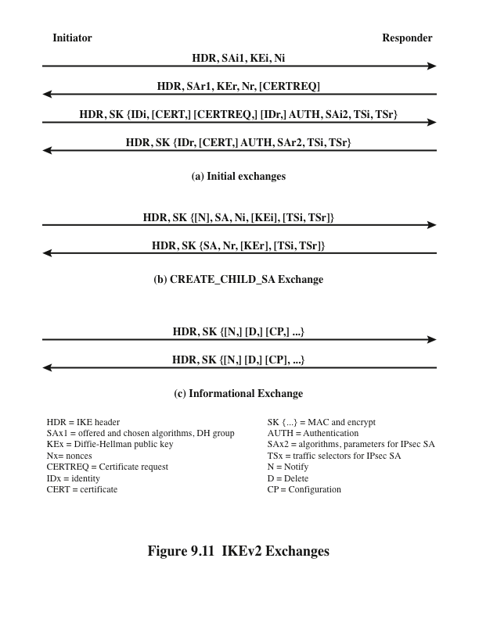
Notes:
The IKEv2 protocol involves the exchange of messages in
pairs. The first two pairs of exchanges are referred to as the initial exchanges
(Figure 9.11a). In the first exchange, the two peers exchange information concerning
cryptographic algorithms and other security parameters they are willing to use
along with nonces and Diffie-Hellman (DH) values. The result of this exchange is to
set up a special SA called the IKE SA (see Figure 9.2). This SA defines parameters
for a secure channel between the peers over which subsequent message exchanges
take place. Thus, all subsequent IKE message exchanges are protected by encryption
and message authentication. In the second exchange, the two parties authenticate
one another and set up a first IPsec SA to be placed in the SADB and used for
protecting ordinary (i.e. non-IKE) communications between the peers. Thus, four
messages are needed to establish the first SA for general use.
The CREATE_CHILD_SA exchange can be used to establish further SAs
for protecting traffic. The informational exchange is used to exchange management
information, IKEv2 error messages, and other notifications.

Slide 114
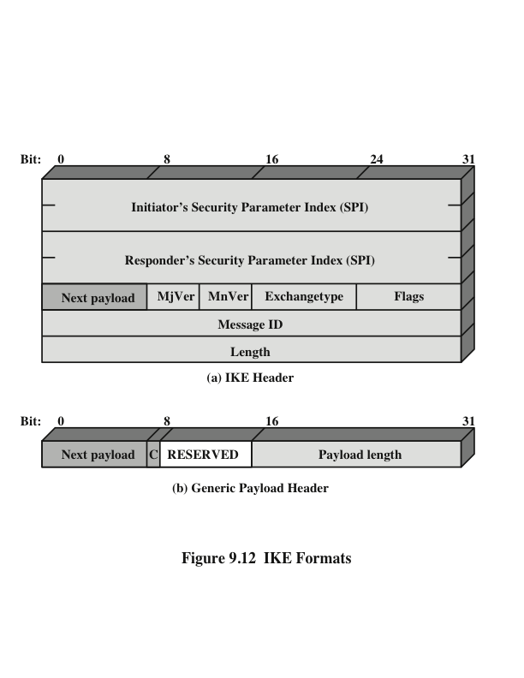
Notes:
Figure 9.12a shows the header format for an IKE message. It consists of the
following fields.
• Initiator SPI (64 bits): A value chosen by the initiator to identify a unique IKE
security association (SA).
• Responder SPI (64 bits): A value chosen by the responder to identify a unique
IKE SA.
• Next Payload (8 bits): Indicates the type of the first payload in the message;
payloads are discussed in the next subsection.
• Major Version (4 bits): Indicates major version of IKE in use.
• Minor Version (4 bits): Indicates minor version in use.
• Exchange Type (8 bits): Indicates the type of exchange; these are discussed
later in this section.
• Flags (8 bits): Indicates specific options set for this IKE exchange. Three bits
are defined so far. The initiator bit indicates whether this packet is sent by
the SA initiator. The version bit indicates whether the transmitter is capable
of using a higher major version number than the one currently indicated. The
response bit indicates whether this is a response to a message containing the
same message ID.
• Message ID (32 bits): Used to control retransmission of lost packets and
matching of requests and responses.
• Length (32 bits): Length of total message (header plus all payloads) in octets.
All IKE payloads begin with the same generic payload header
shown in Figure 9.12b. The Next Payload field has a value of 0 if this is the last
payload in the message; otherwise its value is the type of the next payload. The
Payload Length field indicates the length in octets of this payload, including the
generic payload header.
The critical bit is 0 if the sender wants the recipient to skip this payload if it
does not understand the payload type code in the Next Payload field of the previous
payload. It is set to 1 if the sender wants the recipient to reject this entire message if
it does not understand the payload type.

Slide 115
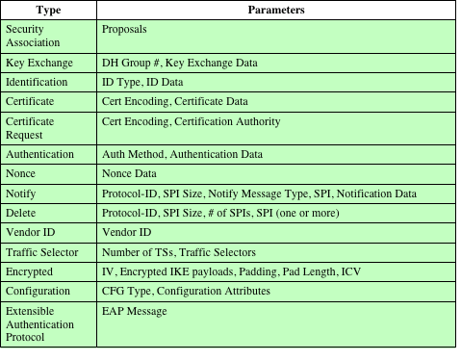
Table 9.3
IKE Payload Types
Notes:
Table 9.3 summarizes the payload types defined for IKE and lists the fields,
or parameters, that are part of each payload. The SA payload is used to begin the
establishment of an SA. The payload has a complex, hierarchical structure. The
payload may contain multiple proposals. Each proposal may contain multiple protocols.
Each protocol may contain multiple transforms. And each transform may
contain multiple attributes. These elements are formatted as substructures within
the payload as follows.
• Proposal: This substructure includes a proposal number, a protocol ID (AH,
ESP, or IKE), an indicator of the number of transforms, and then a transform
substructure. If more than one protocol is to be included in a proposal,
then there is a subsequent proposal substructure with the same proposal
number.
• Transform: Different protocols support different transform types. The transforms
are used primarily to define cryptographic algorithms to be used with a
particular protocol.
• Attribute: Each transform may include attributes that modify or complete the
specification of the transform. An example is key length.
The Key Exchange payload can be used for a variety of key exchange techniques,
including Oakley, Diffie-Hellman, and the RSA-based key exchange used
by PGP. The Key Exchange data field contains the data required to generate a session
key and is dependent on the key exchange algorithm used.
The Identification payload is used to determine the identity of communicating
peers and may be used for determining authenticity of information. Typically the
ID Data field will contain an IPv4 or IPv6 address.
The Certificate payload transfers a public-key certificate. The Certificate
Encoding field indicates the type of certificate or certificate-related information,
which may include the following:
• PKCS #7 wrapped X.509 certificate
• PGP certificate
• DNS signed key
• X.509 certificate—signature
• X.509 certificate—key exchange
• Kerberos tokens
• Certificate Revocation List (CRL)
• Authority Revocation List (ARL)
• SPKI certificate
At any point in an IKE exchange, the sender may include a Certificate Request
payload to request the certificate of the other communicating entity. The payload
may list more than one certificate type that is acceptable and more than one certificate
authority that is acceptable.
The Authentication payload contains data used for message authentication
purposes. The authentication method types so far defined are RSA digital signature,
shared-key message integrity code, and DSS digital signature.
The Nonce payload contains random data used to guarantee liveness during
an exchange and to protect against replay attacks.
The Notify payload contains either error or status information associated with
this SA or this SA negotiation. The following table lists the IKE notify messages.
The Delete payload indicates one or more SAs that the sender has deleted
from its database and that therefore are no longer valid.
The Vendor ID payload contains a vendor-defined constant. The constant is
used by vendors to identify and recognize remote instances of their implementations.
This mechanism allows a vendor to experiment with new features while maintaining
backward compatibility.
The Traffic Selector payload allows peers to identify packet flows for processing
by IPsec services.
The Encrypted payload contains other payloads in encrypted form. The encrypted
payload format is similar to that of ESP. It may include an IV if the encryption
algorithm requires it and an ICV if authentication is selected.
The Configuration payload is used to exchange configuration information between
IKE peers.
The Extensible Authentication Protocol (EAP) payload allows IKE SAs to
be authenticated using EAP, which was discussed in Chapter 5.

Slide 116
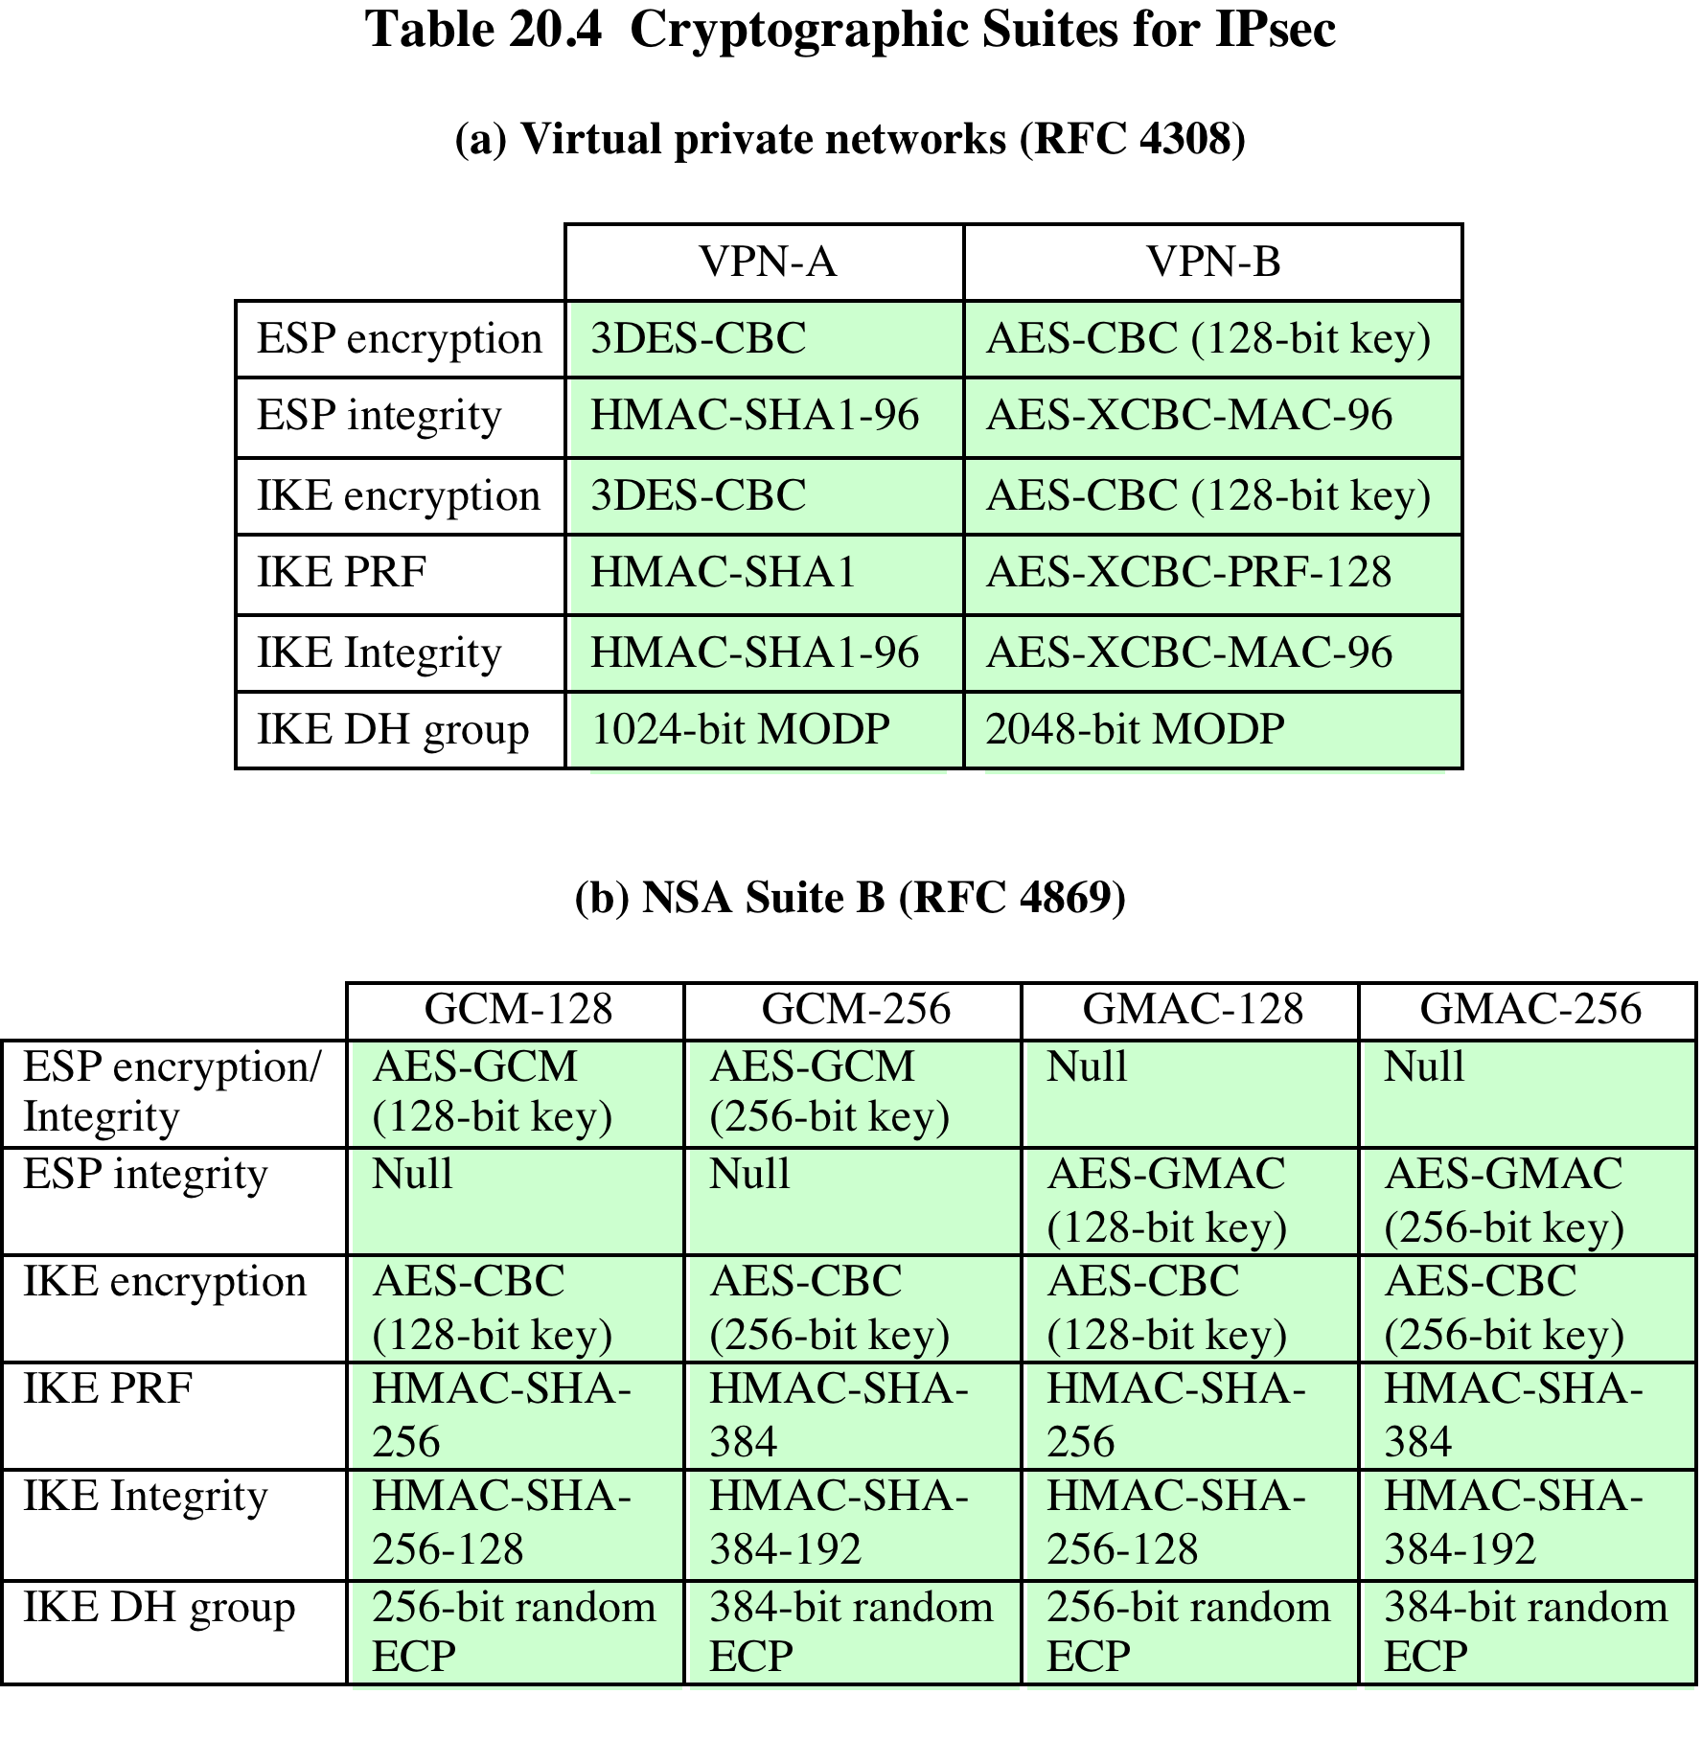
Table 9.4 Cryptographic Suites for IPsec
Notes:
The IPsecv3 and IKEv3 protocols rely on a variety of types of cryptographic algorithms.
As we have seen in this book, there are many cryptographic algorithms of
each type, each with a variety of parameters, such as key size. To promote interoperability,
two RFCs define recommended suites of cryptographic algorithms and
parameters for various applications.
RFC 4308 defines two cryptographic suites for establishing virtual private networks.
Suite VPN-A matches the commonly used corporate VPN security used in
older IKEv1 implementations at the time of the issuance of IKEv2 in 2005. Suite
VPN-B provides stronger security and is recommended for new VPNs that implement
IPsecv3 and IKEv2.
Table 9.4a lists the algorithms and parameters for the two suites. There are
several points to note about these two suites. Note that for symmetric cryptography,
VPN-A relies on 3DES and HMAC, while VPN-B relies exclusively on AES. Three
types of secret-key algorithms are used:
• Encryption: For encryption, the cipher block chaining (CBC) mode is used.
• Message authentication: For message authentication, VPN-A relies on HMAC
with SHA-1 with the output truncated to 96 bits. VPN-B relies on a variant of
CMAC with the output truncated to 96 bits.
• Pseudorandom function: IKEv2 generates pseudorandom bits by repeated
use of the MAC used for message authentication.
RFC 6379 defines four optional cryptographic suites that are compatible with
the United States National Security Agency’s Suite B specifications. In 2005, the
NSA issued Suite B, which defined the algorithms and strengths needed to protect
both sensitive but unclassified (SBU) and classified information for use in
its Cryptographic Modernization program [LATT09]. The four suites defined in
RFC 4869 provide choices for ESP and IKE. The four suites are differentiated by
the choice of cryptographic algorithm strengths and a choice of whether ESP is to
provide both confidentiality and integrity or integrity only. All of the suites offer
greater protection than the two VPN suites defined in RFC 4308.
Table 9.4b lists the algorithms and parameters for the two suites. As with
RFC 4308, three categories of secret key algorithms are listed:
• Encryption: For ESP, authenticated encryption is provided using the GCM
mode with either 128-bit or 256-bit AES keys. For IKE encryption, CBC is
used, as it was for the VPN suites.
• Message authentication: For ESP, if only authentication is required, then
GMAC is used. As discussed in Chapter 12, GMAC is simply the authentication
portion of GMC. For IKE, message authentication is provided using
HMAC with one of the SHA-3 hash functions.
• Pseudorandom function: As with the VPN suites, IKEv2 in these suites generates
pseudorandom bits by repeated use of the MAC used for message
authentication.
For the Diffie-Hellman algorithm, the use of elliptic curve groups modulo
a prime is specified. For authentication, elliptic curve digital signatures are listed.
The original IKEv2 documents used RSA-based digital signatures. Equivalent or
greater strength can be achieved using ECC with fewer key bits.

Slide 117
Summary
IP security overview
Applications of IPsec
Benefits of IPsec
Routing applications
IPsec documents
IPsec services
Transport and tunnel modes
IP security policy
Security associations
Security association database
Security policy database
IP traffic processing
Cryptographic suites
Encapsulating security payload
ESP format
Encryption and authentication algorithms
Padding anti-replay service
Transport and tunnel modes
Combining security associations
Authentication plus confidentiality
Basic combinations of security associations
Internet key exchange
Key determination protocol
Header and payload formats
Notes:
Chapter 9 summary.

Slide 118
Network Security Essentials
Fifth Edition
by William Stallings
Notes:
Lecture slides prepared for “Network Security Essentials”, 5/e, by William Stallings, Chapter 10 – “Malicious Software”.

Slide 119
Chapter 10
Malicious Software
http://informationsecuritycis608.blogspot.co.id/2015/11/week-10malware-attacks-amit.html
Notes:
This chapter examines the wide spectrum of malware threats and countermeasures.
We begin with a survey of various types of malware and offer a broad
classification based first on the means malware uses to spread or propagate , and
then on the variety of actions or payloads used once the malware has reached a
target. Propagation mechanisms include those used by viruses, worms, and trojans.
Payloads include system corruption, bots, phishing, spyware, and rootkits. The discussion
then includes a review of countermeasure approaches. Finally, distributed
denial-of-service (DDoS) attacks are reviewed.

Slide 120
What is the concept of defense: The parrying of a blow. What is its characteristic feature: Awaiting the blow.
—On War, Carl Von Clausewitz
SOUP12a Soup, M. and Scar, K. Guide to Malware Incident Preventiona and Handling for Desktops and Laptops, NIST Special Publication 800-53 (Draft), July 2012.
Notes:
Malicious software, or malware, arguably constitutes one of the most significant categories
of threats to computer systems. [SOUP12a] defines malware as “a program that is
covertly inserted into another program with the intent to destroy data, run destructive
or intrusive programs, or otherwise compromise the confidentiality, integrity, or availability
of the victim’s data, applications, or operating system.” Hence, we are concerned
with the threat malware poses to application programs, to utility programs, such as editors
and compilers, and to kernel-level programs. We are also concerned with its use on
compromised or malicious Web sites and servers, or in especially crafted spam e-mails
or other messages, which aim to trick users into revealing sensitive personal information.

Slide 121
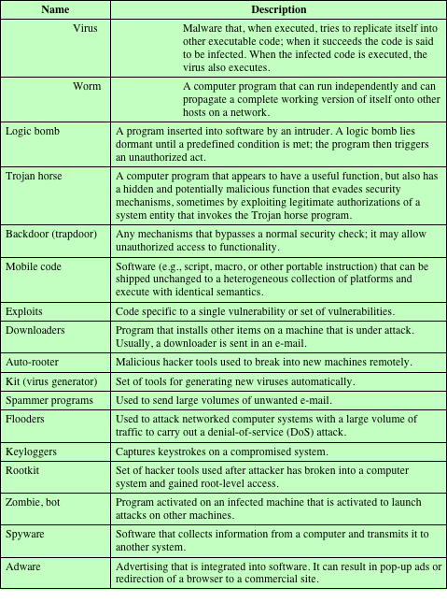
Table 10.1
Terminology for Malicious Software
(This table can be found on page 301 in the textbook.)
Notes:
The terminology in this area presents problems because of a lack of universal agreement
on all of the terms and because some of the categories overlap. Table 10.1 is a
useful guide to some of the terms in use.

Slide 122
A Broad classification of malware
Based first on how it spreads or propagates to reach the desired targets
Then on the actions or payloads it performs once a target is reached
Can be classified into two broad categories:
Propagation mechanisms:
Include infection of existing executable or interpreted content by viruses that is subsequently spread to other system
Exploit of software vulnerabilities either locally or over a network by worms or drive-by-downloads to allow the malware to replicate
Social engineering attacks that convince users to bypass security mechanisms to install trojans or to respond to phishing attacks
Notes:
Although a range of schemes can be used, one useful approach classifies malware
into two broad categories, based first on how it spreads or propagates to reach the
desired targets and then on the actions or payloads it performs once a target is
reached.
Propagation mechanisms include infection of existing executable or interpreted
content by viruses that is subsequently spread to other systems; exploit of software
vulnerabilities either locally or over a network by worms or drive-by-downloads to
allow the malware to replicate; and social engineering attacks that convince users to
bypass security mechanisms to install trojans or to respond to phishing attacks.

Slide 123
Broad classification (continued)
Earlier approaches to malware classification distinguished between:
Those that need a host program, being parasitic code such as viruses
Those that are independent, self-contained programs (no need host programs or they are standalone) run on the system such as worms, or not so independent like trojans, and bots
Another distinction used was:
Malware that does not replicate, such as trojans and spam e-mail
Malware that does, including viruses and worms
Payload actions performed by malware once it reaches a target system can include:
Corruption of system or data files
Theft of service in order to make the system a zombie agent of attack as part of a botnet
Theft of information from the system, especially of logins, passwords, or other personal details by key-logging or spyware programs
Stealthing where the malware hides its presence on the system from attempts to detect and block it
Blended attack
Uses multiple methods of infection or propagation to maximize the speed of contagion and the severity of the attack
Notes:
Earlier approaches to malware classification distinguished between those that
need a host program, being parasitic code such as viruses, and those that are independent,
self-contained programs run on the system such as worms, trojans, and bots. Another distinction used was between malware that does not replicate, such as
trojans and spam e-mail, and malware that does, including viruses and worms.
Payload actions performed by malware once it reaches a target system can
include corruption of system or data files; theft of service in order to make the system
a zombie agent of attack as part of a botnet; theft of information from the
system, especially of logins, passwords, or other personal details by keylogging
or spyware programs; and stealthing where the malware hides its presence on the
system from attempts to detect and block it.
While early malware tended to use a single means of propagation to deliver a
single payload, as it evolved we see a growth of blended malware that incorporates
a range of both propagation mechanisms and payloads that increase its ability to
spread, hide, and perform a range of actions on targets. A blended attack uses multiple
methods of infection or propagation, to maximize the speed of contagion and
the severity of the attack. Some malware even support an update mechanism that
allows it to change the range of propagation and payload mechanisms utilized once
it is deployed.
In the following sections, we survey these various categories of malware, and then follow with a discussion of appropriate countermeasures. Worm is an independent malicious program that need not any host program - even from Cisco (http://www.cisco.com/c/en/us/about/security-center/virus-differences.html) site it says
“worms are standalone software and do not require a host program or human help to propagate. To spread, worms either exploit a vulnerability on the target system or use some kind of social engineering to trick users into executing them. A worm enters a computer through a vulnerability in the system and takes advantage of file-transport or information-transport features on the system, allowing it to travel unaided.”

Slide 124
Attack kits
Initially the development and deployment of malware required considerable technical skill by software authors
This changed with the development of virus-creation toolkits in the early 1990s and more general attack kits in the 2000s
These toolkits are often known as crimeware
Include a variety of propagation mechanisms and payload modules that even novices can combine, select, and deploy
Can easily be customized with the latest discovered vulnerabilities in order to exploit the window of opportunity between the publication of a weakness and the deployment of patches to close it
These kits greatly enlarged the population of attackers able to deploy malware
Notes:
Initially, the development and deployment of malware required considerable technical
skill by software authors. This changed with the development of virus-creation
toolkits in the early 1990s, and then later of more general attack kits in the 2000s,
that greatly assisted in the development and deployment of malware [FOSS10].
These toolkits, often known as crimeware , now include a variety of propagation
mechanisms and payload modules that even novices can combine, select, and deploy.
They can also easily be customized with the latest discovered vulnerabilities in
order to exploit the window of opportunity between the publication of a weakness
and the widespread deployment of patches to close it. These kits greatly enlarged
the population of attackers able to deploy malware. Although the malware created
with such toolkits tends to be less sophisticated than that designed from scratch, the
sheer number of new variants that can be generated by attackers using these toolkits
creates a significant problem for those defending systems against them.
The Zeus crimeware toolkit is a prominent, recent example of such an attack
kit, which was used to generate a wide range of very effective, stealthed malware
that facilitates a range of criminal activities, in particular capturing and exploiting
banking credentials [BINS10].

Slide 125
Attack sources
Another significant malware development over the last couple of decades is the change from attackers being individuals to more organized and dangerous attack sources
These include politically motivated attackers, criminals, organized crime, organizations that sell their services to companies and nations, and national government agencies
This has significantly changed the resources available and motivation behind the rise of malware leading to development of a large underground economy involving the sale of attack kits, access to compromised hosts, and to stolen information
Notes:
Another significant malware development over the last couple of decades is the
change from attackers being individuals, often motivated to demonstrate their
technical competence to their peers, to more organized and dangerous attack
sources. These include politically motivated attackers, criminals, and organized
crime; organizations that sell their services to companies and nations; and national
government agencies. This has significantly changed the resources available and
motivation behind the rise of malware, and indeed has led to development of a
large underground economy involving the sale of attack kits, access to compromised
hosts, and to stolen information.

Slide 126
Viruses
Parasitic software fragments that attach themselves to some existing executable content
Can “infect” other programs or any type of executable content and modify them
The modification includes injecting the original code with a routine to make copies of the virus code, which can then go on to infect other content
One reason viruses dominated the malware scene in earlier years was the lack of user authentication and access controls on personal computer systems
Notes:
A computer virus is a piece of software that can “infect” other programs, or indeed
any type of executable content, by modifying them. The modification includes
injecting the original code with a routine to make copies of the virus code, which can
then go on to infect other content.
A computer virus carries in its instructional code the recipe for making perfect
copies of itself. The typical virus becomes embedded in a program, or carrier of
executable content, on a computer. Then, whenever the infected computer comes
into contact with an uninfected piece of code, a fresh copy of the virus passes into
the new location. Thus, the infection can spread from computer to computer, aided
by unsuspecting users, who exchange these programs or carrier files on disk or USB
stick, or who send them to one another over a network. In a network environment,
the ability to access documents, applications, and system services on other computers
provides a perfect culture for the spread of such viral code.
A virus that attaches to an executable program can do anything that the program
is permitted to do. It executes secretly when the host program is run. Once
the virus code is executing, it can perform any function, such as erasing files and
programs, that is allowed by the privileges of the current user. One reason viruses
dominated the malware scene in earlier years was the lack of user authentication
and access controls on personal computer systems at that time. This enabled a virus
to infect any executable content on the system. The significant quantity of programs
shared on floppy disk also enabled its easy, if somewhat slow, spread. The inclusion
of tighter access controls on modern operating systems significantly hinders the ease
of infection of such traditional, machine-executable code, viruses. This resulted in
the development of macro viruses that exploit the active content supported by some
document types, such as Microsoft Word or Excel files, or Adobe PDF documents.
Such documents are easily modified and shared by users as part of their normal system
use and are not protected by the same access controls as programs. Currently,
a viral mode of infection is typically one of several propagation mechanisms used
by contemporary malware, which may also include worm and Trojan capabilities.

Slide 127
Virus Structure
A computer virus and many contemporary types of malware includes one or more variants of each of these components:
Infection mechanism
The means by which a virus spreads or propagates, enabling it to replicate
Also referred to as the infection vector
Trigger
The event or condition that determines when the payload is activated or delivered
Sometimes known as a logic bomb
Payload
What the virus does, besides spreading
May involve damage or benign but noticeable activity
Notes:
A computer virus, and more generally many contemporary types of malware,
includes one or more variants of each of these components:
• Infection mechanism: The means by which a virus spreads or propagates,
enabling it to replicate. The mechanism is also referred to as the infection vector .
• Trigger: The event or condition that determines when the payload is activated
or delivered, sometimes known as a logic bomb .
• Payload: What the virus does, besides spreading. The payload may involve
damage or benign but noticeable activity.

Slide 128
Virus phases
During its lifetime, a typical virus goes through the following four phases:
Dormant phase
The virus is idle
Will eventually be activated by some event
Not all viruses have this stage
Propagation phase
The virus places a copy of itself onto other programs or into certain system areas on the disk
Triggering phase
The virus is activated to perform the function for which it was intended
Can be caused by a variety of system events
Execution phase
The function is performed
Notes:
During its lifetime, a typical virus goes through the following four phases:
• Dormant phase: The virus is idle. The virus will eventually be activated by
some event, such as a date, the presence of another program or file, or the
capacity of the disk exceeding some limit. Not all viruses have this stage.
• Propagation phase: The virus places a copy of itself into other programs or
into certain system areas on the disk. The copy may not be identical to the
propagating version; viruses often morph to evade detection. Each infected
program will now contain a clone of the virus, which will itself enter a propagation
phase.
• Triggering phase: The virus is activated to perform the function for which it
was intended. As with the dormant phase, the triggering phase can be caused
by a variety of system events, including a count of the number of times that
this copy of the virus has made copies of itself.
• Execution phase: The function is performed. The function may be harmless,
such as a message on the screen, or damaging, such as the destruction of programs
and data files.
Most viruses that infect executable program files carry out their work in a
manner that is specific to a particular operating system and, in some cases, specific
to a particular hardware platform. Thus, they are designed to take advantage of the
details and weaknesses of particular systems. Macro viruses, though, target specific
document types, which are often supported on a variety of systems.

Slide 129
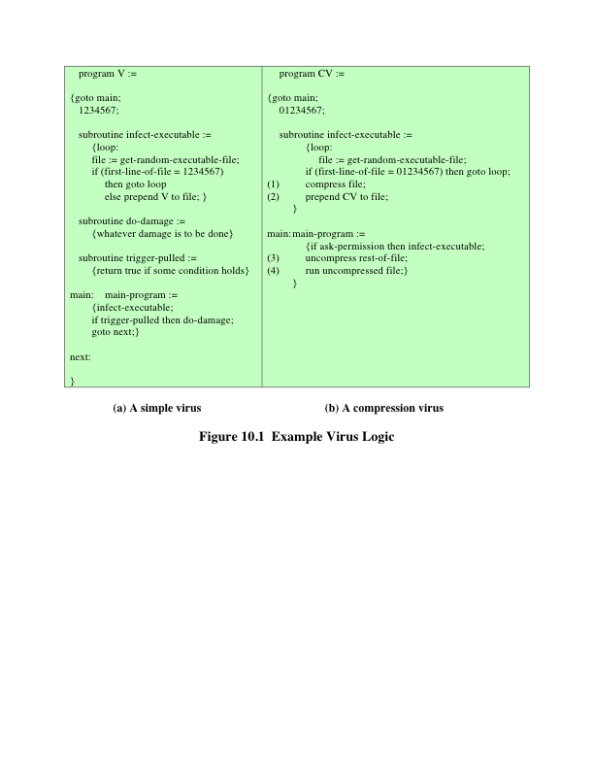
Notes:
Traditional machine-executable virus code can be
prepended or postpended to some executable program, or it can be embedded into
the program in some other fashion. The key to its operation is that the infected program,
when invoked, will first execute the virus code and then execute the original
code of the program.
A very general depiction of virus structure is shown in Figure 10.1a. In this
case, the virus code, V, is prepended to infected programs, and it is assumed that the
entry point to the program, when invoked, is the first line of the program.
The infected program begins with the virus code and works as follows.
The first line of code labels the program, which then begins execution with the
main action block of the virus. The second line is a special marker that is used
by the virus to determine whether or not a potential victim program has already
been infected with this virus. When the program is invoked, control is immediately
transferred to the main virus program. The virus program may first seek
out uninfected executable files and infect them. Next, the virus may execute its
payload if the required trigger conditions, if any, are met. Finally, the virus
transfers control to the original program. If the infection phase of the program
is reasonably rapid, a user is unlikely to notice any difference between the
execution of an infected and an uninfected program.
A virus such as the one just described is easily detected because an infected version
of a program is longer than the corresponding uninfected one. A way to thwart
such a simple means of detecting a virus is to compress the executable file so that
both the infected and uninfected versions are of identical length. Figure 10.1b shows
in general terms the logic required. The key lines in this virus are labeled with times,
and Figure 10.2 illustrates the operation.

Slide 130
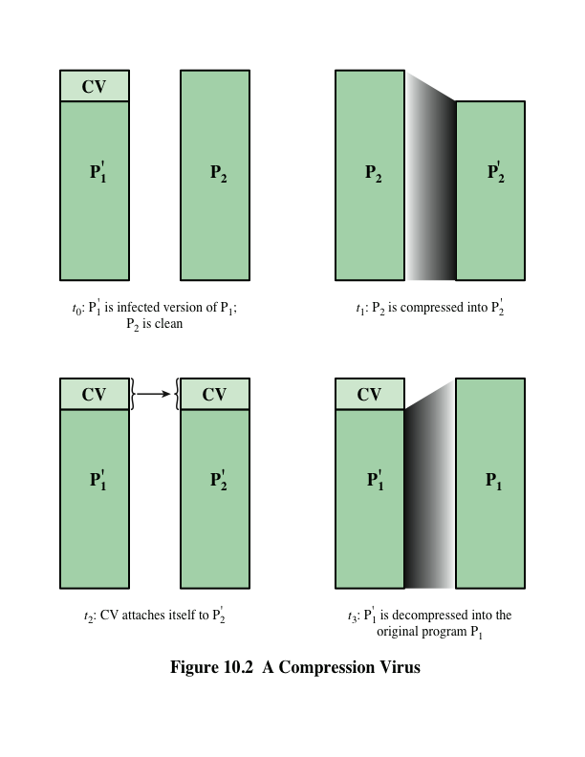
Notes:
Once a virus has gained entry to a system by infecting a single program,
it is in a position to potentially infect some or all other executable files on that
system when the infected program executes, depending on the access permissions
the infected program has. Thus, viral infection can be completely prevented by
blocking the virus from gaining entry in the first place. Unfortunately, prevention
is extraordinarily difficult because a virus can be part of any program outside a
system. Thus, unless one is content to take an absolutely bare piece of iron and
write all one’s own system and application programs, one is vulnerable. Many
forms of infection can also be blocked by denying normal users the right to modify
programs on the system.

Slide 131
Virus Classification by target
Boot sector infector
Infects a master boot record or boot record and spreads when a system is booted from the disk containing the virus
File infector
Infects files that the operating system or shell consider to be executable
Macro virus
Infects files with macro or scripting code that is interpreted by an application
Multipartite virus
Infects files in multiple ways
Includes the following categories:
Notes:
There has been a continuous arms race between virus writers and writers of antivirus
software since viruses first appeared. As effective countermeasures are developed
for existing types of viruses, newer types are developed. There is no simple or
universally agreed-upon classification scheme for viruses. In this section, we follow
[AYCO06] and classify viruses along two orthogonal axes: the type of target the
virus tries to infect and the method the virus uses to conceal itself from detection by
users and antivirus software.
A virus classification by target includes the following categories:
• Boot sector infector: Infects a master boot record or boot record and spreads
when a system is booted from the disk containing the virus.
• File infector: Infects files that the operating system or shell consider to be
executable.
• Macro virus: Infects files with macro or scripting code that is interpreted by an
application.
• Multipartite virus: Infects files in multiple ways. Typically, the multipartite
virus is capable of infecting multiple types of files, so that virus eradication
must deal with all of the possible sites of infection.

Slide 132
Virus classification by concealment strategy
Includes the following categories:
Encrypted virus
Portion of the virus creates a random encryption key and encrypts the remainder of the virus
When an infected program is invoked, the virus uses the stored random key to decrypt the virus
When the virus replicates, a different random key is selected
Because the bulk of the virus is encrypted with a different key for each instance, there is no constant bit pattern to observe
Stealth virus
A form of virus explicitly designed to hide itself from detection by antivirus software
The entire virus, not just a payload is hidden
Polymorphic virus
A virus that mutates with every infection, making detection by the “signature” of the virus impossible
Metamorphic virus
Mutates with every infection
Rewrites itself completely at each iteration, increasing the difficulty of detection
May change their behavior as well as their appearance
Notes:
A virus classification by concealment strategy includes the following categories:
• Encrypted virus: A typical approach is as follows. A portion of the virus creates
a random encryption key and encrypts the remainder of the virus. The
key is stored with the virus. When an infected program is invoked, the virus
uses the stored random key to decrypt the virus. When the virus replicates, a
different random key is selected. Because the bulk of the virus is encrypted
with a different key for each instance, there is no constant bit pattern to
observe.
• Stealth virus: A form of virus explicitly designed to hide itself from detection
by antivirus software. Thus, the entire virus, not just a payload, is hidden.
It may use both code mutation, for example, compression, and rootkit techniques
to achieve this.
• Polymorphic virus: A virus that mutates with every infection, making detection
by the “signature” of the virus impossible.
• Metamorphic virus: As with a polymorphic virus, a metamorphic virus
mutates with every infection. The difference is that a metamorphic virus
rewrites itself completely at each iteration, increasing the difficulty of
detection. Metamorphic viruses may change their behavior as well as their
appearance.
A polymorphic virus creates copies during replication that are functionally equivalent
but have distinctly different bit patterns, in order to defeat programs that
scan for viruses. In this case, the “signature” of the virus will vary with each copy.
To achieve this variation, the virus may randomly insert superfluous instructions
or interchange the order of independent instructions. A more effective approach
is to use encryption. The strategy of the encryption virus is followed. The portion
of the virus that is responsible for generating keys and performing encryption/
decryption is referred to as the mutation engine . The mutation engine itself is
altered with each use.

Slide 133
Macro and scripting viruses
Macro viruses infect scripting code used to support active content in a variety of user document types
Threatening for a number of reasons:
A macro virus is platform independent
Macro viruses infect documents, not executable portions of code
Macro viruses are easily spread, as the documents they exploit are shared in normal use
Because macro viruses infect user documents rather than system programs, traditional file system access controls are of limited use in preventing their spread
Notes:
Macro viruses infect scripting code used to support active content in a variety of user
document types. Macro viruses are particularly threatening for a number of reasons:
1. A macro virus is platform independent. Many macro viruses infect active content
in commonly used applications, such as macros in Microsoft Word documents
or other Microsoft Office documents, or scripting code in Adobe PDF
documents. Any hardware platform and operating system that supports these
applications can be infected.
2. Macro viruses infect documents, not executable portions of code. Most of the
information introduced onto a computer system is in the form of documents
rather than programs.
3. Macro viruses are easily spread, as the documents they exploit are shared in
normal use. A very common method is by electronic mail.
4. Because macro viruses infect user documents rather than system programs,
traditional file system access controls are of limited use in preventing their
spread, since users are expected to modify them.
Macro viruses take advantage of support for active content using a scripting or
macro language, embedded in a word processing document or other type of file.
Typically, users employ macros to automate repetitive tasks and thereby save keystrokes.
They are also used to support dynamic content, form validation, and other
useful tasks associated with these documents.
Successive releases of MS Office products provide increased protection against
macro viruses. For example, Microsoft offers an optional Macro Virus Protection tool
that detects suspicious Word files and alerts the customer to the potential risk of opening
a file with macros. Various antivirus product vendors have also developed tools to
detect and remove macro viruses. As in other types of viruses, the arms race continues
in the field of macro viruses, but they no longer are the predominant virus threat.
Another possible host for macro virus–style malware is in Adobe’s PDF documents.
These can support a range of embedded components, including Javascript
and other types of scripting code. Although recent PDF viewers include measures
to warn users when such code is run, the message the user is shown can be
manipulated to trick them into permitting its execution. If this occurs, the code
could potentially act as a virus to infect other PDF documents the user can access
on his or her system. Alternatively, it can install a Trojan, or act as a worm, as we
discuss later [STEV11].

Slide 134
worms
A program that actively seeks out more machines to infect
Upon activation, the worm may replicate and propagate again
To replicate itself, a worm uses some means to access remote systems:
Electronic mail or instant messenger facility
File sharing
Remote execution capability
Remote file access or transfer capability
Remote login capability
Notes:
A worm is a program that actively seeks out more machines to infect, and then
each infected machine serves as an automated launching pad for attacks on other
machines. Worm programs exploit software vulnerabilities in client or server programs
to gain access to each new system. They can use network connections to spread
from system to system. They can also spread through shared media, such as USB
drives or CD and DVD data disks. E-mail worms spread in macro or script code included
in documents attached to e-mail or to instant messenger file transfers. Upon
activation, the worm may replicate and propagate again. In addition to propagation,
the worm usually carries some form of payload, such as those we discuss later.
To replicate itself, a worm uses some means to access remote systems. These
include the following:
• Electronic mail or instant messenger facility: A worm e-mails a copy of itself
to other systems or sends itself as an attachment via an of instant message
service, so that its code is run when the e-mail or attachment is received or
viewed.
• File sharing: A worm either creates a copy of itself or infects other suitable
files as a virus on removable media such as a USB drive; it then executes when
the drive is connected to another system using the autorun mechanism by
exploiting some software vulnerability or when a user opens the infected file
on the target system.
• Remote execution capability: A worm executes a copy of itself on another
system, either by using an explicit remote execution facility or by exploiting a
program flaw in a network service to subvert its operations.
• Remote file access or transfer capability: A worm uses a remote file access or
transfer service to another system to copy itself from one system to the other,
where users on that system may then execute it.
• Remote login capability: A worm logs onto a remote system as a user and
then uses commands to copy itself from one system to the other, where it then
executes.
The new copy of the worm program is then run on the remote system where,
in addition to any payload functions that it performs on that system, it continues to
propagate.

Slide 135
Worm phases
A worm typically uses the same phases as a computer virus:
Dormant
Propagation
Triggering
Execution
The propagation phase generally performs the following functions:
Search for appropriate access mechanisms to other systems to infect by examining host tables, address books, buddy lists, trusted peers, and other similar repositories of remote system access details
Use the access mechanisms found to transfer a copy of itself to the remote system and cause the copy to be run
Notes:
A worm typically uses the same phases as a computer virus: dormant, propagation,
triggering, and execution. The propagation phase generally performs the
following functions:
• Search for appropriate access mechanisms to other systems to infect by
examining host tables, address books, buddy lists, trusted peers, and other
similar repositories of remote system access details; by scanning possible
target host addresses; or by searching for suitable removable media devices
to use.
• Use the access mechanisms found to transfer a copy of itself to the remote
system and cause the copy to be run.
The worm may also attempt to determine whether a system has previously
been infected before copying itself to the system. In a multiprogramming system,
it can also disguise its presence by naming itself as a system process or using some
other name that may not be noticed by a system operator. More recent worms can
even inject their code into existing processes on the system and run using additional
threads in that process, to further disguise their presence.

Slide 136
Target discovery
Scanning/fingerprinting
The function in the propagation phase for a network worm to search for other systems to infect
Worm network scanning strategies:
Random
Each compromised host probes random addresses in the IP address space, using a different seed
Produces a high volume of Internet traffic, which may cause generalized disruption even before the actual attack is lunched
Hit list
The attacker first compiles a long list of potential vulnerable machines
Once the list is compiled, the attacker begins infecting machines on the list
Each infected machine is provided with a portion of the list to scan
This results in a very short scanning period, which may make it difficult to detect that infection is taking place
Topological
Uses information contained on an infected victim machine to find more hosts to scan
Local subnet
If a host is infected behind a firewall, that host then looks for targets in its own local network
The host uses the subnet address structure to find other hosts that would otherwise be protected by the firewall
Notes:
The first function in the propagation phase for a network worm is for it to search for
other systems to infect, a process known as scanning or fingerprinting . For such worms,
which exploit software vulnerabilities in remotely accessible network services, it must
identify potential systems running the vulnerable service, and then infect them. Then,
typically, the worm code now installed on the infected machines repeats the same
scanning process, until a large distributed network of infected machines is created.
[MIRK04] lists the following types of network address scanning strategies that
such a worm can use:
• Random: Each compromised host probes random addresses in the IP
address space, using a different seed. This technique produces a high volume
of Internet traffic, which may cause generalized disruption even before the
actual attack is launched.
• Hit list: The attacker first compiles a long list of potential vulnerable machines.
This can be a slow process done over a long period to avoid detection that an
attack is underway. Once the list is compiled, the attacker begins infecting
machines on the list. Each infected machine is provided with a portion of the
list to scan. This strategy results in a very short scanning period, which may
make it difficult to detect that infection is taking place.
• Topological: This method uses information contained on an infected victim
machine to find more hosts to scan.
• Local subnet: If a host is infected behind a firewall, that host then looks for
targets in its own local network. The host uses the subnet address structure to
find other hosts that would otherwise be protected by the firewall.

Slide 137
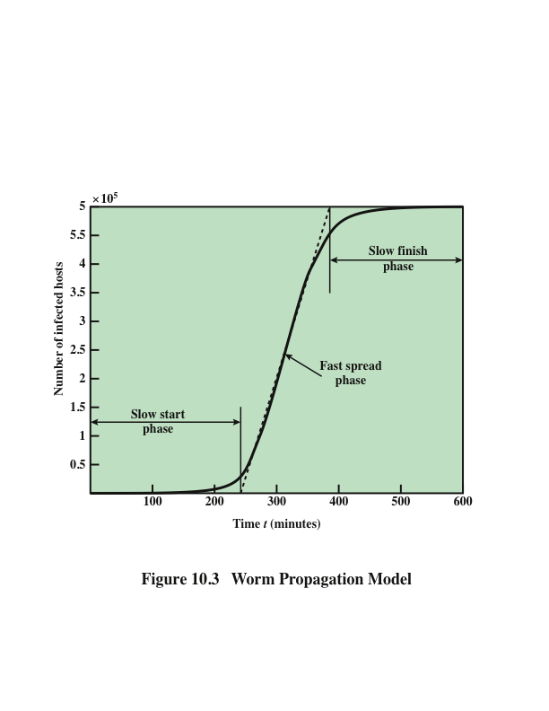
Notes:
A well-designed worm can spread rapidly and infect massive numbers of hosts. It is
useful to have a general model for the rate of worm propagation. Computer viruses
and worms exhibit similar self-replication and propagation behavior to biological
viruses. Thus we can look to classic epidemic models for understanding computer
virus and worm propagation behavior.
Figure 10.3 shows the dynamics of worm propagation.
Propagation proceeds through three phases. In the initial phase, the number of hosts
increases exponentially. To see that this is so, consider a simplified case in which a
worm is launched from a single host and infects two nearby hosts. Each of these
hosts infects two more hosts, and so on. This results in exponential growth. After
a time, infecting hosts waste some time attacking already-infected hosts, which reduces
the rate of infection. During this middle phase, growth is approximately linear,
but the rate of infection is rapid. When most vulnerable computers have been
infected, the attack enters a slow finish phase as the worm seeks out those remaining
hosts that are difficult to identify.
Clearly, the objective in countering a worm is to catch the worm in its slow
start phase, at a time when few hosts have been infected.
Zou and others [ZOU05] describe a model for worm propagation based on
an analysis of network worm attacks at that time. The speed of propagation and
the total number of hosts infected depend on a number of factors, including the
mode of propagation, the vulnerability or vulnerabilities exploited, and the degree
of similarity to preceding attacks. For the latter factor, an attack that is a variation
of a recent previous attack may be countered more effectively than a more novel
attack. Zou's model agrees closely with Figure 10.3.

Slide 138
The morris worm
Released onto the Internet by Robert Morris in 1988
Designed to spread on UNIX systems and used a number of different techniques for propagation
When a copy began execution its first task was to discover other hosts known to this host that would allow entry from this host
For each discovered host, the worm tried a number of methods for gaining access:
It attempted to log on to a remote host as a legitimate user
It exploited a bug in the UNIX finger protocol, which reports the whereabouts of a remote user
It exploited a trapdoor in the debug option of the remote process that receives and sends mail
Notes:
The earliest significant worm infection was released onto the Internet by Robert Morris in 1988 [ORMA03]. The Morris worm was designed to spread on UNIX systems and used a number of different techniques for propagation. When a copy began execution, its first task was to discover other hosts known to this host that would allow entry from this host. The worm performed this task by examining a variety of lists and tables, including system tables that declared which other machines were trusted by this host, users’ mail forwarding files, tables by which users gave themselves permission for access to remote accounts, and from a program that reported the status of network connections. For each discovered host, the worm
tried a number of methods for gaining access:
1. It attempted to log on to a remote host as a legitimate user. In this method,
the worm first attempted to crack the local password file and then used the
discovered passwords and corresponding user IDs. The assumption was that
many users would use the same password on different systems. To obtain the
passwords, the worm ran a password-cracking program that tried
a. Each user’s account name and simple permutations of it
b. A list of 432 built-in passwords that Morris thought to be likely candidates
c. All the words in the local system dictionary
2. It exploited a bug in the UNIX finger protocol, which reports the whereabouts
of a remote user.
3. It exploited a trapdoor in the debug option of the remote process that receives
and sends mail.
If any of these attacks succeeded, the worm achieved communication with the
operating system command interpreter. It then sent this interpreter a short bootstrap
program, issued a command to execute that program, and then logged off.
The bootstrap program then called back the parent program and downloaded the
remainder of the worm. The new worm was then executed.

Slide 139
Worm Technology
Multiplatform
Newer worms can attack a variety of platforms
Multi-exploit
New worms penetrate systems in a variety of ways, using exploits against Web servers, browsers, e-mail, file sharing, and other network-based applications, or via shared media
Ultrafast spreading
Exploit various techniques to optimize the rate of spread of a worm to maximize its likelihood of locating as many vulnerable machines as possible in a short time period
Polymorphic
To evade detection, skip past filters, and foil real-time analysis, each copy of the worm has new code generated on the fly using functionally equivalent instructions and encryption techniques
Metamorphic
In addition to changing their appearance, metamorphic worms have a repertoire of behavior patterns that are unleashed at different stages of propagation
Transport vehicles
Because worms can rapidly compromise a large number of systems, they are ideal for spreading a wide variety of malicious payloads
Zero-day exploit
To achieve maximum surprise and distribution, a worm should exploit an unknown vulnerability that is only discovered by the general network community when the worm is launched
Notes:
The state of the art in worm technology includes the following:
• Multiplatform: Newer worms are not limited to Windows machines but can
attack a variety of platforms, especially the popular varieties of UNIX, or
exploit macro or scripting languages supported in popular document types.
• Multiexploit: New worms penetrate systems in a variety of ways, using
exploits against Web servers, browsers, e-mail, file sharing, and other network-
based applications, or via shared media.
• Ultrafast spreading: Exploit various techniques to optimize the rate of spread
of a worm to maximize its likelihood of locating as many vulnerable machines
as possible in a short time period.
• Polymorphic: To evade detection, skip past filters, and foil real-time analysis,
worms adopt the virus polymorphic technique. Each copy of the worm has
new code generated on the fly using functionally equivalent instructions and
encryption techniques.
• Metamorphic: In addition to changing their appearance, metamorphic worms
have a repertoire of behavior patterns that are unleashed at different stages of
propagation.
• Transport vehicles: Because worms can rapidly compromise a large number
of systems, they are ideal for spreading a wide variety of malicious payloads,
such as distributed denial-of-service bots, rootkits, spam e-mail generators,
and spyware.
• Zero-day exploit: To achieve maximum surprise and distribution, a worm
should exploit an unknown vulnerability that is only discovered by the general
network community when the worm is launched.

Slide 140
Mobile code
Refers to programs that can be shipped unchanged to a heterogeneous collection of platforms and execute with identical semantics
Transmitted from a remote system to a local system and then executed on the local system without the user’s explicit instruction
Often acts as a mechanism for a virus, worm, or Trojan horse to be transmitted to the user’s workstation
Popular vehicles for mobile code include:
The most common ways of using mobile code for malicious operations on local system are:
Cross-site scripting
Interactive and dynamic Web sites
E-mail attachments
Downloads from untrusted sites or of untrusted software
Java applets
ActiveX
JavaScript
VBScript
Notes:
Mobile code refers to programs (e.g., script, macro, or other portable instruction)
that can be shipped unchanged to a heterogeneous collection of platforms and
execute with identical semantics [JANS08].
Mobile code is transmitted from a remote system to a local system and then
executed on the local system without the user’s explicit instruction. Mobile code
often acts as a mechanism for a virus, worm, or Trojan horse to be transmitted to the
user’s workstation. In other cases, mobile code takes advantage of vulnerabilities
to perform its own exploits, such as unauthorized data access or root compromise.
Popular vehicles for mobile code include Java applets, ActiveX, JavaScript, and
VBScript. The most common ways of using mobile code for malicious operations
on local system are cross-site scripting, interactive and dynamic Web sites, e-mail
attachments, and downloads from untrusted sites or of untrusted software.

Slide 141
Drive-by-downloads
Exploits browser vulnerabilities so that when the user views a Web page controlled by the attacker, it contains code that exploits the browser bug to download and install malware on the system without the user’s knowledge or consent
Does not actively propagate as a worm does, but rather waits for unsuspecting users to visit the malicious Web page in order to spread to their systems
Notes:
Another approach to exploiting software vulnerabilities involves the exploit of
bugs in user applications to install malware. One common approach to this exploits
browser vulnerabilities so that when the user views a Web page controlled by the
attacker, it contains code that exploits the browser bug to download and install malware
on the system without the user’s knowledge or consent. This is known as a
drive-by-download and is a common exploit in recent attack kits. In most cases this
malware does not actively propagate as a worm does, but rather waits for unsuspecting
users to visit the malicious Web page in order to spread to their systems.
Related variants can exploit bugs in common e-mail clients, such as the Klez
mass-mailing worm seen in October 2001, which targeted a bug in the HTML handling
in Microsoft’s Outlook and Outlook Express programs to automatically run
itself. Or, such malware may target common PDF viewers to also download and
install malware without the user’s consent, when they view a malicious PDF document
[STEV11]. Such documents may be spread by spam e-mail or be part of a
targeted phishing attack, as we discuss next.

Slide 142
spam
Unsolicited bulk e-mail
Imposes significant costs on both the network infrastructure needed to relay this traffic and on users who need to filter their legitimate e-mails
Most recent spam is sent by botnets using compromised user systems
Is a significant carrier of malware
May be used in a phishing attack
Although a significant security concern, in many cases it requires the user’s active choice to view the e-mail and any attached document or to permit the installation of some program, in order for the compromise to occur
Notes:
Unsolicited bulk e-mail, commonly known as spam, imposes significant costs on
both the network infrastructure needed to relay this traffic and on users who need
to filter their legitimate e-mails out of this flood. In response to the explosive growth
in spam, there has been the equally rapid growth of the antispam industry, which
provides products to detect and filter spam e-mails. This has led to an arms race
between the spammers devising techniques to sneak their content through and the
defenders taking efforts to block them [KREI09].
While some spam is sent from legitimate mail servers, most recent spam is
sent by botnets using compromised user systems, as we discuss in Section 10.6.
A significant portion of spam e-mail content is just advertising, trying to convince
the recipient to purchase some product online, or used in scams, such as stock
scams or money mule job ads. But spam is also a significant carrier of malware.
The e-mail may have an attached document, which, if opened, may exploit a software
vulnerability to install malware on the user’s system, as we discussed in the
previous section. Or, it may have an attached Trojan horse program or scripting
code that, if run, also installs malware on the user’s system. Some trojans avoid the
need for user agreement by exploiting a software vulnerability in order to install
themselves, as we discuss next. Finally the spam may be used in a phishing attack,
typically directing the user either to a fake Web site that mirrors some legitimate
service, such as an online banking site, where it attempts to capture the user’s
login and password details, or to complete some form with sufficient personal details
to allow the attacker to impersonate the user in an identity theft. All of these
uses make spam e-mails a significant security concern. However, in many cases it
requires the user’s active choice to view the e-mail and any attached document or
to permit the installation of some program, in order for the compromise to occur.

Slide 143
Trojan horses
Is a useful, or apparently useful, program or utility containing hidden code that, when invoked, performs some unwanted or harmful function
Can be used to accomplish functions indirectly that the attacker could not accomplish directly
Fit into one of three models:
Continuing to perform the function of the original program but modifying the function to perform malicious activity or to disguise other malicious activity
Performing a malicious function that completely replaces the function of the original program
Continuing to perform the function of the original program and additionally performing a separate malicious activity
Notes:
A Trojan horse is a useful, or apparently useful, program or utility containing hidden
code that, when invoked, performs some unwanted or harmful function.
Trojan horse programs can be used to accomplish functions indirectly that
the attacker could not accomplish directly. For example, to gain access to sensitive,
personal information stored in the files of a user, an attacker could create a Trojan
horse program that, when executed, scans the user’s files for the desired sensitive
information and sends a copy of it to the attacker via a Web form or e-mail or text
message. The author could then entice users to run the program by incorporating it
into a game or useful utility program and making it available via a known software
distribution site or app store. This approach has been used recently with utilities
that “claim” to be the latest antivirus scanner, or security update, for systems, but
which are actually malicious trojans, often carrying payloads such as spyware that
searches for banking credentials. Hence, users need to take precautions to validate
the source of any software they install.
Trojan horses fit into one of three models:
• Continuing to perform the function of the original program and additionally
performing a separate malicious activity
• Continuing to perform the function of the original program but modifying the
function to perform malicious activity (e.g., a Trojan horse version of a login
program that collects passwords) or to disguise other malicious activity (e.g., a
Trojan horse version of a process-listing program that does not display certain
processes that are malicious)
• Performing a malicious function that completely replaces the function of the
original program
Some trojans avoid the requirement for user assistance by exploiting some software
vulnerability to enable their automatic installation and execution. In this
they share some features of a worm, but unlike it, they do not replicate. A prominent
example of such an attack was the Hydraq Trojan used in Operation Aurora
in 2009 and early 2010. This exploited a vulnerability in Internet Explorer to install
itself and targeted several high-profile companies [SYMA11]. It was typically
distributed either by spam e-mail or via a compromised Web site using a
“drive-by-download.”

Slide 144
Payload – system corruption
Once malware is active on the target system, the next concern is what actions it will take on this system
Examples:
Data destruction on the infected system when certain trigger conditions were met
Display unwanted messages or content on the user’s system when triggered
Encrypt the user’s data and demand payment in order to access the key needed to recover this information (ransomware)
Inflict real-world damage on the system
Attempt to rewrite the BIOS code used to initially boot the computer
Target specific industrial control system software
Logic bomb
Code embedded in the malware that is set to “explode” when certain conditions are met
Notes:
Once malware is active on the target system, the next concern is what actions it
will take on this system, that is, what payload does it carry. Some malware has a
nonexistent or nonfunctional payload. Its only purpose, either deliberate or due to
accidental early release, is to spread. More commonly, it carries one or more payloads
that perform covert actions for the attacker.
An early payload seen in a number of viruses and worms resulted in data
destruction on the infected system when certain trigger conditions were met [WEAV03].
A related payload is one that displays unwanted messages or content on the user’s
system when triggered. More seriously, another variant attempts to inflict real-world
damage on the system. All of these actions target the integrity of the computer system’s
software or hardware, or of the user’s data. These changes may not occur immediately,
but only when specific trigger conditions are met that satisfy their logic-bomb code.
As an alternative to just destroying data, some malware encrypts the user’s
data and demands payment in order to access the key needed to recover this information.
This is sometimes known as ransomware . The PC Cyborg Trojan seen in
1989 was an early example of this. However, around mid-2006 a number of worms
and trojans, such as the Gpcode Trojan, that used public-key cryptography with
increasingly larger key sizes to encrypt data. The user needed to pay a ransom or to
make a purchase from certain sites, in order to receive the key to decrypt this data.
While earlier instances used weaker cryptography that could be cracked without
paying the ransom, the later versions using public-key cryptography with large key
sizes could not be broken this way.
Real-World Damage
A further variant of system corruption payloads aims to cause damage to physical
equipment. The infected system is clearly the device most easily targeted. The
Chernobyl virus not only corrupts data, it attempts to rewrite the BIOS code used
to initially boot the computer. If it is successful, the boot process fails, and the system
is unusable until the BIOS chip is either reprogrammed or replaced.
The Stuxnet worm targets some specific industrial control system software as
its key payload [CHEN11]. If control systems using certain Siemens industrial control
software with a specific configuration of devices are infected, then the worm
replaces the original control code with code that deliberately drives the controlled
equipment outside its normal operating range, resulting in the failure of the attached
equipment. The centrifuges used in the Iranian uranium enrichment program were
strongly suspected as the target, with reports of much higher than normal failure
rates observed in them over the period when this worm was active. As noted in our
earlier discussion, this has raised concerns over the use of sophisticated targeted
malware for industrial sabotage.
Logic Bomb
A key component of data-corrupting malware is the logic bomb. The logic bomb is
code embedded in the malware that is set to “explode” when certain conditions are
met. Examples of conditions that can be used as triggers for a logic bomb are the
presence or absence of certain files or devices on the system, a particular day of the
week or date, a particular version or configuration of some software, or a particular
user running the application. Once triggered, a bomb may alter or delete data or
entire files, cause a machine halt, or do some other damage. All of the examples we
describe in this section include such code.

Slide 145
Payload – attack agent
Malware subverts the computational and network resources of the infected system for use by the attacker
Bot (robot), zombie, drone
Secretly takes over another Internet-attached computer and then uses that computer to launch or manage attacks that are difficult to trace to the bot’s creator
A botnet is a collection of bots often capable of acting in a coordinated manner
Notes:
The next category of payload we discuss is where the malware subverts the computational
and network resources of the infected system for use by the attacker. Such a
system is known as a bot (robot), zombie, or drone, and secretly takes over another
Internet-attached computer and then uses that computer to launch or manage attacks
that are difficult to trace to the bot’s creator. The bot is typically planted on hundreds or
thousands of computers belonging to unsuspecting third parties. The collection of bots
often is capable of acting in a coordinated manner; such a collection is referred to as a
botnet . This type of payload attacks the integrity and availability of the infected system.

Slide 146
Uses of bots
Distributed denial-of-service (DDoS) attacks
Spamming
Sniffing traffic
Keylogging
Spreading new malware
Installing advertisement add-ons and browser helper objects (BHOs)
Attacking Internet Relay Chat (IRC) networks
Manipulating online polls/games
Notes:
[HONE05] lists the following uses of bots:
• Distributed denial-of-service (DDoS) attacks: A DDoS attack is an attack on
a computer system or network that causes a loss of service to users. We examine
DDoS attacks in Section 10.10.
• Spamming: With the help of a botnet and thousands of bots, an attacker is able
to send massive amounts of bulk e-mail (spam).
• Sniffing traffic: Bots can also use a packet sniffer to watch for interesting cleartext
data passing by a compromised machine. The sniffers are mostly used to
retrieve sensitive information like usernames and passwords.
• Keylogging: If the compromised machine uses encrypted communication
channels (e.g., HTTPS or POP3S), then just sniffing the network packets on
the victim’s computer is useless because the appropriate key to decrypt the
packets is missing. But by using a keylogger, which captures keystrokes on the
infected machine, an attacker can retrieve sensitive information.
• Spreading new malware: Botnets are used to spread new bots. This is very
easy since all bots implement mechanisms to download and execute a file via
HTTP or FTP. A botnet with 10,000 hosts that acts as the start base for a
worm or mail virus allows very fast spreading and thus causes more harm.
• Installing advertisement add-ons and browser helper objects (BHOs): Botnets
can also be used to gain financial advantages. This works by setting up a fake
Web site with some advertisements: The operator of this Web site negotiates a
deal with some hosting companies that pay for clicks on ads. With the help of
a botnet, these clicks can be “automated” so that instantly a few thousand bots
click on the pop-ups. This process can be further enhanced if the bot hijacks
the start-page of a compromised machine so that the “clicks” are executed
each time the victim uses the browser.
• Attacking IRC chat networks: Botnets are also used for attacks against
Internet Relay Chat (IRC) networks. Popular among attackers is the so-called
clone attack: In this kind of attack, the controller orders each bot to connect
a large number of clones to the victim IRC network. The victim is flooded by
service requests from thousands of bots or thousands of channel-joins by these
cloned bots. In this way, the victim IRC network is brought down, similar to a
DDoS attack.
• Manipulating online polls/games: Online polls/games are getting more and
more attention and it is rather easy to manipulate them with botnets. Since
every bot has a distinct IP address, every vote will have the same credibility as
a vote cast by a real person. Online games can be manipulated in a similar way.

Slide 147
Remote control facility
Distinguishes a bot from a worm
A worm propagates itself and activates itself, whereas a bot is controlled from some central facility
Typical means of implementing is on an IRC server
More recent botnets use covert communication channels via protocols such as HTTP
Distributed control mechanisms, using peer-to-peer protocols, are also used, to avoid a single point of failure
Once a communications path is established between a control module and the bots, the control module can activate the bots
Can also issue update commands that instruct the bots to download a file from some Internet location and execute it
Notes:
The remote control facility is what distinguishes a bot from a worm. A worm propagates
itself and activates itself, whereas a bot is controlled from some central facility,
at least initially.
A typical means of implementing the remote control facility is on an IRC
server. All bots join a specific channel on this server and treat incoming messages
as commands. More recent botnets tend to avoid IRC mechanisms and use covert
communication channels via protocols such as HTTP. Distributed control mechanisms,
using peer-to-peer protocols, are also used, to avoid a single point of failure.
Once a communications path is established between a control module and the
bots, the control module can activate the bots. In its simplest form, the control module
simply issues command to the bot that causes the bot to execute routines that
are already implemented in the bot. For greater flexibility, the control module can
issue update commands that instruct the bots to download a file from some Internet
location and execute it. The bot in this latter case becomes a more general-purpose
tool that can be used for multiple attacks.

Slide 148
Payload – information theft
Keylogger
Captures keystrokes on the infected machine to allow an attacker to monitor user login and password credentials
Spyware
Developed in response to efforts to try and stop keylogging
Subvert the compromised machine to allow monitoring of a wide range of activity on the system which can result in significantly compromising the user’s personal information
Phishing
Exploits social engineering to leverage the user’s trust by masquerading as communication from a trusted source
Spear-phishing
An e-mail claiming to be from a trusted source, however, the recipients are carefully researched by the attacker, and each e-mail is carefully crafted to suit its recipient specifically
Notes:
Typically, users send their login and password credentials to banking, gaming, and
related sites over encrypted communication channels (e.g., HTTPS or POP3S),
which protect them from capture by monitoring network packets. To bypass this,
an attacker can install a keylogger , which captures keystrokes on the infected machine
to allow an attacker to monitor this sensitive information. Since this would
result in the attacker receiving a copy of all text entered on the compromised
machine, keyloggers typically implement some form of filtering mechanism that
only returns information close to desired keywords (e.g., “login” or “password” or
“paypal.com”).
In response to the use of keyloggers, some banking and other sites switched
to using a graphical applet to enter critical information, such as passwords. Since
these do not use text entered via the keyboard, traditional keyloggers do not capture
this information. In response, attackers developed more general spyware payloads,
which subvert the compromised machine to allow monitoring of a wide range
of activity on the system. This may include monitoring the history and content of
browsing activity, redirecting certain Web page requests to fake sites controlled by
the attacker, dynamically modifying data exchanged between the browser and certain
Web sites of interest. All of which can result in significant compromise of the
user’s personal information.
Another approach used to capture a user’s login and password credentials is to
include a URL in a spam e-mail that links to a fake Web site controlled by the
attacker, but which mimics the login page of some banking, gaming, or similar site.
This is normally included in some message suggesting that urgent action is required
by the user to authenticate his or her account, to prevent it being locked. If the user
is careless, and doesn’t realize that he or she is being conned, then following the link
and supplying the requested details will certainly result in the attackers exploiting
the user’s account using the captured credentials.
More generally, such a spam e-mail may direct a user to a fake Web site controlled
by the attacker or to complete some enclosed form and return to an e-mail
accessible to the attacker, which is used to gather a range of private, personal,
information on the user. Given sufficient details, the attacker can then “assume”
the user’s identity for the purpose of obtaining credit or sensitive access to other
resources. This is known as a phishing attack, which exploits social engineering to
leverage user’s trust by masquerading as communications from a trusted source
[GOLD10].
Such general spam e-mails are typically widely distributed to very large numbers
of users, often via a botnet. While the content will not match appropriate
trusted sources for a significant fraction of the recipients, the attackers rely on it
reaching sufficient users of the named trusted source, a gullible portion of whom
will respond, for it to be profitable.
A more dangerous variant of this is the spear-phishing attack. This again is
an e-mail claiming to be from a trusted source. However, the recipients are carefully
researched by the attacker, and each e-mail is carefully crafted to suit its recipient
specifically, often quoting a range of information to convince him or her of
its authenticity. This greatly increases the likelihood of the recipient responding as
desired by the attacker.

Slide 149
Payload – stealthing
Backdoor
Also know as a trapdoor
Is a secret entry point into a program that allows someone who is aware of the backdoor to gain access without going through the usual security access procedures
Code that recognizes some special sequence of input or is triggered by being run from a certain user ID or by an unlikely sequence of events
Usually implemented as a network service listening on some nonstandard port that the attacker can connect to and issue commands through to be run on the compromised system
Notes:
A backdoor , also known as a trapdoor , is a secret entry point into a program that
allows someone who is aware of the backdoor to gain access without going through
the usual security access procedures. The backdoor is code that recognizes some
special sequence of input or is triggered by being run from a certain user ID or by an
unlikely sequence of events.
A backdoor is usually implemented as a network service listening on some
nonstandard port that the attacker can connect to and issue commands through to
be run on the compromised system.
It is difficult to implement operating system controls for backdoors in applications.
Security measures must focus on the program development and software
update activities, and on programs that wish to offer a network service.

Slide 150
Payload – stealthing
Rootkit
A set of programs installed on a system to maintain covert access to that system with administrator (or root) privileges, while hiding evidence of its presence to the greatest extent possible
Alters the host’s standard functionality in a malicious and stealthy way
An attacker has complete control of the system and can add or change programs and files, monitor processes, send and receive network traffic, and get backdoor access on demand
Hides by subverting the mechanisms that monitor and report on the processes, files, and registries on a computer
Notes:
A rootkit is a set of programs installed on a system to maintain covert access to that
system with administrator (or root) privileges, while hiding evidence of its presence
to the greatest extent possible. This provides access to all the functions and
services of the operating system. The rootkit alters the host’s standard functionality
in a malicious and stealthy way. With root access, an attacker has complete control
of the system and can add or change programs and files, monitor processes, send
and receive network traffic, and get backdoor access on demand.
A rootkit can make many changes to a system to hide its existence, making
it difficult for the user to determine that the rootkit is present and to identify
what changes have been made. In essence, a rootkit hides by subverting the
mechanisms that monitor and report on the processes, files, and registries on a
computer.

Slide 151
rootkits
Can be classified using the following characteristics:
Persistent
Activates each time the system boots
Memory based
Has no persistent code and therefore cannot survive a reboot
User mode
Intercepts calls to application program interfaces (APIs) and modifies returned results
Kernel mode
Can intercept calls to native APIs in kernel mode
Virtual machine based
Installs a lightweight virtual machine monitor and then runs the operating system in a virtual machine above it
External mode
Malware is located outside the normal operation mode of the targeted system, in BIOS or system management mode, where it can directly access hardware
Notes:
A rootkit can be classified using the following characteristics:
• Persistent: Activates each time the system boots. The rootkit must store code
in a persistent store, such as the registry or file system, and configure a method
by which the code executes without user intervention. This means it is easier
to detect, as the copy in persistent storage can potentially be scanned.
• Memory based: Has no persistent code and therefore cannot survive a reboot.
However, because it is only in memory, it can be harder to detect.
• User mode: Intercepts calls to APIs (application program interfaces) and
modifies returned results. For example, when an application performs a directory
listing, the return results don’t include entries identifying the files associated
with the rootkit.
• Kernel mode: Can intercept calls to native APIs in kernel mode. The rootkit
can also hide the presence of a malware process by removing it from the kernel’s
list of active processes.
• Virtual machine based: This type of rootkit installs a lightweight virtual
machine monitor and then runs the operating system in a virtual machine
above it. The rootkit can then transparently intercept and modify states and
events occurring in the virtualized system.
• External mode: The malware is located outside the normal operation mode
of the targeted system, in BIOS or system management mode, where it can
directly access hardware.
This classification shows a continuing arms race between rootkit authors, who
exploit ever more stealthy mechanisms to hide their code, and those who develop
mechanisms to harden systems against such subversion or to detect when it has
occurred.

Slide 152
countermeasures
Policy
Awareness
Vulnerability mitigation
Threat mitigation
Elements of prevention:
One of the first countermeasures that should be employed is to ensure all systems are as current as possible, with all patches applied, in order to reduce the number of vulnerabilities that might be exploited on the system
The next is to set appropriate access controls on the applications and data stored on the system, to reduce the number of files that any user can access, and hence potentially infect or corrupt, as a result of them executing some malware code
The third common propagation mechanism, which targets users in a social engineering attack, can be countered using appropriate user awareness and training
Notes:
[SOUP12a] lists four main elements of prevention: policy, awareness, vulnerability
mitigation, and threat mitigation. Having a suitable policy to address malware
prevention provides a basis for implementing appropriate preventative
countermeasures.
One of the first countermeasures that should be employed is to ensure all
systems are as current as possible, with all patches applied, in order to reduce the
number of vulnerabilities that might be exploited on the system. The next is to set
appropriate access controls on the applications and data stored on the system, to
reduce the number of files that any user can access, and hence potentially infect or
corrupt, as a result of them executing some malware code. These measures directly
target the key propagation mechanisms used by worms, viruses, and some trojans.
The third common propagation mechanism, which targets users in a social
engineering attack, can be countered using appropriate user awareness and training.
This aims to equip users to be more aware of these attacks, and less likely to take
actions that result in their compromise. [SOUP12a] provides examples of suitable
awareness issues.

Slide 153
Malware countermeasure approaches
If prevention fails, then technical mechanisms can be used to support the following threat mitigation options:
Detection
Identification
Removal
Requirements for effective malware countermeasures:
Generality
Timeliness
Resiliency
Minimal denial-of-service costs
Transparency
Global and local coverage
Notes:
If prevention fails, then technical mechanisms can be used to support the following
threat mitigation options:
• Detection: Once the infection has occurred, determine that it has occurred
and locate the malware.
• Identification: Once detection has been achieved, identify the specific malware
that has infected the system.
• Removal: Once the specific malware has been identified, remove all traces of
malware virus from all infected systems so that it cannot spread further.
If detection succeeds but either identification or removal is not possible,
then the alternative is to discard any infected or malicious files and reload a clean
backup version. In the case of some particularly nasty infections, this may require a
complete wipe of all storage, and rebuild of the infected system from known clean
media.
To begin, let us consider some requirements for effective malware
countermeasures:
• Generality: The approach taken should be able to handle a wide variety of
attacks.
• Timeliness: The approach should respond quickly so as to limit the number of
infected programs or systems and the consequent activity.
• Resiliency: The approach should be resistant to evasion techniques employed
by attackers to hide the presence of their malware.
• Minimal denial-of-service costs: The approach should result in minimal reduction
in capacity or service due to the actions of the countermeasure software,
and should not significantly disrupt normal operation.
• Transparency: The countermeasure software and devices should not require
modification to existing (legacy) OSs, application software, and hardware.
• Global and local coverage: The approach should be able to deal with attack
sources both from outside and inside the enterprise network.
Achieving all these requirements often requires the use of multiple approaches.
Detection of the presence of malware can occur in a number of locations. It
may occur on the infected system, where some host-based “antivirus” program is
running, monitoring data imported into the system, and the execution and behavior
of programs running on the system. Or, it may take place as part of the perimeter security
mechanisms used in an organization’s firewall and intrusion detection systems
(IDSs). Lastly, detection may use distributed mechanisms that gather data from both
host-based and perimeter sensors, potentially over a large number of networks and
organizations, in order to obtain the largest scale view of the movement of malware.

Slide 154
Host-based scanners
First generation
Simple scanners
Scanner requires a malware signature to identify the malware
Second generation
Heuristic scanners
Uses heuristic rules to search for probable malware instances
Integrity checking
Third generation
Activity traps
Memory-resident programs that identify malware by its actions rather than its structure in an infected program
Fourth generation
Full-feature protection
Packages consisting of a variety of antivirus techniques used in conjunction
Four generations of antivirus software:
Notes:
The first location where antivirus software is used is on each end system. This gives
the software the maximum access to information not only on the behavior of the
malware as it interacts with the targeted system but also on the smallest overall view
of malware activity. The use of antivirus software on personal computers is now
widespread, in part caused by the explosive growth in malware volume and activity.
Advances in virus and other malware technology, and in antivirus technology and
other countermeasures, go hand in hand. Early malware used relatively simple and
easily detected code, and hence could be identified and purged with relatively simple
antivirus software packages. As the malware arms race has evolved, both the
malware code and, necessarily, antivirus software have grown more complex and
sophisticated.
[STEP93] identifies four generations of antivirus software:
• First generation: Simple scanners
• Second generation: Heuristic scanners
• Third generation: Activity traps
• Fourth generation: Full-featured protection
A first-generation scanner requires a malware signature to identify the malware.
The signature may contain “wildcards” but matches essentially the same structure
and bit pattern in all copies of the malware. Such signature-specific scanners are
limited to the detection of known malware. Another type of first-generation scanner
maintains a record of the length of programs and looks for changes in length as a
result of virus infection.
A second-generation scanner does not rely on a specific signature. Rather, the
scanner uses heuristic rules to search for probable malware instances. One class of
such scanners looks for fragments of code that are often associated with malware.
For example, a scanner may look for the beginning of an encryption loop used in a
polymorphic virus and discover the encryption key. Once the key is discovered, the
scanner can decrypt the malware to identify it, and then remove the infection and
return the program to service.
Another second-generation approach is integrity checking. A checksum can
be appended to each program. If malware alters or replaces some program without
changing the checksum, then an integrity check will catch this change. To counter
malware that is sophisticated enough to change the checksum when it alters a program,
an encrypted hash function can be used. The encryption key is stored separately
from the program so that the malware cannot generate a new hash code and
encrypt that. By using a hash function rather than a simpler checksum, the malware
is prevented from adjusting the program to produce the same hash code as before.
If a protected list of programs in trusted locations is kept, this approach can also
detect attempts to replace or install rogue code or programs in these locations.
Third-generation programs are memory-resident programs that identify malware
by its actions rather than its structure in an infected program. Such programs
the advantage that it is not necessary to develop signatures and heuristics for a wide
array of malware. Rather, it is necessary only to identify the small set of actions that
indicate that malicious activity is being attempted and then to intervene.
Fourth-generation products are packages consisting of a variety of antivirus
techniques used in conjunction. These include scanning and activity trap components.
In addition, such a package includes access control capability, which limits
the ability of malware to penetrate a system and then limits the ability of a malware
to update files in order to propagate.
The arms race continues. With fourth-generation packages, a more comprehensive
defense strategy is employed, broadening the scope of defense to more
general-purpose computer security measures. These include more sophisticated
antivirus approaches. We now highlight two of the most important.

Slide 155
Host-based behavior-blocking software
Integrates with the operating system of a host computer and monitors program behavior in real time for malicious actions
The software then blocks potentially malicious actions before they have a chance to affect the system
Can block suspicious software in real time so it has an advantage over antivirus detection techniques such as fingerprinting or heuristics
Limitations:
Because the malicious code must run on the target machine before all its behaviors can be identified, it can cause harm before it has been detected and blocked
Notes:
Unlike heuristics or fingerprint-based
scanners, behavior-blocking software integrates with the operating system of a
host computer and monitors program behavior in real time for malicious actions
[CONR02, NACH02]. The behavior blocking software then blocks potentially malicious
actions before they have a chance to affect the system. Monitored behaviors
can include the following:
• Attempts to open, view, delete, and/or modify files
• Attempts to format disk drives and other unrecoverable disk operations
• Modifications to the logic of executable files or macros
• Modification of critical system settings, such as start-up settings
• Scripting of e-mail and instant messaging clients to send executable content
• Initiation of network communications
Because a behavior blocker can block suspicious software in real time, it has
an advantage over such established antivirus detection techniques as fingerprinting
or heuristics. There are literally trillions of different ways to obfuscate and rearrange
the instructions of a virus or worm, many of which will evade detection by a
fingerprint scanner or heuristic. But eventually, malicious code must make a well defined
request to the operating system. Given that the behavior blocker can intercept
all such requests, it can identify and block malicious actions regardless of how
obfuscated the program logic appears to be.
Behavior blocking alone has limitations. Because the malicious code must
run on the target machine before all its behaviors can be identified, it can cause
harm before it has been detected and blocked. For example, a new item of malware
might shuffle a number of seemingly unimportant files around the hard drive before
modifying a single file and being blocked. Even though the actual modification was
blocked, the user may be unable to locate his or her files, causing a loss to productivity
or possibly having worse consequences.

Slide 156
Perimeter scanning approaches
Antivirus software is used on an organization’s firewall and IDS
Typically included in e-mail and Web proxy services running on these systems
May also be included in the traffic analysis component of an IDS
Two types of monitoring software may be used:
Ingress monitors
Located at the border between the enterprise network and the Internet
They can be part of the ingress-filtering software of a border router or external firewall or a separate passive monitor
Egress monitors
These can be located at the egress point of individual LANs on the enterprise network as well as at the border between the enterprise network and the Internet
Designed to catch the source of a malware attack by monitoring outgoing traffic for signs of scanning or other suspicious behavior
Notes:
The next location where antivirus software is used is on an organization’s firewall
and IDS. It is typically included in e-mail and Web proxy services running on these
systems. It may also be included in the traffic analysis component of an IDS. This
gives the antivirus software access to malware in transit over a network connection
to any of the organization’s systems, providing a larger-scale view of malware activity.
This software may also include intrusion prevention measures, blocking the flow
of any suspicious traffic, thus preventing it reaching and compromising some target
system, either inside or outside the organization.
However, this approach is limited to scanning the malware content, as it does
not have access to any behavior observed when it runs on an infected system. Two
types of monitoring software may be used:
• Ingress monitors: These are located at the border between the enterprise
network and the Internet. They can be part of the ingress-filtering software
of a border router or external firewall or a separate passive monitor.
A honeypot can also capture incoming malware traffic. An example of a detection
technique for an ingress monitor is to look for incoming traffic to unused
local IP addresses.
• Egress monitors: These can be located at the egress point of individual LANs
on the enterprise network as well as at the border between the enterprise network
and the Internet. In the former case, the egress monitor can be part of
the egress-filtering software of a LAN router or switch. As with ingress monitors,
the external firewall or a honeypot can house the monitoring software.
Indeed, the two types of monitors can be collocated. The egress monitor is
designed to catch the source of a malware attack by monitoring outgoing traffic
for signs of scanning or other suspicious behavior.
Perimeter monitoring can also assist in detecting and responding to botnet activity
by detecting abnormal traffic patterns associated with this activity. Once bots
are activated and an attack is underway, such monitoring can be used to detect the
attack. However, the primary objective is to try to detect and disable the botnet
during its construction phase, using the various scanning techniques we have just
discussed, identifying and blocking the malware that is used to propagate this type
of payload.

Slide 157
Perimeter worm countermeasures
Classes of worm defense:
(Class A) Signature-based worm scan filtering
This type of approach generates a worm signature, which is then used to prevent worm scans from entering/leaving a network/host
(Class B) Filter-based worm containment
This approach is similar to class A but focuses on worm content rather than a scan signature
(Class C) Payload-classification-based worm containment
These network-based techniques examine packets to see if they contain a worm
Continued . . .
Notes:
There is considerable overlap in techniques
for dealing with viruses and worms. Once a worm is resident on a machine, antivirus
software can be used to detect it, and possibly remove it. In addition, because
worm propagation generates considerable network activity, perimeter network
activity and usage monitoring can form the basis of a worm defense. Following
[JHI07], we list six classes of worm defense that address the network activity it may
generate:
A. Signature-based worm scan filtering: This type of approach generates a worm
signature, which is then used to prevent worm scans from entering/leaving a
network/host. Typically, this approach involves identifying suspicious flows
and generating a worm signature. This approach is vulnerable to the use of
polymorphic worms: Either the detection software misses the worm or, if it
is sufficiently sophisticated to deal with polymorphic worms, the scheme may
take a long time to react. [NEWS05] is an example of this approach.
B. Filter-based worm containment: This approach is similar to class A but focuses
on worm content rather than a scan signature. The filter checks a message
to determine if it contains worm code. An example is Vigilante [COST05],
which relies on collaborative worm detection at end hosts. This approach can
be quite effective but requires efficient detection algorithms and rapid alert
dissemination.
C. Payload-classification-based worm containment: These network-based techniques
examine packets to see if they contain a worm. Various anomaly detection
techniques can be used, but care is needed to avoid high levels of false
positives or negatives. An example of this approach, which looks for exploit
code in network flows, is reported in [CHIN05]. This approach does not generate
signatures based on byte patterns but rather looks for control and data
flow structures that suggest an exploit.

Slide 158
Perimeter worm countermeasures
(Class D) Threshold random walk (TRW) scan detection
Exploits randomness in picking designations to connect to as a way of detecting if a scanner is in operation
(Class E) Rate limiting
This class limits the rate of scanlike traffic from an infected host
(Class F) Rate halting
This approach immediately blocks outgoing traffic when a threshold is exceeded either in outgoing connection rate or in diversity of connection attempts
Notes:
D. Threshold random walk (TRW) scan detection: TRW exploits randomness
in picking destinations to connect to as a way of detecting if a scanner is in
operation [JUNG04]. TRW is suitable for deployment in high-speed, lowcost
network devices. It is effective against the common behavior seen in
worm scans.
E. Rate limiting: This class limits the rate of scanlike traffic from an infected
host. Various strategies can be used, including limiting the number of new
machines a host can connect to in a window of time, detecting a high connection
failure rate, and limiting the number of unique IP addresses a host can
scan in a window of time. [CHEN04] is an example. This class of countermeasures
may introduce longer delays for normal traffic. This class is also not
suited for slow, stealthy worms that spread slowly to avoid detection based on
activity level.
F. Rate halting: This approach immediately blocks outgoing traffic when a
threshold is exceeded either in outgoing connection rate or in diversity of connection
attempts [JHI07]. The approach must include measures to quickly
unblock mistakenly blocked hosts in a transparent way. Rate halting can
integrate with a signature- or filter-based approach so that once a signature or
filter is generated, every blocked host can be unblocked. Rate halting appears
to offer a very effective countermeasure. As with rate limiting, rate-halting
techniques are not suitable for slow, stealthy worms.

Slide 159
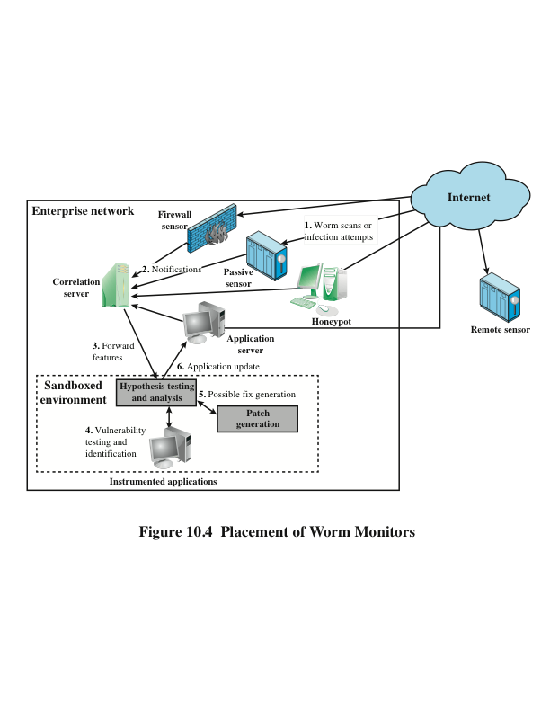
Notes:
The final location where antivirus software is used is in a distributed configuration.
It gathers data from a large number of both host-based and perimeter sensors,
relays this intelligence to a central analysis system able to correlate and analyze
the data, which can then return updated signatures and behavior patterns to
enable all of the coordinated systems to respond and defend against malware attacks.
A number of such systems have been proposed. We discuss one such approach in
the remainder of this section.
Figure 10.4 shows an example of a distributed worm countermeasure architecture
(based on [SIDI05]). The system works as follows (numbers in figure refer to
numbers in the following list):
1. Sensors deployed at various network locations detect a potential worm. The
sensor logic can also be incorporated in IDS sensors.
2. The sensors send alerts to a central server, which correlates and analyzes the
incoming alerts. The correlation server determines the likelihood that a worm
attack is being observed and the key characteristics of the attack.
3. The server forwards its information to a protected environment, where the
potential worm may be sandboxed for analysis and testing.
4. The protected system tests the suspicious software against an appropriately
instrumented version of the targeted application to identify the vulnerability.
5. The protected system generates one or more software patches and tests these.
6. If the patch is not susceptible to the infection and does not compromise the
application’s functionality, the system sends the patch to the application host
to update the targeted application.

Slide 160
Distributed Denial of Service Attacks (DDOS)
Attacks that make computer systems inaccessible by flooding servers, networks, or even end-user systems with useless traffic so that legitimate users can no longer gain access to those resources
One way to classify DDoS attacks is in terms of the type of resources that is consumed
The resource consumed is either an internal host resource on the target system or data transmission capacity in the local network to which the target is attacked
Notes:
A denial-of-service (DoS) attack is an attempt to prevent legitimate users of a
service from using that service. When this attack comes from a single host or network
node, then it is simply referred to as a DoS attack. A more serious threat is
posed by a DDoS attack. DDoS attacks make computer systems inaccessible by
flooding servers, networks, or even end-user systems with useless traffic so that
legitimate users can no longer gain access to those resources. In a typical DDoS
attack, a large number of compromised hosts are amassed to send useless packets.
This section is concerned with DDoS attacks. First, we look at the nature and
types of attacks. Next, we examine methods by which an attacker is able to recruit
a network of hosts for attack launch. Finally, this section looks at countermeasures.
A DDoS attack attempts to consume the target’s resources so that it cannot provide
service. One way to classify DDoS attacks is in terms of the type of resource that
is consumed. Broadly speaking, the resource consumed is either an internal host
resource on the target system or data transmission capacity in the local network to
which the target is attacked.

Slide 161
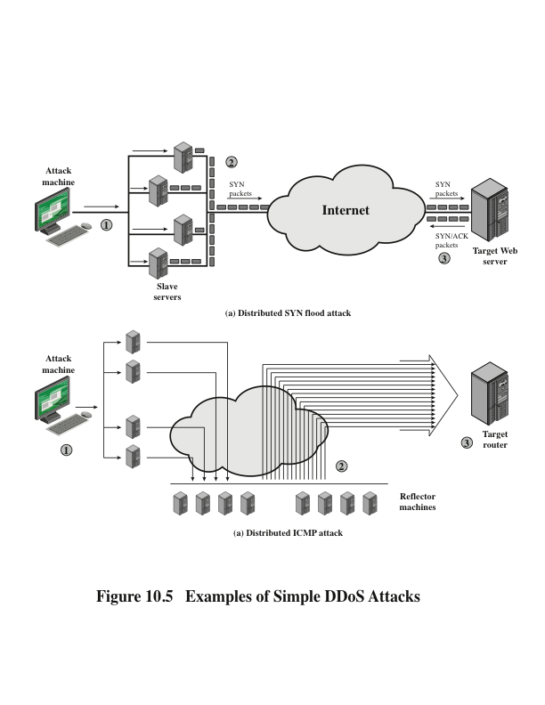
Notes:
A simple example of an internal resource attack is the SYN flood attack.
Figure 10.5a shows the steps involved:
1. The attacker takes control of multiple hosts over the Internet, instructing
them to contact the target Web server.
2. The slave hosts begin sending TCP/IP SYN (synchronize/initialization) packets,
with erroneous return IP address information, to the target.
3. Each SYN packet is a request to open a TCP connection. For each such
packet, the Web server responds with a SYN/ACK (synchronize/acknowledge)
packet, trying to establish a TCP connection with a TCP entity at a
spurious IP address. The Web server maintains a data structure for each SYN
request waiting for a response back and becomes bogged down as more traffic
floods in. The result is that legitimate connections are denied while the victim
machine is waiting to complete bogus “half-open” connections.
The TCP state data structure is a popular internal resource target but by no
means the only one. [CERT01] gives the following examples:
1. An intruder may attempt to use up available data structures that are used by
the OS to manage processes, such as process table entries and process control
information entries. The attack can be quite simple, such as a program that
forks new processes repeatedly.
2. An intruder may attempt to allocate to itself large amounts of disk space
by a variety of straightforward means. These include generating numerous
emails, forcing errors that trigger audit trails, and placing files in shareable
areas.
Figure 10.5b illustrates an example of an attack that consumes data transmission
resources . The following steps are involved:
1. The attacker takes control of multiple hosts over the Internet, instructing
them to send ICMP ECHO packets with the target’s spoofed IP address to a
group of hosts that act as reflectors, as described subsequently.
2. Nodes at the bounce site receive multiple spoofed requests and respond by
sending echo reply packets to the target site.
3. The target’s router is flooded with packets from the bounce site, leaving no
data transmission capacity for legitimate traffic.

Slide 162
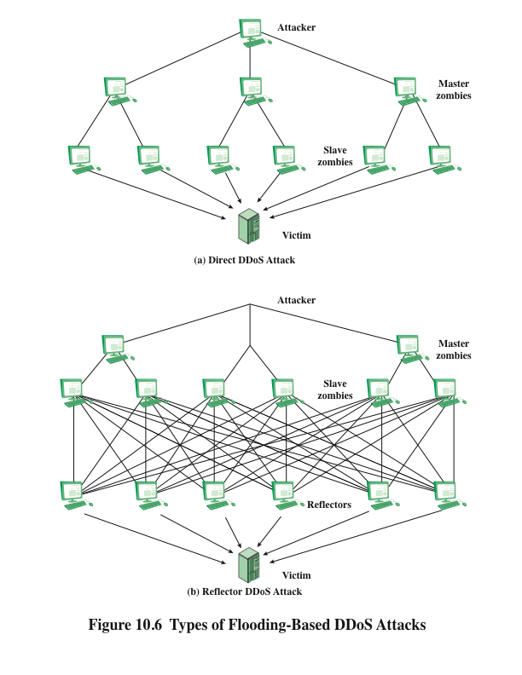
Notes:
Another way to classify DDoS attacks is as either direct or reflector DDoS
attacks. In a direct DDoS attack (Figure 10.6a), the attacker is able to implant zombie
software on a number of sites distributed throughout the Internet. Often, the DDoS
attack involves two levels of zombie machines: master zombies and slave zombies.
The hosts of both machines have been infected with malicious code. The attacker
coordinates and triggers the master zombies, which in turn coordinate and trigger
the slave zombies. The use of two levels of zombies makes it more difficult to trace
the attack back to its source and provides for a more resilient network of attackers.
A reflector DDoS attack adds another layer of machines (Figure 10.6b). In
this type of attack, the slave zombies construct packets requiring a response that
contain the target’s IP address as the source IP address in the packet’s IP header.
These packets are sent to uninfected machines known as reflectors. The uninfected
machines respond with packets directed at the target machine. A reflector DDoS
attack can easily involve more machines and more traffic than a direct DDoS
attack and hence be more damaging. Further, tracing back the attack or filtering out
the attack packets is more difficult because the attack comes from widely dispersed
uninfected machines.

Slide 163
Constructing the Attack Network
The first step in a DDoS attack is for the attacker to infect a number of machines with zombie software that will ultimately be used to carry out the attack
Essential ingredients:
Software that can carry out the DDoS attack
A vulnerability in a large number of systems
A strategy for locating vulnerable machines (scanning)
Scanning strategies:
Random
Each compromised host probes random addresses in the IP address space, using a different seed
Hit list
The attacker first compiles a long list of potential vulnerable machines
Topological
This method uses information contained on an infected victim machine to find more hosts to scan
Local subnet
If a host is infected behind a firewall, that host then looks for targets in its own local network
Notes:
The first step in a DDoS attack is for the attacker to infect a number of machines
with zombie software that will ultimately be used to carry out the attack. The essential
ingredients in this phase of the attack are the following:
1. Software that can carry out the DDoS attack. The software must be able to
run on a large number of machines, must be able to conceal its existence,
must be able to communicate with the attacker or have some sort of timetriggered
mechanism, and must be able to launch the intended attack toward
the target.
2. A vulnerability in a large number of systems. The attacker must become
aware of a vulnerability that many system administrators and individual
users have failed to patch and that enables the attacker to install the zombie
software.
A strategy for locating vulnerable machines, a process known as scanning.
In the scanning process, the attacker first seeks out a number of vulnerable
machines and infects them. Then, typically, the zombie software that is installed in
the infected machines repeats the same scanning process, until a large distributed
network of infected machines is created. [MIRK04] lists the following types of scanning
strategies:
• Random: Each compromised host probes random addresses in the IP
address space, using a different seed. This technique produces a high volume
of Internet traffic, which may cause generalized disruption even before the
actual attack is launched.
• Hit list: The attacker first compiles a long list of potential vulnerable machines.
This can be a slow process done over a long period to avoid detection that an
attack is underway. Once the list is compiled, the attacker begins infecting
machines on the list. Each infected machine is provided with a portion of the
list to scan. This strategy results in a very short scanning period, which may
make it difficult to detect that infection is taking place.
• Topological: This method uses information contained on an infected victim
machine to find more hosts to scan.
• Local subnet: If a host is infected behind a firewall, that host then looks for
targets in its own local network. The host uses the subnet address structure to
find other hosts that would otherwise be protected by the firewall.

Slide 164
DDoS Countermeasures
In general, there are three lines of defense against DDoS attacks:
Attack prevention and preemption (before the attack)
These mechanisms enable the victim to endure attack attempts without denying service to legitimate clients
Attack detection and filtering (during the attack)
These mechanisms attempt to detect the attack as it begins and respond immediately
Attack source traceback and identification (during and after the attack)
This is an attempt to identify the source of the attack as a first step in preventing future attacks
Notes:
In general, there are three lines of defense against DDoS attacks [CHAN02]:
• Attack prevention and preemption (before the attack): These mechanisms
enable the victim to endure attack attempts without denying service to legitimate
clients. Techniques include enforcing policies for resource consumption
and providing backup resources available on demand. In addition, prevention
mechanisms modify systems and protocols on the Internet to reduce the possibility
of DDoS attacks.
• Attack detection and filtering (during the attack): These mechanisms attempt
to detect the attack as it begins and respond immediately. This minimizes the
impact of the attack on the target. Detection involves looking for suspicious
patterns of behavior. Response involves filtering out packets likely to be part
of the attack.
• Attack source traceback and identification (during and after the attack): This
is an attempt to identify the source of the attack as a first step in preventing
future attacks. However, this method typically does not yield results fast
enough, if at all, to mitigate an ongoing attack.
The challenge in coping with DDoS attacks is the sheer number of ways in
which they can operate. Thus, DDoS countermeasures must evolve with the threat.

Slide 165
Summary
Types of malicious software (malware)
Propagation:
Infected content – viruses
Vulnerability exploit – worms
Social engineering – spam e-mail, trojans
Payload:
Attack agent – zombie, bots
Information theft – keyloggers, phishing, spyware
Stealthing – backdoors, rootkits
Countermeasures
DDoS attacks
Notes:
Chapter 10 summary.

Slide 166
Network Security Essentials
Fifth Edition
by William Stallings
Notes:
Lecture slides prepared for “Network Security Essentials”, 5/e, by William Stallings, Chapter 11 – “Intruders”.

Slide 167
Chapter 11
Intruders
Notes:
This chapter covers the subject of intruders. First, we examine the nature of the
attack and then look at strategies intended for prevention and, failing that, detection.
Next we examine the related topic of password management.

Slide 168
They agreed that Graham should set the test for Charles Mabledene. It was neither more nor less than that Dragon should get Stern’s code. If he had the ‘in’ at Utting which he claimed to have this should be possible, only loyalty to Moscow Centre would prevent it. If he got the key to the code he would prove his loyalty to London Central beyond a doubt.
— Talking to Strange Men, Ruth Rendell
Notes:
A significant security problem for networked systems is hostile, or at least unwanted,
trespass by users or software. User trespass can take the form of unauthorized logon
to a machine or, in the case of an authorized user, acquisition of privileges or performance
of actions beyond those that have been authorized. Software trespass can take
the form of a virus, worm, or Trojan horse.
All these attacks relate to network security because system entry can be
achieved by means of a network. However, these attacks are not confined to network-
based attacks. A user with access to a local terminal may attempt trespass
without using an intermediate network. A virus or Trojan horse may be introduced
into a system by means of an optical disc. Only the worm is a uniquely network phenomenon.
Thus, system trespass is an area in which the concerns of network security
and computer security overlap.
Because the focus of this book is network security, we do not attempt
a comprehensive analysis of either the attacks or the security countermeasures
related to system trespass. Instead, in this Part we present a broad overview of
these concerns.

Slide 169
Intruders
Three classes of intruders:
Masquerader
An individual who is not authorized to use the computer and who penetrates a system’s access controls to exploit a legitimate user’s account
Misfeasor
A legitimate user who accesses data, programs, or resources for which such access is not authorized, or who is authorized for such access but misuses his or her privileges
Clandestine user
An individual who seizes supervisory control of the system and uses this control to evade auditing and access controls or to suppress audit collection
Notes:
One of the two most publicized threats to security is the intruder (the other is
viruses), often referred to as a hacker or cracker. In an important early study of
intrusion, Anderson [ANDE80] identified three classes of intruders:
• Masquerader: An individual who is not authorized to use the computer and
who penetrates a system’s access controls to exploit a legitimate user’s account
• Misfeasor: A legitimate user who accesses data, programs, or resources for
which such access is not authorized, or who is authorized for such access but
misuses his or her privileges
• Clandestine user: An individual who seizes supervisory control of the system
and uses this control to evade auditing and access controls or to suppress audit
collection
The masquerader is likely to be an outsider, the misfeasor generally is an insider,
and the clandestine user can be either an outsider or an insider.

Slide 170
Examples of Intrusion
Performing a remote root compromise of an e-mail server
Defacing a Web server
Guessing and cracking passwords
Copying a database containing credit card numbers
Viewing sensitive data, including payroll records and medical information, without authorization
Running a packet sniffer on a workstation to capture usernames and passwords
Using a permission error on an anonymous FTP server to distribute pirated software and music files
Dialing into an unsecured modem and gaining internal network access
Posing as an executive, calling the help desk, resetting the executive’s e-mail password, and learning the new password
Using an unattended, logged-in workstation without permission
Notes:
Intruder attacks range from the benign to the serious. At the benign end of the
scale, there are many people who simply wish to explore internets and see what is
out there. At the serious end are individuals who are attempting to read privileged
data, perform unauthorized modifications to data, or disrupt the system.
[GRAN04] lists the following examples of intrusion:
• Performing a remote root compromise of an e-mail server
• Defacing a Web server
• Guessing and cracking passwords
• Copying a database containing credit card numbers
• Viewing sensitive data, including payroll records and medical information,
without authorization
• Running a packet sniffer on a workstation to capture usernames and passwords
• Using a permission error on an anonymous FTP server to distribute pirated
software and music files
• Dialing into an unsecured modem and gaining internal network access
• Posing as an executive, calling the help desk, resetting the executive’s e-mail
password, and learning the new password
• Using an unattended, logged-in workstation without permission

Slide 171
Hackers
Traditionally, those who hack into computers do so for the thrill of it or for status
Intrusion detection systems (IDSs) and intrusion prevention systems (IPSs) are designed to counter hacker threats
In addition to using such systems, organizations can consider restricting remote logons to specific IP addresses and/or use virtual private network technology
CERTs
Computer emergency response teams
These cooperative ventures collect information about system vulnerabilities and disseminate it to systems managers
Hackers also routinely read CERT reports
It is important for system administrators to quickly insert all software patches to discovered vulnerabilities
Notes:
Traditionally, those who hack into computers do so for the thrill
of it or for status. The hacking community is a strong meritocracy in which status
is determined by level of competence. Thus, attackers often look for targets
of opportunity and then share the information with others. A typical example is a
break-in at a large financial institution reported in [RADC04]. The intruder took
advantage of the fact that the corporate network was running unprotected services,
some of which were not even needed. In this case, the key to the break-in was the
pcAnywhere application. The manufacturer, Symantec, advertises this program as
a remote control solution that enables secure connection to remote devices. But the
attacker had an easy time gaining access to pcAnywhere; the administrator used the
same three-letter username and password for the program. In this case, there was
no intrusion detection system on the 700-node corporate network. The intruder was
only discovered when a vice-president walked into her office and saw the cursor
moving files around on her Windows workstation.
Benign intruders might be tolerable, although they do consume resources and
may slow performance for legitimate users. However, there is no way in advance to
know whether an intruder will be benign or malign. Consequently, even for systems
with no particularly sensitive resources, there is a motivation to control this problem.
Intrusion detection systems (IDSs) and intrusion prevention systems (IPSs)
are designed to counter this type of hacker threat. In addition to using such systems,
organizations can consider restricting remote logons to specific IP addresses and/or
use virtual private network technology.
One of the results of the growing awareness of the intruder problem has been
the establishment of a number of computer emergency response teams (CERTs).
These cooperative ventures collect information about system vulnerabilities and disseminate
it to systems managers. Hackers also routinely read CERT reports. Thus,
it is important for system administrators to quickly insert all software patches to
discovered vulnerabilities. Unfortunately, given the complexity of many IT systems,
and the rate at which patches are released, this is increasingly difficult to achieve
without automated updating. Even then, there are problems caused by incompatibilities
resulting from the updated software. Hence the need for multiple layers of
defense in managing security threats to IT systems.

Slide 172
Criminal hackers
Organized groups of hackers
Usually have specific targets, or at least classes of targets in mind
Once a site is penetrated, the attacker acts quickly, scooping up as much valuable information as possible and exiting
IDSs and IPSs can be used for these types of attackers, but may be less effective because of the quick in-and-out nature of the attack
Notes:
Organized groups of hackers have become a widespread and common
threat to Internet-based systems. These groups can be in the employ of a corporation
or government but often are loosely affiliated gangs of hackers. Typically, these gangs
are young, often Eastern European, Russian, or southeast Asian hackers who do
business on the Web [ANTE06]. They meet in underground forums with names like
DarkMarket.org and theftservices.com to trade tips and data and coordinate attacks.
A common target is a credit card file at an e-commerce server. Attackers attempt to
gain root access. The card numbers are used by organized crime gangs to purchase
expensive items and are then posted to carder sites, where others can access and use
the account numbers; this obscures usage patterns and complicates investigation.
Whereas traditional hackers look for targets of opportunity, criminal hackers
usually have specific targets, or at least classes of targets in mind. Once a site
is penetrated, the attacker acts quickly, scooping up as much valuable information as
possible and exiting.
IDSs and IPSs can also be used for these types of attackers, but may be less
effective because of the quick in-and-out nature of the attack. For e-commerce
sites, database encryption should be used for sensitive customer information, especially
credit cards. For hosted e-commerce sites (provided by an outsider service),
the e-commerce organization should make use of a dedicated server (not used to
support multiple customers) and closely monitor the provider’s security services.

Slide 173
Insider Attacks
Among the most difficult to detect and prevent
Can be motivated by revenge or simply a feeling of entitlement
Countermeasures:
Enforce least privilege, only allowing access to the resources employees need to do their job
Set logs to see what users access and what commands they are entering
Protect sensitive resources with strong authentication
Upon termination, delete employee’s computer and network access
Upon termination, make a mirror image of employee’s hard drive before reissuing it (used as evidence if your company information turns up at a competitor
Notes:
Insider attacks are among the most difficult to detect and prevent.
Employees already have access and knowledge about the structure and content of
corporate databases. Insider attacks can be motivated by revenge or simply a feeling
of entitlement. An example of the former is the case of Kenneth Patterson, fired
from his position as data communications manager for American Eagle Outfitters.
Patterson disabled the company’s ability to process credit card purchases during
five days of the holiday season of 2002. As for a sense of entitlement, there have
always been many employees who felt entitled to take extra office supplies for home
use, but this now extends to corporate data. An example is that of a vice-president
of sales for a stock analysis firm who quit to go to a competitor. Before she left, she
copied the customer database to take with her. The offender reported feeling no
animus toward her former employee; she simply wanted the data because it would
be useful to her.
Although IDS and IPS facilities can be useful in countering insider attacks,
other more direct approaches are of higher priority. Examples include the
following:
• Enforce least privilege, only allowing access to the resources employees need
to do their job.
• Set logs to see what users access and what commands they are entering.
• Protect sensitive resources with strong authentication.
• Upon termination, delete employee’s computer and network access.
• Upon termination, make a mirror image of employee’s hard drive before reissuing
it. That evidence might be needed if your company information turns up
at a competitor.
In this section, we look at the techniques used for intrusion. Then we examine
ways to detect intrusion.

Slide 174
Intrusion Techniques
Objective of the intruder is to gain access to a system or to increase the range of privileges accessible on a system
Most initial attacks use system or software vulnerabilities that allow a user to execute code that opens a backdoor into the system
Ways to protect a password file:
One-way functioning
The system stores only the value of a function based on the user’s password
Access control
Access to the password file is limited to one or a very few accounts
Notes:
The objective of the intruder is to gain access to a system or to increase the range of
privileges accessible on a system. Most initial attacks use system or software vulnerabilities
that allow a user to execute code that opens a backdoor into the system.
Alternatively, the intruder attempts to acquire information that should have been
protected. In some cases, this information is in the form of a user password. With
knowledge of some other user’s password, an intruder can log in to a system and
exercise all the privileges accorded to the legitimate user.
Typically, a system must maintain a file that associates a password with each
authorized user. If such a file is stored with no protection, then it is an easy matter
to gain access to it and learn passwords. The password file can be protected in one
of two ways:
• One-way function: The system stores only the value of a function based on the
user’s password. When the user presents a password, the system transforms
that password and compares it with the stored value. In practice, the system
usually performs a one-way transformation (not reversible), in which the password
is used to generate a key for the one-way function and in which a fixed length
output is produced.
• Access control: Access to the password file is limited to one or a very few
accounts.

Slide 175
Password Guessing
1. Try default passwords used with standard accounts that are shipped with the system. Many administrators do not bother to change these defaults.
2. Exhaustively try all short passwords (those of one to three characters).
3. Try words in the system’s online dictionary or a list of likely passwords.
Examples of the latter are readily available on hacker bulletin boards.
4. Collect information about users, such as their full names, the names of their
spouse and children, pictures in their office, and books in their office that are
related to hobbies.
5. Try users’ phone numbers, Social Security numbers, and room numbers.
6. Try all legitimate license plate numbers for this state.
7. Use a Trojan horse (described in Chapter 10) to bypass restrictions on access.
8. Tap the line between a remote user and the host system.
Notes:
On the basis of a survey of the literature
and interviews with a number of password crackers, [ALVA90] reports the following
techniques for learning passwords:
1. Try default passwords used with standard accounts that are shipped with the
system. Many administrators do not bother to change these defaults.
2. Exhaustively try all short passwords (those of one to three characters).
3. Try words in the system’s online dictionary or a list of likely passwords.
Examples of the latter are readily available on hacker bulletin boards.
4. Collect information about users, such as their full names, the names of their
spouse and children, pictures in their office, and books in their office that are
related to hobbies.
5. Try users’ phone numbers, Social Security numbers, and room numbers.
6. Try all legitimate license plate numbers for this state.
7. Use a Trojan horse (described in Chapter 10) to bypass restrictions on access.
8. Tap the line between a remote user and the host system.
The first six methods are various ways of guessing a password. If an intruder has
to verify the guess by attempting to log in, it is a tedious and easily countered means
of attack. For example, a system can simply reject any login after three password attempts,
thus requiring the intruder to reconnect to the host to try again. Under these
circumstances, it is not practical to try more than a handful of passwords. However,
the intruder is unlikely to try such crude methods. For example, if an intruder can gain
access with a low level of privileges to an encrypted password file, then the strategy
would be to capture that file and then use the encryption mechanism of that particular
system at leisure until a valid password that provided greater privileges was discovered.
Guessing attacks are feasible, and indeed highly effective, when a large number
of guesses can be attempted automatically and each guess verified, without the
guessing process being detectable. Later in this chapter, we have much to say about
thwarting guessing attacks.
The seventh method of attack listed earlier, the Trojan horse, can be particularly
difficult to counter. An example of a program that bypasses access controls has
been cited in [ALVA90]. A low-privilege user produced a game program and invited
the system operator to use it in his or her spare time. The program did indeed play a
game, but in the background it also contained code to copy the password file, which
was unencrypted but access protected, into the user’s file. Because the game was
running under the operator’s high-privilege mode, it was able to gain access to the
password file.
The eighth attack listed, line tapping, is a matter of physical security.
Other intrusion techniques do not require learning a password. Intruders can
get access to a system by exploiting attacks such as buffer overflows on a program
that runs with certain privileges. Privilege escalation can be done this way as well.

Slide 176

Intrusion Detection
A system’s second line of defense
Is based on the assumption that the behavior of the intruder differs from that of a legitimate user in ways that can be quantified
Considerations:
If an intrusion is detected quickly enough, the intruder can be identified and ejected from the system before any damage is done or any data are compromised
An effective intrusion detection system can serve as a deterrent, so acting to prevent intrusions
Intrusion detection enables the collection of information about intrusion techniques that can be used to strengthen the intrusion prevention facility
Notes:
Inevitably, the best intrusion prevention system will fail. A system’s second line
of defense is intrusion detection, and this has been the focus of much research in
recent years. This interest is motivated by a number of considerations, including the
following:
1. If an intrusion is detected quickly enough, the intruder can be identified and
ejected from the system before any damage is done or any data are compromised.
Even if the detection is not sufficiently timely to preempt the intruder,
the sooner that the intrusion is detected, the less the amount of damage and
the more quickly that recovery can be achieved.
2. An effective intrusion detection system can serve as a deterrent, so acting to
prevent intrusions.
3. Intrusion detection enables the collection of information about intrusion techniques
that can be used to strengthen the intrusion prevention facility.
Intrusion detection is based on the assumption that the behavior of the
intruder differs from that of a legitimate user in ways that can be quantified. Of
course, we cannot expect that there will be a crisp, exact distinction between an
attack by an intruder and the normal use of resources by an authorized user. Rather,
we must expect that there will be some overlap.

Slide 177
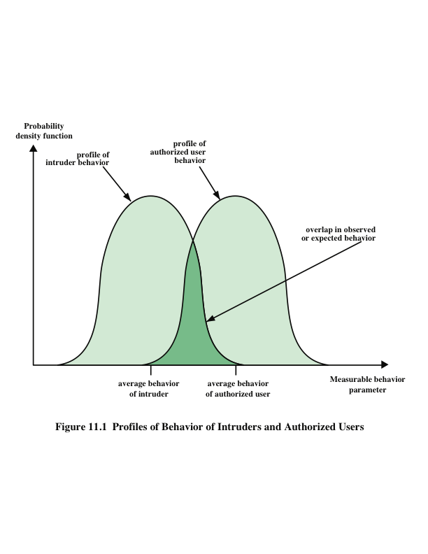
false positives , or authorized users
identified as intruders
Notes:
Figure 11.1 suggests, in very abstract terms, the nature of the task confronting
the designer of an intrusion detection system. Although the typical behavior of an
intruder differs from the typical behavior of an authorized user, there is an overlap
in these behaviors. Thus, a loose interpretation of intruder behavior, which will catch
more intruders, will also lead to a number of false positives , or authorized users
identified as intruders. On the other hand, an attempt to limit false positives by a
tight interpretation of intruder behavior will lead to an increase in false negatives ,
or intruders not identified as intruders. Thus, there is an element of compromise and
art in the practice of intrusion detection.
In Anderson’s study [ANDE80], it was postulated that one could, with reasonable
confidence, distinguish between a masquerader and a legitimate user. Patterns
of legitimate user behavior can be established by observing past history, and significant
deviation from such patterns can be detected. Anderson suggests that the task
of detecting a misfeasor (legitimate user performing in an unauthorized fashion) is
more difficult, in that the distinction between abnormal and normal behavior may
be small. Anderson concluded that such violations would be undetectable solely
through the search for anomalous behavior. However, misfeasor behavior might
nevertheless be detectable by intelligent definition of the class of conditions that
suggest unauthorized use. Finally, the detection of the clandestine user was felt to
be beyond the scope of purely automated techniques. These observations, which
were made in 1980, remain true today.

Slide 178
Approaches to Intrusion Detection
Statistical anomaly detection
Involves the collection of data relating to the behavior of legitimate users over a period of time
Then statistical tests are applied to observed behavior to determine whether that behavior is not legitimate user behavior
Threshold detection
This approach involves defining thresholds, independent of user, for the frequency of occurrence of various events
Profile based
A profile of the activity of each user is developed and used to detect changes in the behavior of individual accounts
Rule-based detection
Involves an attempt to define a set of rules or attack patterns that can be used to decide that a given behavior is that of an intruder
Often referred to as signature detection
Notes:
[PORR92] identifies the following approaches to intrusion detection:
1. Statistical anomaly detection: Involves the collection of data relating to the
behavior of legitimate users over a period of time. Then statistical tests are
applied to observed behavior to determine with a high level of confidence
whether that behavior is not legitimate user behavior.
a. Threshold detection: This approach involves defining thresholds, independent
of user, for the frequency of occurrence of various events.
b. Profile based: A profile of the activity of each user is developed and used to
detect changes in the behavior of individual accounts.
In essence, anomaly approaches attempt to define normal, or expected,
behavior, whereas signature-based approaches attempt to define proper behavior.
In terms of the types of attackers listed earlier, statistical anomaly detection is
effective against masqueraders, who are unlikely to mimic the behavior patterns of
the accounts they appropriate. On the other hand, such techniques may be unable to
deal with misfeasors. For such attacks, rule-based approaches may be able to recognize
events and sequences that, in context, reveal penetration. In practice, a system may exhibit
a combination of both approaches to be effective against a broad range of attacks.

Slide 179
Audit Records
Fundamental tool for intrusion detection
Native audit records
Virtually all multiuser operating systems include accounting software that collects information on user activity
The advantage of using this information is that no additional collection software is needed
The disadvantage is that the native audit records may not contain the needed information or may contain it in a convenient form
Detection-specific audit records
A collection facility can be implemented that generates audit records containing only that information required by the intrusion detection system
One advantage of such an approach is that it could be made vendor independent and ported to a variety of systems
The disadvantage is the extra overhead involved in having two accounting packages running on a machine
Notes:
A fundamental tool for intrusion detection is the audit record. Some record of
ongoing activity by users must be maintained as input to an intrusion detection
system. Basically, two plans are used:
• Native audit records: Virtually all multiuser operating systems include
accounting software that collects information on user activity. The advantage
of using this information is that no additional collection software is needed.
The disadvantage is that the native audit records may not contain the needed
information or may not contain it in a convenient form.
• Detection-specific audit records: A collection facility can be implemented that
generates audit records containing only that information required by the intrusion
detection system. One advantage of such an approach is that it could
be made vendor independent and ported to a variety of systems. The disadvantage
is the extra overhead involved in having, in effect, two accounting
packages running on a machine.

Slide 180
Statistical Anomaly Detection
Threshold detection
Involves counting the number of occurrences of a specific event type over an interval of time
If the count surpasses what is considered a reasonable number that one might expect to occur, then intrusion is assumed
By itself is a crude and ineffective detector of even moderately sophisticated attacks
Profile-based
Focuses on characterizing the past behavior of individual users or related groups of users and then detecting significant deviations
A profile may consist of a set of parameters, so that deviation on just a single parameter may not be sufficient in itself to signal an alert
Notes:
As was mentioned, statistical anomaly detection techniques fall into two broad categories:
threshold detection and profile-based systems. Threshold detection involves
counting the number of occurrences of a specific event type over an interval of
time. If the count surpasses what is considered a reasonable number that one might
expect to occur, then intrusion is assumed.
Threshold analysis, by itself, is a crude and ineffective detector of even moderately
sophisticated attacks. Both the threshold and the time interval must be
determined. Because of the variability across users, such thresholds are likely to
generate either a lot of false positives or a lot of false negatives. However, simple
threshold detectors may be useful in conjunction with more sophisticated
techniques.
Profile-based anomaly detection focuses on characterizing the past behavior
of individual users or related groups of users and then detecting significant deviations.
A profile may consist of a set of parameters, so that deviation on just a single
parameter may not be sufficient in itself to signal an alert.
The foundation of this approach is an analysis of audit records. The audit
records provide input to the intrusion detection function in two ways. First, the
designer must decide on a number of quantitative metrics that can be used to measure
user behavior. An analysis of audit records over a period of time can be used to
determine the activity profile of the average user. Thus, the audit records serve to
define typical behavior. Second, current audit records are the input used to detect
intrusion. That is, the intrusion detection model analyzes incoming audit records to
determine deviation from average behavior.

Slide 181

Table 11.1
Measures That
May
Be
Used
For
Intrusion Detection
(This table can be found on page 348 in the textbook.)
Notes:
As an example of the use of these various metrics and models, Table 11.1
shows various measures considered or tested for the Stanford Research Institute
(SRI) Intrusion Detection System (IDES) [ANDE95, JAVI91] and the follow-on
program Emerald [NEUM99].
The main advantage of the use of statistical profiles is that a prior knowledge
of security flaws is not required. The detector program learns what is “normal” behavior
and then looks for deviations. The approach is not based on system-dependent
characteristics and vulnerabilities. Thus, it should be readily portable among a
variety of systems.

Slide 182
Rule-Based Intrusion Detection
Techniques detect intrusion by observing events in the system and applying a set of rules that lead to a decision regarding whether a given pattern of activity is or is not suspicious
Rule-based anomaly detection (e.g. Snort)
Is similar in terms of its approach and strengths to statistical anomaly detection
Historical audit records are analyzed to identify usage patterns and to automatically generate rules that describe those patterns
Current behavior is then observed, and each transaction is matched against the set of rules to determine if it conforms to any historically observed pattern of behavior
In order for this approach to be effective, a rather large database of rules will be needed
Notes:
Rule-based techniques detect intrusion by observing events in the system and applying
a set of rules that lead to a decision regarding whether a given pattern of activity
is or is not suspicious. In very general terms, we can characterize all approaches as
focusing on either anomaly detection or penetration identification, although there is
some overlap in these approaches.
Rule-based anomaly detection is similar in terms of its approach and strengths
to statistical anomaly detection. With the rule-based approach, historical audit
records are analyzed to identify usage patterns and to automatically generate rules
that describe those patterns. Rules may represent past behavior patterns of users,
programs, privileges, time slots, terminals, and so on. Current behavior is then
observed, and each transaction is matched against the set of rules to determine if it
conforms to any historically observed pattern of behavior.
As with statistical anomaly detection, rule-based anomaly detection does not
require knowledge of security vulnerabilities within the system. Rather, the scheme
is based on observing past behavior and, in effect, assuming that the future will be
like the past. In order for this approach to be effective, a rather large database of
rules will be needed.

Slide 183
Rule-Based Intrusion Detection
Rule-based penetration identification
Typically, the rules used in these systems are specific to the machine and operating system
The most fruitful approach to developing such rules is to analyze attack tools and scripts collected on the Internet
These rules can be supplemented with rules generated by knowledgeable security personnel
USTAT
A model independent of specific audit records
Deals in general actions rather than the detailed specific actions recorded by the UNIX auditing mechanism
Implemented on a SunOS system that provides audit records on 239 events
Notes:
Rule-based penetration identification takes a very different approach to
intrusion detection. The key feature of such systems is the use of rules for identifying
known penetrations or penetrations that would exploit known weaknesses.
Rules can also be defined that identify suspicious behavior, even when the behavior
is within the bounds of established patterns of usage. Typically, the rules
used in these systems are specific to the machine and operating system. The most
fruitful approach to developing such rules is to analyze attack tools and scripts
collected on the Internet. These rules can be supplemented with rules generated
by knowledgeable security personnel. In this latter case, the normal procedure
is to interview system administrators and security analysts to collect a suite of
known penetration scenarios and key events that threaten the security of the
target system.
The penetration identification scheme used in IDES is representative of the
strategy followed. Audit records are examined as they are generated, and they are
matched against the rule base. If a match is found, then the user’s suspicion rating
is increased. If enough rules are matched, then the rating will pass a threshold that
results in the reporting of an anomaly.
The IDES approach is based on an examination of audit records. A weakness
of this plan is its lack of flexibility. For a given penetration scenario, there may
be a number of alternative audit record sequences that could be produced, each
varying from the others slightly or in subtle ways. It may be difficult to pin down
all these variations in explicit rules. Another method is to develop a higher-level
model independent of specific audit records. An example of this is a state transition
model known as USTAT [VIGN02, ILGU95]. USTAT deals in general actions
rather than the detailed specific actions recorded by the UNIX auditing mechanism.
USTAT is implemented on a SunOS system that provides audit records on
239 events. Of these, only 28 are used by a preprocessor, which maps these onto 10
general actions (Table 11.2). Using just these actions and the parameters that are
invoked with each action, a state transition diagram is developed that characterizes
suspicious activity. Because a number of different auditable events map into a
smaller number of actions, the rule-creation process is simpler. Furthermore, the
state transition diagram model is easily modified to accommodate newly learned
intrusion behaviors.

Slide 184

Table 11.2
USTAT Actions versus SunOS Event Types
Notes:
USTAT Actions versus SunOS Event Types

Slide 185
Base-Rate Fallacy
To be of practical use, an intrusion detection system should detect a substantial percentage of intrusions while keeping the false alarm rate at an acceptable level
If only a modest percentage of actual intrusions are detected, the system provides a false sense of security
If the system frequently triggers an alert when there is no intrusion, then either system managers will begin to ignore the alarms or much time will be wasted analyzing the false alarms
Because of the nature of the probabilities involved, it is very difficult to meet the standard of high rate of detections with a low rate of false alarms
If the actual numbers of intrusions is low compared to the number of legitimate uses of a system, then the false alarm rate will be high unless the test is extremely discriminating
See Appendix J for a brief background on the mathematics of this problem
Notes:
To be of practical use, an intrusion detection system should detect a substantial
percentage of intrusions while keeping the false alarm rate at an acceptable
level. If only a modest percentage of actual intrusions are detected, the system
provides a false sense of security. On the other hand, if the system frequently
triggers an alert when there is no intrusion (a false alarm), then either system
managers will begin to ignore the alarms or much time will be wasted analyzing
the false alarms.
Unfortunately, because of the nature of the probabilities involved, it is very difficult
to meet the standard of high rate of detections with a low rate of false alarms.
In general, if the actual numbers of intrusions is low compared to the number of
legitimate uses of a system, then the false alarm rate will be high unless the test is
extremely discriminating. This is an example of a phenomenon known as the base rate
fallacy . A study of existing intrusion detection systems, reported in [AXEL00],
indicated that current systems have not overcome the problem of the base-rate fallacy.
See Appendix J for a brief background on the mathematics of this problem.

Slide 186
Distributed Intrusion Detection
Traditional systems focused on single-system stand-alone facilities
The typical organization, however, needs to defend a distributed collection of hosts supported by a LAN or internetwork
A more effective defense can be achieved by coordination and cooperation among intrusion detection systems across the network
Major design issues:
A distributed intrusion detection system may need to deal with different audit record formats
One or more nodes in the network will serve as collection and analysis points for the data from the systems on the network
Either a centralized or decentralized architecture can be used
Notes:
Traditionally, work on intrusion detection systems focused on single-system standalone
facilities. The typical organization, however, needs to defend a distributed
collection of hosts supported by a LAN or internetwork. Although it is possible to
mount a defense by using stand-alone intrusion detection systems on each host, a
more effective defense can be achieved by coordination and cooperation among
intrusion detection systems across the network.
Porras points out the following major issues in the design of a distributed
intrusion detection system [PORR92]:
• A distributed intrusion detection system may need to deal with different
audit record formats. In a heterogeneous environment, different systems will
employ different native audit collection systems and, if using intrusion
detection, may employ different formats for security-related audit records.
• One or more nodes in the network will serve as collection and analysis points
for the data from the systems on the network. Thus, either raw audit data or
summary data must be transmitted across the network. Therefore, there is a
requirement to assure the integrity and confidentiality of these data. Integrity
is required to prevent an intruder from masking his or her activities by altering
the transmitted audit information. Confidentiality is required because the
transmitted audit information could be valuable.
• Either a centralized or decentralized architecture can be used. With a centralized
architecture, there is a single central point of collection and analysis of all
audit data. This eases the task of correlating incoming reports but creates a
potential bottleneck and single point of failure. With a decentralized architecture,
there are more than one analysis centers, but these must coordinate their
activities and exchange information.

Slide 187

Notes:
A good example of a distributed intrusion detection system is one developed
at the University of California at Davis [HEBE92, SNAP91]. A similar approach
has been taken for a project at Purdue [SPAF00, BALA98]. Figure 11.2 shows the
overall architecture, which consists of three main components:
• Host agent module: An audit collection module operating as a background
process on a monitored system. Its purpose is to collect data on security related
events on the host and transmit these to the central manager.
• LAN monitor agent module: Operates in the same fashion as a host agent
module except that it analyzes LAN traffic and reports the results to the central
manager.
• Central manager module: Receives reports from LAN monitor and host
agents, and processes and correlates these reports to detect intrusion.

Slide 188

Notes:
The scheme is designed to be independent of any operating system or system
auditing implementation. Figure 11.3 shows the general approach that is taken. The
agent captures each audit record produced by the native audit collection system. A
filter is applied that retains only those records that are of security interest. These
records are then reformatted into a standardized format referred to as the host
audit record (HAR). Next, a template-driven logic module analyzes the records for
suspicious activity. At the lowest level, the agent scans for notable events that are
of interest independent of any past events. Examples include failed file accesses,
accessing system files, and changing a file’s access control. At the next higher level,
the agent looks for sequences of events, such as known attack patterns (signatures).
Finally, the agent looks for anomalous behavior of an individual user based on a
historical profile of that user, such as number of programs executed, number of files
accessed, and the like.
When suspicious activity is detected, an alert is sent to the central manager.
The central manager includes an expert system that can draw inferences from
received data. The manager may also query individual systems for copies of HARs
to correlate with those from other agents.
The LAN monitor agent also supplies information to the central manager.
The LAN monitor agent audits host-host connections, services used, and
volume of traffic. It searches for significant events, such as sudden changes in
network load, the use of security-related services, and network activities such
as rlogin .
The architecture depicted in Figures 11.2 and 11.3 is quite general and flexible.
It offers a foundation for a machine-independent approach that can expand from
stand-alone intrusion detection to a system that is able to correlate activity from
a number of sites and networks to detect suspicious activity that would otherwise
remain undetected.

Slide 189
Honeypots
Decoy systems that are designed to lure a potential attacker away from critical systems
Because any attack against the honeypot is made to seem successful, administrators have time to mobilize and log and track the attacker without ever exposing productive systems
Recent research has focused on building entire honeypot networks that emulate an enterprise, possible with actual or simulated traffic and data
Has no production value
These systems are filled with fabricated information designed to appear valuable but that a legitimate user of the system wouldn’t access
Thus, any attempt to communicate with the system is most likely a probe, scan, or attack
Designed to:
Divert an attacker from accessing critical systems
Collect information about the attacker’s activity
Encourage the attacker to stay on the system long enough for administrators to respond
Notes:
A relatively recent innovation in intrusion detection technology is the honeypot.
Honeypots are decoy systems that are designed to lure a potential attacker away
from critical systems. Honeypots are designed to
• divert an attacker from accessing critical systems
• collect information about the attacker’s activity
• encourage the attacker to stay on the system long enough for administrators
to respond
These systems are filled with fabricated information designed to appear valuable
but that a legitimate user of the system wouldn’t access. Thus, any access to
the honeypot is suspect. The system is instrumented with sensitive monitors and
event loggers that detect these accesses and collect information about the attacker’s
activities. Because any attack against the honeypot is made to seem successful,
administrators have time to mobilize and log and track the attacker without ever
exposing productive systems.
The honeypot is a resource that has no production value. There is no legitimate
reason for anyone outside the network to interact with a honeypot. Thus, any
attempt to communicate with the system is most likely a probe, scan, or attack.
Conversely, if a honeypot initiates outbound communication, the system has probably
been compromised.
Initial efforts involved a single honeypot computer with IP addresses designed
to attract hackers. More recent research has focused on building entire honeypot networks
that emulate an enterprise, possibly with actual or simulated traffic and data.
Once hackers are within the network, administrators can observe their behavior
in detail and figure out defenses.

Slide 190

Notes:
Honeypots can be deployed in a variety of locations. Figure 11.4 illustrates
some possibilities. The location depends on a number of factors, such as the type
of information the organization is interested in gathering and the level of risk that
organizations can tolerate to obtain the maximum amount of data.
A honeypot outside the external firewall (location 1 ) is useful for tracking
attempts to connect to unused IP addresses within the scope of the network.
A honeypot at this location does not increase the risk for the internal network. The
danger of having a compromised system behind the firewall is avoided. Further,
because the honeypot attracts many potential attacks, it reduces the alerts issued
by the firewall and by internal IDS sensors, easing the management burden. The
disadvantage of an external honeypot is that it has little or no ability to trap internal
attackers, especially if the external firewall filters traffic in both directions.
The network of externally available services, such as Web and mail, often
called the DMZ (demilitarized zone), is another candidate for locating a honeypot
(location 2 ). The security administrator must assure that the other systems in the
DMZ are secure against any activity generated by the honeypot. A disadvantage of
this location is that a typical DMZ is not fully accessible, and the firewall typically
blocks traffic to the DMZ that attempts to access unneeded services. Thus, the firewall
either has to open up the traffic beyond what is permissible, which is risky, or
limit the effectiveness of the honeypot.
A fully internal honeypot (location 3 ) has several advantages. Its most important
advantage is that it can catch internal attacks. A honeypot at this location can
also detect a misconfigured firewall that forwards impermissible traffic from the
Internet to the internal network. There are several disadvantages. The most serious
of these is if the honeypot is compromised so that it can attack other internal
systems. Any further traffic from the Internet to the attacker is not blocked by the
firewall because it is regarded as traffic to the honeypot only. Another difficulty for
this honeypot location is that, as with location 2, the firewall must adjust its filtering
to allow traffic to the honeypot, thus complicating firewall configuration and potentially
compromising the internal network.

Slide 191
Intrusion detection exchange format
To facilitate the development of distributed intrusion detection systems that can function across a wide range of platforms and environments, standards are needed to support interoperability
IETF Intrusion Detection Working Group
Purpose of the group is to define data formats and exchange procedures for sharing information of interest to intrusion detection with response systems and to management systems that may need to interact with them
Have issued the following RFCs:
Intrusion Detection Message Exchange Requirements (RFC 4766)
The Intrusion Detection Message Exchange Format (RFC 4765)
The Intrusion Detection Exchange Protocol (RFC 4767)
Notes:
To facilitate the development of distributed intrusion detection systems that can
function across a wide range of platforms and environments, standards are needed
to support interoperability. Such standards are the focus of the IETF Intrusion
Detection Working Group. The purpose of the working group is to define data
formats and exchange procedures for sharing information of interest to intrusion
detection and response systems and to management systems that may need to
interact with them.
The working group issued the following RFCs in 2007:
• Intrusion Detection Message Exchange Requirements (RFC 4766): This document
defines requirements for the Intrusion Detection Message Exchange
Format (IDMEF). The document also specifies requirements for a communication
protocol for communicating IDMEF.
• The Intrusion Detection Message Exchange Format (RFC 4765): This document
describes a data model to represent information exported by intrusion
detection systems and explains the rationale for using this model. An implementation
of the data model in the Extensible Markup Language (XML) is
presented, an XML Document Type Definition is developed, and examples
are provided.
• The Intrusion Detection Exchange Protocol (RFC 4767): This document
describes the Intrusion Detection Exchange Protocol (IDXP), an application level
protocol for exchanging data between intrusion detection entities. IDXP
supports mutual authentication, integrity, and confidentiality over a connection-
oriented protocol.

Slide 192

Notes:
Figure 11.5 illustrates the key elements of the model on which the intrusion
detection message exchange approach is based. This model does not correspond
to any particular product or implementation, but its functional components are the
key elements of any IDS. The functional components are as follows:
• Data source: The raw data that an IDS uses to detect unauthorized or undesired
activity. Common data sources include network packets, operating system
audit logs, application audit logs, and system-generated checksum data.
• Sensor: Collects data from the data source. The sensor forwards events to the
analyzer.
Analyzer: The ID component or process that analyzes the data collected by
the sensor for signs of unauthorized or undesired activity or for events that
might be of interest to the security administrator. In many existing IDSs, the
sensor and the analyzer are part of the same component.
• Administrator: The human with overall responsibility for setting the security
policy of the organization, and, thus, for decisions about deploying and configuring
the IDS. This may or may not be the same person as the operator of the
IDS. In some organizations, the administrator is associated with the network or
systems administration groups. In other organizations, it’s an independent
position.
• Manager: The ID component or process from which the operator manages
the various components of the ID system. Management functions typically
include sensor configuration, analyzer configuration, event notification management,
data consolidation, and reporting.
• Operator: The human that is the primary user of the IDS manager. The operator
often monitors the output of the IDS and initiates or recommends further
action.
In this model, intrusion detection proceeds in the following manner. The sensor
monitors data sources looking for suspicious activity , such as network sessions
showing unexpected telnet activity, operating system log file entries showing a user
attempting to access files to which he or she is not authorized to have access, and
application log files showing persistent login failures. The sensor communicates suspicious
activity to the analyzer as an event , which characterizes an activity within a
given period of time. If the analyzer determines that the event is of interest, it sends
an alert to the manager component that contains information about the unusual
activity that was detected, as well as the specifics of the occurrence. The manager
component issues a notification to the human operator. A response can be initiated
automatically by the manager component or by the human operator. Examples of
responses include logging the activity; recording the raw data (from the data source)
that characterized the event; terminating a network, user, or application session; or
altering network or system access controls. The security policy is the predefined, formally
documented statement that defines what activities are allowed to take place
on an organization’s network or on particular hosts to support the organization’s
requirements. This includes, but is not limited to, which hosts are to be denied external
network access.
The specification defines formats for event and alert messages, message types,
and exchange protocols for communication of intrusion detection information.

Slide 193
Password Management
Front line of defense against intruders
Virtually all multiuser systems require that a user provide not only a name or identifier (ID) but also a password
Password serves to authenticate the ID of the individual logging on to the system
The ID provides security by:
Determining whether the user is authorized to gain access to a system
Determining the privileges accorded to the user
Used in discretionary access control
Notes:
The front line of defense against intruders is the password system. Virtually all
multiuser systems require that a user provide not only a name or identifier (ID)
but also a password. The password serves to authenticate the ID of the individual
logging on to the system. In turn, the ID provides security in the following
ways:
• The ID determines whether the user is authorized to gain access to a system.
In some systems, only those who already have an ID filed on the system are
allowed to gain access.
• The ID determines the privileges accorded to the user. A few users may have
supervisory or “superuser” status that enables them to read files and perform
functions that are especially protected by the operating system. Some systems
have guest or anonymous accounts, and users of these accounts have more
limited privileges than others.
• The ID is used in what is referred to as discretionary access control. For
example, by listing the IDs of the other users, a user may grant permission to
them to read files owned by that user.

Slide 194
Attack strategies and countermeasures
Workstation hijacking
The attacker waits until a logged-in workstation is unattended
The standard countermeasure is automatically logging the workstation out after a period of inactivity
Exploiting user mistakes
Attackers are frequently successful in obtaining passwords by using social engineering tactics that trick the user or an account manager into revealing a password; a user may intentionally share a password to enable a colleague to share files; users tend to write passwords down because it is difficult to remember them
Countermeasures include user training, intrusion detection, and simpler passwords combined with another authentication mechanism
Offline dictionary attack
Determined hackers can frequently bypass access controls and gain access to the system’s password file
Countermeasures include controls to prevent unauthorized access to the password file, intrusion detection measures to identify a compromise, and rapid reissuance of passwords should the password file be compromised
Specific account attack
The attacker targets a specific account and submits password guesses until the correct password is discovered
The standard countermeasure is an account lockout mechanism, which locks out access to the account after a number of failed login attempts
Notes:
In this subsection, we outline the main forms of attack against password-based
authentication and briefly outline a countermeasure strategy. The remainder of
Section 11.3 goes into more detail on the key countermeasures.
Typically, a system that uses password-based authentication maintains a
password file indexed by user ID. One technique that is typically used is to store
not the user’s password but a one-way hash function of the password, as described
subsequently.
We can identify the following attack strategies and countermeasures:
• Offline dictionary attack: Typically, strong access controls are used to protect
the system’s password file. However, experience shows that determined
hackers can frequently bypass such controls and gain access to the file. The
attacker obtains the system password file and compares the password hashes
against hashes of commonly used passwords. If a match is found, the attacker
can gain access by that ID/password combination. Countermeasures include
controls to prevent unauthorized access to the password file, intrusion detection
measures to identify a compromise, and rapid reissuance of passwords
should the password file be compromised.
• Specific account attack: The attacker targets a specific account and submits
password guesses until the correct password is discovered. The standard countermeasure
is an account lockout mechanism, which locks out access to the
account after a number of failed login attempts. Typical practice is no more
than five access attempts.
• Workstation hijacking: The attacker waits until a logged-in workstation is
unattended. The standard countermeasure is automatically logging the workstation
out after a period of inactivity. Intrusion detection schemes can be
used to detect changes in user behavior.
• Exploiting user mistakes: If the system assigns a password, then the user is
more likely to write it down because it is difficult to remember. This situation
creates the potential for an adversary to read the written password. A user
may intentionally share a password, to enable a colleague to share files, for
example. Also, attackers are frequently successful in obtaining passwords by
using social engineering tactics that trick the user or an account manager into
revealing a password. Many computer systems are shipped with preconfigured
passwords for system administrators. Unless these preconfigured passwords
are changed, they are easily guessed. Countermeasures include user training,
intrusion detection, and simpler passwords combined with another authentication
mechanism.

Slide 195
Attack strategies and countermeasures
Electronic monitoring
If a password is communicated across a network to log on to a remote system, it is vulnerable to eavesdropping
Simple encryption will not fix this problem, because the encrypted password is, in effect, the password and can be observed and reused by an adversary
Password guessing against single user
The attacker attempts to gain knowledge about the account holder and system password policies and uses that knowledge to guess the password
Countermeasures include training in and enforcement of password policies that make passwords difficult to guess
Exploiting multiple password use
Attacks can become much more effective or damaging if different network devices share the same or a similar password for a given user
Countermeasures include a policy that forbids the same or similar password on particular network devices
Popular password attack
Attack is to use a popular password and try it against a wide range of user IDs
Countermeasures include policies to inhibit the selection by users of common passwords and scanning the IP addresses of authentication requests and client cookies for submission patterns
Notes:
• Exploiting multiple password use: Attacks can also become much more
effective or damaging if different network devices share the same or a similar
password for a given user. Countermeasures include a policy that forbids the
same or similar password on particular network devices.
• Popular password attack: A variation of the preceding attack is to use a popular
password and try it against a wide range of user IDs. A user’s tendency is
to choose a password that is easily remembered; this unfortunately makes the
password easy to guess. Countermeasures include policies to inhibit the selection
by users of common passwords and scanning the IP addresses of authentication
requests and client cookies for submission patterns.
• Electronic monitoring: If a password is communicated across a network to log
on to a remote system, it is vulnerable to eavesdropping. Simple encryption
will not fix this problem, because the encrypted password is, in effect, the password
and can be observed and reused by an adversary.
• Password guessing against single user: The attacker attempts to gain knowledge
about the account holder and system password policies and uses that
knowledge to guess the password. Countermeasures include training in and
enforcement of password policies that make passwords difficult to guess.
Such policies address the secrecy, minimum length of the password, character
set, prohibition against using well-known user identifiers, and length of time
before the password must be changed.

Slide 196

Notes:
A widely used password security technique is the use of hashed passwords and a salt
value. This scheme is found on virtually all UNIX variants as well as on a number
of other operating systems. The following procedure is employed (Figure 11.6a). To
load a new password into the system, the user selects or is assigned a password. This
password is combined with a fixed-length salt value [MORR79]. In older implementations,
this value is related to the time at which the password is assigned to the user.
Newer implementations use a pseudorandom or random number. The password
and salt serve as inputs to a hashing algorithm to produce a fixed-length hash code.
The hash algorithm is designed to be slow to execute to thwart attacks. The hashed
password is then stored, together with a plaintext copy of the salt, in the password
file for the corresponding user ID. The hashed-password method has been shown to
be secure against a variety of cryptanalytic attacks [WAGN00].
When a user attempts to log on to a UNIX system, the user provides an ID
and a password (Figure 11.6b). The operating system uses the ID to index into the
password file and retrieve the plaintext salt and the encrypted password. The salt
and user-supplied password are used as input to the encryption routine. If the result
matches the stored value, the password is accepted.
The salt serves three purposes:
• It prevents duplicate passwords from being visible in the password file. Even
if two users choose the same password, those passwords will be assigned
different salt values. Hence, the hashed passwords of the two users will
differ.
• It greatly increases the difficulty of offline dictionary attacks. For a salt of
length b bits, the number of possible passwords is increased by a factor of 2b ,
increasing the difficulty of guessing a password in a dictionary attack.
• It becomes nearly impossible to find out whether a person with passwords on
two or more systems has used the same password on all of them.
To see the second point, consider the way that an offline dictionary attack
would work. The attacker obtains a copy of the password file. Suppose first that the
salt is not used. The attacker’s goal is to guess a single password. To that end, the
attacker submits a large number of likely passwords to the hashing function. If any
of the guesses matches one of the hashes in the file, then the attacker has found a
password that is in the file. But faced with the UNIX scheme, the attacker must take
each guess and submit it to the hash function once for each salt value in the dictionary
file, multiplying the number of guesses that must be checked.
There are two threats to the UNIX password scheme. First, a user can gain
access on a machine using a guest account or by some other means and then run
a password guessing program, called a password cracker, on that machine. The
attacker should be able to check many thousands of possible passwords with little
resource consumption. In addition, if an opponent is able to obtain a copy of the
password file, then a cracker program can be run on another machine at leisure.
This enables the opponent to run through millions of possible passwords in a reasonable
period.

Slide 197
Unix implementations
Crypt(3)
Was designed to discourage guessing attacks
This particular implementation is now considered inadequate
Despite its known weaknesses, this UNIX scheme is still often required for compatibility with existing account management software or in multivendor environments
MD5 secure hash algorithm
The recommended hash function for many UNIX systems, including Linux, Solaris, and FreeBSD
Far slower than crypt(3)
Bcrypt
Developed for OpenBSD
Probably the most secure version of the UNIX hash/salt scheme
Uses a hash function based on the Blowfish symmetric block cipher
Slow to execute
Includes a cost variable
Notes:
Since the original development of UNIX, most implementations
have relied on the following password scheme. Each user selects a
password of up to eight printable characters in length. This is converted into a
56-bit value (using 7-bit ASCII) that serves as the key input to an encryption routine.
The hash routine, known as crypt(3), is based on DES. A 12-bit salt value is
used. The modified DES algorithm is executed with a data input consisting of a
64-bit block of zeros. The output of the algorithm then serves as input for a second
encryption. This process is repeated for a total of 25 encryptions. The resulting
64-bit output is then translated into an 11-character sequence. The modification of
the DES algorithm converts it into a one-way hash function. The crypt(3) routine
is designed to discourage guessing attacks. Software implementations of DES are
slow compared to hardware versions, and the use of 25 iterations multiplies the
time required by 25.
This particular implementation is now considered woefully inadequate. For
example, [PERR03] reports the results of a dictionary attack using a supercomputer.
The attack was able to process over 50 million password guesses in about 80 minutes.
Further, the results showed that for about $10,000 anyone should be able to
do the same in a few months using one uniprocessor machine. Despite its known
weaknesses, this UNIX scheme is still often required for compatibility with existing
account management software or in multivendor environments.
There are other, much stronger, hash/salt schemes available for UNIX. The
recommended hash function for many UNIX systems, including Linux, Solaris, and
FreeBSD (a widely used open source UNIX implementation), is based on the MD5
secure hash algorithm (which is similar to, but not as secure as SHA-1). The MD5
crypt routine uses a salt of up to 48 bits and effectively has no limitations on password
length. It produces a 128-bit hash value. It is also far slower than crypt(3). To
achieve the slowdown, MD5 crypt uses an inner loop with 1000 iterations.
Probably the most secure version of the UNIX hash/salt scheme was developed
for OpenBSD, another widely used open source UNIX. This scheme, reported
in [PROV99], uses a hash function based on the Blowfish symmetric block cipher.
The hash function, called Bcrypt, is quite slow to execute. Bcrypt allows passwords
of up to 55 characters in length and requires a random salt value of 128 bits, to
produce a 192-bit hash value. Bcrypt also includes a cost variable; an increase in
the cost variable causes a corresponding increase in the time required to perform a
Bcyrpt hash. The cost assigned to a new password is configurable, so that administrators
can assign a higher cost to privileged users.

Slide 198

Table 11.3
Observed Password Lengths [SPAF92a]
http://codereview.stackexchange.com/questions/38474/brute-force-algorithm-in-c
Notes:
Even the stupendous guessing rates referenced in the preceding section do not
yet make it feasible for an attacker to use a dumb brute-force technique of trying
all possible combinations of characters to discover a password. Instead, password
crackers rely on the fact that some people choose easily guessable passwords.
http://www.howtogeek.com/166832/brute-force-attacks-explained-how-all-encryption-is-vulnerable/
Some users, when permitted to choose their own password, pick one that is
absurdly short. The results of one study at Purdue University are shown in
Table 11.3. The study observed password change choices on 54 machines, representing
approximately 7000 user accounts. Almost 3% of the passwords were three
characters or fewer in length. An attacker could begin the attack by exhaustively
testing all possible passwords of length 3 or fewer. A simple remedy is for the
system to reject any password choice of fewer than, say, six characters or even to
require that all passwords be exactly eight characters in length. Most users would
not complain about such a restriction.
Password length is only part of the problem. Many people, when permitted
to choose their own password, pick a password that is guessable, such as their
own name, their street name, a common dictionary word, and so forth. This makes
the job of password cracking straightforward. The cracker simply has to test the
password file against lists of likely passwords. Because many people use guessable
passwords, such a strategy should succeed on virtually all systems.

Slide 199

Table 11.4
Passwords Cracked from a Sample Set of 13,797 Accounts [KLEI90]
* Computed as the number of matches divided by the search size. The more words that needed to be tested for a match, the lower the cost/benefit ratio.
(This table can be found on page 364 in the textbook.)
Notes:
One demonstration of the effectiveness of guessing is reported in [KLEI90].
From a variety of sources, the author collected UNIX password files, containing
nearly 14,000 encrypted passwords. The result, which the author rightly characterizes
as frightening, is shown in Table 11.4. In all, nearly one-fourth of the passwords
were guessed. The following strategy was used:
1. Try the user’s name, initials, account name, and other relevant personal information.
In all, 130 different permutations for each user were tried.
2. Try words from various dictionaries. The author compiled a dictionary of over
60,000 words, including the online dictionary on the system itself, and various
other lists as shown.
3. Try various permutations on the words from step 2. This included making the
first letter uppercase or a control character, making the entire word uppercase,
reversing the word, changing the letter “o” to the digit “zero,” and so on. These
permutations added another 1 million words to the list.
4. Try various capitalization permutations on the words from step 2 that
were not considered in step 3. This added almost 2 million additional words
to the list.
Thus, the test involved in the neighborhood of 3 million words. Using the fastest
Thinking Machines implementation listed earlier, the time to encrypt all these
words for all possible salt values is under an hour. Keep in mind that such a thorough
search could produce a success rate of about 25%, whereas even a single hit
may be enough to gain a wide range of privileges on a system.

Slide 200
Password selection strategies
The goal is to eliminate guessable passwords while allowing the user to select a password that is memorable
Four basic techniques are in use:
User education
Users can be told the importance of using hard-to-guess passwords and can be provided with guidelines for selecting strong passwords
Computer-generated passwords
Computer-generated password schemes have a history of poor acceptance by users
Users have difficulty remembering them
Reactive password checking
A strategy in which the system periodically runs its own password cracker to find guessable passwords
Proactive password checking
A user is allowed to select his or her own password, however, at the time of selection, the system checks to see if the password is allowable and, if not, rejects it
Notes:
The lesson from the two experiments just described (Tables 11.3 and 11.4) is that,
left to their own devices, many users choose a password that is too short or too easy
to guess. At the other extreme, if users are assigned passwords consisting of eight
randomly selected printable characters, password cracking is effectively impossible.
But it would be almost as impossible for most users to remember their passwords.
Fortunately, even if we limit the password universe to strings of characters that are
reasonably memorable, the size of the universe is still too large to permit practical
cracking. Our goal, then, is to eliminate guessable passwords while allowing the user
to select a password that is memorable. Four basic techniques are in use:
• User education
• Computer-generated passwords
• Reactive password checking
• Proactive password checking
Users can be told the importance of using hard-to-guess passwords and can be
provided with guidelines for selecting strong passwords. This user education strategy
is unlikely to succeed at most installations, particularly where there is a large
user population or a lot of turnover. Many users will simply ignore the guidelines.
Others may not be good judges of what is a strong password. For example, many
users (mistakenly) believe that reversing a word or capitalizing the last letter makes
a password unguessable.
Computer-generated passwords also have problems. If the passwords are
quite random in nature, users will not be able to remember them. Even if the password
is pronounceable, the user may have difficulty remembering it and so be
tempted to write it down. In general, computer-generated password schemes have a
history of poor acceptance by users. FIPS PUB 181 defines one of the best-designed
automated password generators. The standard includes not only a description of
the approach but also a complete listing of the C source code of the algorithm. The
algorithm generates words by forming pronounceable syllables and concatenating
them to form a word. A random number generator produces a random stream of
characters used to construct the syllables and words.
A reactive password checking strategy is one in which the system periodically
runs its own password cracker to find guessable passwords. The system cancels
any passwords that are guessed and notifies the user. This tactic has a number of
drawbacks. First, it is resource intensive if the job is done right. Because a determined
opponent who is able to steal a password file can devote full CPU time to the
task for hours or even days, an effective reactive password checker is at a distinct
disadvantage. Furthermore, any existing passwords remain vulnerable until the
reactive password checker finds them.
The most promising approach to improved password security is a proactive
password checker . In this scheme, a user is allowed to select his or her own password.
However, at the time of selection, the system checks to see if the password
is allowable and, if not, rejects it. Such checkers are based on the philosophy that,
with sufficient guidance from the system, users can select memorable passwords
from a fairly large password space that are not likely to be guessed in a dictionary
attack.
The trick with a proactive password checker is to strike a balance between
user acceptability and strength. If the system rejects too many passwords, users will
complain that it is too hard to select a password. If the system uses some simple
algorithm to define what is acceptable, this provides guidance to password crackers
to refine their guessing technique. In the remainder of this subsection, we look at
possible approaches to proactive password checking.
The first approach is a simple system for rule enforcement. For example, the
following rules could be enforced:
• All passwords must be at least eight characters long.
• In the first eight characters, the passwords must include at least one each of
uppercase, lowercase, numeric digits, and punctuation marks.
These rules could be coupled with advice to the user. Although this approach is
superior to simply educating users, it may not be sufficient to thwart password
crackers. This scheme alerts crackers as to which passwords not to try but may still
make it possible to do password cracking.
Another possible procedure is simply to compile a large dictionary of possible
“bad” passwords. When a user selects a password, the system checks to
make sure that it is not on the disapproved list. There are two problems with this
approach:
• Space: The dictionary must be very large to be effective. For example, the dictionary
used in the Purdue study [SPAF92a] occupies more than 30 megabytes
of storage.
• Time: The time required to search a large dictionary may itself be large. In
addition, to check for likely permutations of dictionary words, either those
words most be included in the dictionary, making it truly huge, or each search
must also involve considerable processing.

Slide 201

Notes:
A technique [SPAF92a, SPAF92b] for developing an effective and efficient
proactive password checker that is based on rejecting words on a list has been
implemented on a number of systems, including Linux. It is based on the use of
a Bloom filter [BLOO70].

Slide 202
Summary
Intruders
Behavior patterns
Intrusion techniques
Intrusion detection
Audit records
Statistical anomaly detection
Rule-based intrusion detection
The base-rate fallacy
Distributed intrusion detection
Honeypots
Intrusion detection exchange format
Password management
The vulnerability of passwords
The use of hashed passwords
User password choices
Password selection strategies
Bloom filter
Notes:
Chapter 11 summary.

Slide 203
Network Security Essentials
Fifth Edition
by William Stallings
Notes:
Lecture slides prepared for “Network Security Essentials”, 5/e, by William Stallings, Chapter 12 – “Firewalls”.

Slide 204
Chapter 12
Firewalls
Notes:
Firewalls can be an effective means of protecting a local system or network of systems
from network-based security threats while at the same time affording access to the
outside world via wide area networks and the Internet.

Slide 205
The function of a strong position is to make the forces holding it practically unassailable.
— On War, Carl Von Clausewitz
On the day that you take up your command, block the frontier passes, destroy the official tallies, and stop the passage of all emissaries.
—The Art of War, Sun Tzu
Notes:
Opening quote.

Slide 206
The Need for firewalls
Internet connectivity is no longer optional for organizations
Individual users within the organization want and need Internet access
While Internet access provides benefits to the organization, it enables the outside world to reach and interact with local network assets
This creates a threat to the organization
While it is possible to equip each workstation and server on the premises network with strong security features, this may not be sufficient and in some cases is not cost-effective
Firewall
An alternative, or at least complement, to host-based security services
Is inserted between the premises network and the Internet to establish a controlled link and to erect an outer security wall or perimeter
The aim of this perimeter is to protect the premises network from Internet-based attacks and to provide a single choke point where security and auditing can be imposed
May be a single computer system or a set of two or more systems that cooperate to perform the firewall function
Notes:
Information systems in corporations, government agencies, and other organizations
have undergone a steady evolution. The following are notable developments:
• Centralized data processing system, with a central mainframe supporting a
number of directly connected terminals
• Local area networks (LANs) interconnecting PCs and terminals to each other
and the mainframe
• Premises network, consisting of a number of LANs, interconnecting PCs,
servers, and perhaps a mainframe or two
• Enterprise-wide network, consisting of multiple, geographically distributed
premises networks interconnected by a private wide area network (WAN)
• Internet connectivity, in which the various premises networks all hook into the
Internet and may or may not also be connected by a private WAN
Internet connectivity is no longer optional for organizations. The information
and services available are essential to the organization. Moreover, individual users
within the organization want and need Internet access, and if this is not provided via
their LAN, they will use dial-up capability from their PC to an Internet service provider
(ISP). However, while Internet access provides benefits to the organization, it
enables the outside world to reach and interact with local network assets. This creates
a threat to the organization. While it is possible to equip each workstation and
server on the premises network with strong security features, such as intrusion protection,
this may not be sufficient and in some cases is not cost-effective. Consider
a network with hundreds or even thousands of systems, running various operating
systems, such as different versions of UNIX and Windows. When a security flaw
is discovered, each potentially affected system must be upgraded to fix that flaw.
This requires scaleable configuration management and aggressive patching to function
effectively. While difficult, this is possible and is necessary if only host-based
security is used. A widely accepted alternative or at least complement to host-based
security services is the firewall. The firewall is inserted between the premises network
and the Internet to establish a controlled link and to erect an outer security
wall or perimeter. The aim of this perimeter is to protect the premises network from
Internet-based attacks and to provide a single choke point where security and auditing
can be imposed. The firewall may be a single computer system or a set of two or
more systems that cooperate to perform the firewall function.
The firewall, then, provides an additional layer of defense, insulating the
internal systems from external networks. This follows the classic military doctrine of
“defense in depth,” which is just as applicable to IT security.

Slide 207
Firewall characteristics
Design goals for a firewall:
All traffic from inside to outside, and vice versa, must pass through the firewall
Only authorized traffic, as defined by the local security policy, will be allowed to pass
The firewall itself is immune to penetration
Techniques that firewalls use to control access and enforce the site’s security policy:
Service control
Determines the types of Internet services that can be accessed, inbound or outbound
Direction control
Determines the direction in which particular service requests may be initiated and allowed to flow through the firewall
User control
Controls access to a service according to which user is attempting to access it
Behavior control
Controls how particular services are used
Notes:
[BELL94] lists the following design goals for a firewall:
1. All traffic from inside to outside, and vice versa, must pass through the firewall.
This is achieved by physically blocking all access to the local network
except via the firewall. Various configurations are possible, as explained later
in this chapter.
2. Only authorized traffic, as defined by the local security policy, will be allowed
to pass. Various types of firewalls are used, which implement various types of
security policies, as explained later in this chapter.
3. The firewall itself is immune to penetration. This implies the use of a hardened
system with a secured operating system. Trusted computer systems are
suitable for hosting a firewall and often required in government applications.
[SMIT97] lists four general techniques that firewalls use to control access and
enforce the site’s security policy. Originally, firewalls focused primarily on service
control, but they have since evolved to provide all four:
• Service control: Determines the types of Internet services that can be accessed,
inbound or outbound. The firewall may filter traffic on the basis of IP
address, protocol, or port number; may provide proxy software that receives
and interprets each service request before passing it on; or may host the server
software itself, such as a Web or mail service.
• Direction control: Determines the direction in which particular service
requests may be initiated and allowed to flow through the firewall.
• User control: Controls access to a service according to which user is attempting
to access it. This feature is typically applied to users inside the firewall
perimeter (local users). It may also be applied to incoming traffic from external
users; the latter requires some form of secure authentication technology,
such as is provided in IPsec (Chapter 9).
• Behavior control: Controls how particular services are used. For example, the
firewall may filter e-mail to eliminate spam, or it may enable external access to
only a portion of the information on a local Web server.

Slide 208
Firewall expectations
A firewall
Defines a single choke point that keeps unauthorized users out of the protected network, prohibits potentially vulnerable services from entering or leaving the network, and provides protection from various kinds of IP spoofing and routing attacks
Provides a location for monitoring
security-related events
Is a convenient platform for several Internet functions that are not security related
Can serve as the platform for IPsec
Notes:
Before proceeding to the details of firewall types and configurations, it is best
to summarize what one can expect from a firewall. The following capabilities are
within the scope of a firewall:
1. A firewall defines a single choke point that keeps unauthorized users out of
the protected network, prohibits potentially vulnerable services from entering
or leaving the network, and provides protection from various kinds of IP
spoofing and routing attacks. The use of a single choke point simplifies security
management because security capabilities are consolidated on a single
system or set of systems.
2. A firewall provides a location for monitoring security-related events. Audits
and alarms can be implemented on the firewall system.
3. A firewall is a convenient platform for several Internet functions that are not
security related. These include a network address translator, which maps local
addresses to Internet addresses, and a network management function that
audits or logs Internet usage.
4. A firewall can serve as the platform for IPsec. Using the tunnel mode capability
described in Chapter 9, the firewall can be used to implement virtual
private networks.

Slide 209
Firewall limitations
Cannot protect against attacks that bypass the firewall
May not protect fully against internal threats, such as a disgruntled employee or an employee who unwittingly cooperates with an external attacker
Cannot guard against wireless communications between local systems on different sides of the internal firewall
A laptop, PDA, or portable storage device may be used and infected outside the corporate network, and then attached and used internally
A Firewall
Notes:
Firewalls have their limitations, including the following:
1. The firewall cannot protect against attacks that bypass the firewall. Internal
systems may have dial-out capability to connect to an ISP. An internal LAN
may support a modem pool that provides dial-in capability for traveling
employees and telecommuters.
2. The firewall may not protect fully against internal threats, such as a disgruntled
employee or an employee who unwittingly cooperates with an external
attacker.
3. An improperly secured wireless LAN may be accessed from outside the
organization. An internal firewall that separates portions of an enterprise
network cannot guard against wireless communications between local
systems on different sides of the internal firewall.
4. A laptop, PDA, or portable storage device may be used and infected outside
the corporate network, and then attached and used internally.

Slide 210

Notes:
A packet filtering firewall applies a set of rules to each incoming and outgoing
IP packet and then forwards or discards the packet (Figure 12.1b). The firewall
is typically configured to filter packets going in both directions (from and to
the internal network). Filtering rules are based on information contained in a
network packet:
• Source IP address: The IP address of the system that originated the IP packet
(e.g., 192.178.1.1)
• Destination IP address: The IP address of the system the IP packet is trying to
reach (e.g., 192.168.1.2)
• Source and destination transport-level address: The transport-level (e.g., TCP
or UDP) port number, which defines applications such as SNMP or TELNET
• IP protocol field: Defines the transport protocol
• Interface: For a firewall with three or more ports, which interface of the
firewall the packet came from or which interface of the firewall the packet is
destined for
The packet filter is typically set up as a list of rules based on matches to fields
in the IP or TCP header. If there is a match to one of the rules, that rule is invoked
to determine whether to forward or discard the packet. If there is no match to any
rule, then a default action is taken. Two default policies are possible:
• Default discard: That which is not expressly permitted is prohibited.
• Default forward: That which is not expressly prohibited is permitted.
The default discard policy is more conservative. Initially, everything is
blocked, and services must be added on a case-by-case basis. This policy is more
visible to users, who are more likely to see the firewall as a hindrance. However,
this is the policy likely to be preferred by businesses and government organizations.
Further, visibility to users diminishes as rules are created. The default forward
policy increases ease of use for end users but provides reduced security; the
security administrator must, in essence, react to each new security threat as it
becomes known. This policy may be used by generally more open organizations,
such as universities.

Slide 211

Table 12.1
Packet-Filtering Example
Notes:
Table 12.1 is a simplified example of a ruleset for SMTP traffic. The goal is to
allow inbound and outbound e-mail traffic but to block all other traffic. The rules
are applied top to bottom to each packet.

Slide 212
Packet Filtering firewalls
Weaknesses
Its simplicity
Transparent to users and are very fast
Because packet filter firewalls do not examine upper-layer data, they cannot prevent attacks that employ application-specific vulnerabilities or functions
Because of the limited information available to the firewall, the logging functionality present in packet filter firewalls is limited
Most packet filter firewalls do not support advanced user authentication schemes
Packet filter firewalls are generally vulnerable to attacks and exploits that take advantage of problems within the TCP/IP specification and protocol stack
Due to the small number of variables used in access control decisions, packet filter firewalls are susceptible to security breaches caused by improper configurations
Strengths
Notes:
One advantage of a packet filtering firewall is its simplicity. Also, packet
filters typically are transparent to users and are very fast. [SCAR09b] lists the
following weaknesses of packet filter firewalls:
• Because packet filter firewalls do not examine upper-layer data, they cannot
prevent attacks that employ application-specific vulnerabilities or functions.
For example, a packet filter firewall cannot block specific application
commands; if a packet filter firewall allows a given application, all functions
available within that application will be permitted.
• Because of the limited information available to the firewall, the logging functionality
present in packet filter firewalls is limited. Packet filter logs normally
contain the same information used to make access control decisions (source
address, destination address, and traffic type).
• Most packet filter firewalls do not support advanced user authentication
schemes. Once again, this limitation is mostly due to the lack of upper-layer
functionality by the firewall.
• Packet filter firewalls are generally vulnerable to attacks and exploits that take
advantage of problems within the TCP/IP specification and protocol stack,
such as network layer address spoofing . Many packet filter firewalls cannot
detect a network packet in which the OSI Layer 3 addressing information has
been altered. Spoofing attacks are generally employed by intruders to bypass
the security controls implemented in a firewall platform.
• Finally, due to the small number of variables used in access control decisions,
packet filter firewalls are susceptible to security breaches caused by improper
configurations. In other words, it is easy to accidentally configure a packet
filter firewall to allow traffic types, sources, and destinations that should be
denied based on an organization’s information security policy.

Slide 213
Attacks and countermeasures
IP address spoofing
The intruder transmits packets from the outside with a source IP address field containing an address of an internal host
Countermeasure is to discard packets with an inside source address if the packet arrives on an external interface
Source routing attacks
The source station specifies the route that a packet should take as it crosses the internet, in the hopes that this will bypass security measures that do not analyze the source routing information
Countermeasure is to discard all packets that use this option
Tiny fragment attacks
The intruder uses the IP fragmentation option to create extremely small fragments and force the TCP header information into a separate packet fragment
Countermeasure is to enforce a rule that the first fragment of a packet must contain a predefined minimum amount of the transport header
Notes:
Some of the attacks that can be made on packet filtering firewalls and the appropriate
countermeasures are the following:
• IP address spoofing: The intruder transmits packets from the outside with a
source IP address field containing an address of an internal host. The attacker
hopes that the use of a spoofed address will allow penetration of systems that
employ simple source address security, in which packets from specific trusted
internal hosts are accepted. The countermeasure is to discard packets with an
inside source address if the packet arrives on an external interface. In fact, this
countermeasure is often implemented at the router external to the firewall.
• Source routing attacks: The source station specifies the route that a packet
should take as it crosses the Internet, in the hopes that this will bypass security
measures that do not analyze the source routing information. The countermeasure
is to discard all packets that use this option.
• Tiny fragment attacks: The intruder uses the IP fragmentation option to create
extremely small fragments and force the TCP header information into a
separate packet fragment. This attack is designed to circumvent filtering rules
that depend on TCP header information. Typically, a packet filter will make a
filtering decision on the first fragment of a packet. All subsequent fragments
of that packet are filtered out solely on the basis that they are part of the
packet whose first fragment was rejected. The attacker hopes that the filtering
firewall examines only the first fragment and that the remaining fragments
are passed through. A tiny fragment attack can be defeated by enforcing a
rule that the first fragment of a packet must contain a predefined minimum
amount of the transport header. If the first fragment is rejected, the filter can
remember the packet and discard all subsequent fragments.

Slide 214

Table 12.2
Example Stateful Firewall Connection State Table [SCAR09b]
Notes:
A stateful inspection packet firewall tightens up the rules for TCP traffic by
creating a directory of outbound TCP connections, as shown in Table 12.2. There is
an entry for each currently established connection. The packet filter will now allow
incoming traffic to high-numbered ports only for those packets that fit the profile of
one of the entries in this directory.
A stateful packet inspection firewall reviews the same packet information
as a packet filtering firewall, but also records information about TCP connections
(Figure 12.1c). Some stateful firewalls also keep track of TCP sequence numbers
to prevent attacks that depend on the sequence number, such as session hijacking.
Some even inspect limited amounts of application data for some well-known
protocols like FTP, IM and SIPS commands, in order to identify and track related
connections.

Slide 215
Application Level Gateway
Also called an application proxy
Acts as a relay of application-level traffic
If the gateway does not implement the proxy code for a specific application, the service is not supported and cannot be forwarded across the firewall
The gateway can be configured to support only specific features of an application that the network administrator considers acceptable while denying all other features
Tend to be more secure than packet filters
Disadvantage:
The additional processing overhead on each connection
Notes:
An application-level gateway, also called an application proxy , acts as a relay of
application-level traffic (Figure 12.1d). The user contacts the gateway using a TCP/
IP application, such as Telnet or FTP, and the gateway asks the user for the name
of the remote host to be accessed. When the user responds and provides a valid
user ID and authentication information, the gateway contacts the application on
the remote host and relays TCP segments containing the application data between
the two endpoints. If the gateway does not implement the proxy code for a specific
application, the service is not supported and cannot be forwarded across the firewall.
Further, the gateway can be configured to support only specific features of an
application that the network administrator considers acceptable while denying all
other features.
Application-level gateways tend to be more secure than packet filters. Rather
than trying to deal with the numerous possible combinations that are to be allowed
and forbidden at the TCP and IP level, the application-level gateway need only
scrutinize a few allowable applications. In addition, it is easy to log and audit all
incoming traffic at the application level.
A prime disadvantage of this type of gateway is the additional processing
overhead on each connection. In effect, there are two spliced connections between
the end users, with the gateway at the splice point, and the gateway must examine
and forward all traffic in both directions.

Slide 216
Circuit-Level Gateway
Also called circuit-level proxy
Can be a stand-alone system or it can be a specialized function performed by an application-level gateway for certain applications
Does not permit an end-to-end TCP connection
The security function consists of determining which connections will be allowed
Typical use is a situation in which the system administrator trusts the internal users
Can be configured to support application-level or proxy service on inbound connections and circuit-level functions for outbound connections
Example of implementation is the SOCKS package
Notes:
A fourth type of firewall is the circuit-level gateway or circuit-level proxy
(Figure 12.1e). This can be a stand-alone system or it can be a specialized function
performed by an application-level gateway for certain applications. As with
an application gateway, a circuit-level gateway does not permit an end-to-end TCP
connection; rather, the gateway sets up two TCP connections, one between itself
and a TCP user on an inner host and one between itself and a TCP user on an outside
host. Once the two connections are established, the gateway typically relays
TCP segments from one connection to the other without examining the contents.
The security function consists of determining which connections will be allowed.
A typical use of circuit-level gateways is a situation in which the system administrator
trusts the internal users. The gateway can be configured to support
application-level or proxy service on inbound connections and circuit-level functions
for outbound connections. In this configuration, the gateway can incur the processing
overhead of examining incoming application data for forbidden functions
but does not incur that overhead on outgoing data.
An example of a circuit-level gateway implementation is the SOCKS package
[KOBL92]; version 5 of SOCKS is specified in RFC 1928. The RFC defines SOCKS
in the following fashion:
The protocol described here is designed to provide a framework for
client-server applications in both the TCP and UDP domains to conveniently
and securely use the services of a network firewall. The
protocol is conceptually a “shim-layer” between the application layer
and the transport layer, and as such does not provide network-
layer gateway services, such as forwarding of ICMP messages.
SOCKS consists of the following components:
• The SOCKS server, which often runs on a UNIX-based firewall. SOCKS is
also implemented on Windows systems.
• The SOCKS client library, which runs on internal hosts protected by the firewall.
• SOCKS-ified versions of several standard client programs such as FTP and
TELNET. The implementation of the SOCKS protocol typically involves
either the recompilation or relinking of TCP-based client applications or the
use of alternate dynamically loaded libraries, to use the appropriate encapsulation
routines in the SOCKS library.
When a TCP-based client wishes to establish a connection to an object that is
reachable only via a firewall (such determination is left up to the implementation),
it must open a TCP connection to the appropriate SOCKS port on the SOCKS
server system. The SOCKS service is located on TCP port 1080. If the connection
request succeeds, the client enters a negotiation for the authentication method to
be used, authenticates with the chosen method, and then sends a relay request. The
SOCKS server evaluates the request and either establishes the appropriate connection
or denies it. UDP exchanges are handled in a similar fashion. In essence, a TCP
connection is opened to authenticate a user to send and receive UDP segments, and
the UDP segments are forwarded as long as the TCP connection is open.

Slide 217
Bastion Host
A system identified by the firewall administrator as a critical strong point in the network’s security
Typically serves as a platform for an application-level or circuit-level gateway
Common characteristics:
Executes a secure version of its operating system, making it a hardened system
Only the services that the network administrator considers essential are installed
May require additional authentication before a user is allowed access to the proxy services
Each proxy is configured to support only a subset of the standard application’s command set
Each proxy is configured to allow access only to specific host systems
Each proxy maintains detailed audit information by logging all traffic, each connection, and the duration of each connection
Each proxy module is a very small software package specifically designed for network security
Each proxy is independent of other proxies on the bastion host
A proxy generally performs no disk access other than to read its initial configuration file
Each proxy runs as a nonprivileged user in a private and secured directory on the bastion host
Notes:
A bastion host is a system identified by the firewall administrator as a critical strong
point in the network’s security. Typically, the bastion host serves as a platform for
an application-level or circuit-level gateway. Common characteristics of a bastion
host are as follows:
• The bastion host hardware platform executes a secure version of its operating
system, making it a hardened system.
• Only the services that the network administrator considers essential are
installed on the bastion host. These could include proxy applications for DNS,
FTP, HTTP, and SMTP.
• The bastion host may require additional authentication before a user is
allowed access to the proxy services. In addition, each proxy service may
require its own authentication before granting user access.
• Each proxy is configured to support only a subset of the standard application’s
command set.
• Each proxy is configured to allow access only to specific host systems. This
means that the limited command/feature set may be applied only to a subset
of systems on the protected network.
• Each proxy maintains detailed audit information by logging all traffic, each
connection, and the duration of each connection. The audit log is an essential
tool for discovering and terminating intruder attacks.
• Each proxy module is a very small software package specifically designed for
network security. Because of its relative simplicity, it is easier to check such
modules for security flaws. For example, a typical UNIX mail application may
contain over 20,000 lines of code, while a mail proxy may contain fewer than 1000.
• Each proxy is independent of other proxies on the bastion host. If there is a
problem with the operation of any proxy, or if a future vulnerability is discovered,
it can be uninstalled without affecting the operation of the other proxy
applications. Also, if the user population requires support for a new service, the
network administrator can easily install the required proxy on the bastion host.
• A proxy generally performs no disk access other than to read its initial configuration
file. Hence, the portions of the file system containing executable code
can be made read only. This makes it difficult for an intruder to install Trojan
horse sniffers or other dangerous files on the bastion host.
• Each proxy runs as a nonprivileged user in a private and secured directory on
the bastion host.

Slide 218
Host-Based Firewall
A software module used to secure an individual host
Is available in many operating systems or can be provided as an add-on package
Filters and restricts the flow of packets
Common location is a server
Advantages:
Filtering rules can be tailored to the host environment
Protection is provided independent of topology
Used in conjunction with stand-alone firewalls, provides an additional layer of protection
Notes:
A host-based firewall is a software module used to secure an individual host. Such
modules are available in many operating systems or can be provided as an add-on
package. Like conventional stand-alone firewalls, host-resident firewalls filter and
restrict the flow of packets. A common location for such firewalls is a server. There
are several advantages to the use of a server-based or workstation-based firewall:
• Filtering rules can be tailored to the host environment. Specific corporate security
policies for servers can be implemented, with different filters for servers
used for different application.
• Protection is provided independent of topology. Thus both internal and external
attacks must pass through the firewall.
• Used in conjunction with stand-alone firewalls, the host-based firewall provides
an additional layer of protection. A new type of server can be added to
the network, with its own firewall, without the necessity of altering the network
firewall configuration.

Slide 219
Personal Firewall
Controls the traffic between a personal computer or workstation on one side and the Internet or enterprise network on the other side
Can be used in the home environment and on corporate intranets
Typically is a software module on the personal computer
Can also be housed in a router that connects all of the home computers to a DSL, cable modem, or other Internet interface
Primary role is to deny unauthorized remote access to the computer
Can also monitor outgoing activity in an attempt to detect and block worms and other malware
Notes:
A personal firewall controls the traffic between a personal computer or workstation
on one side and the Internet or enterprise network on the other side. Personal firewall
functionality can be used in the home environment and on corporate intranets.
Typically, the personal firewall is a software module on the personal computer. In
a home environment with multiple computers connected to the Internet, firewall
functionality can also be housed in a router that connects all of the home computers
to a DSL, cable modem, or other Internet interface.
Personal firewalls are typically much less complex than either server-based
firewalls or stand-alone firewalls. The primary role of the personal firewall is to
deny unauthorized remote access to the computer. The firewall can also monitor
outgoing activity in an attempt to detect and block worms and other malware.

Slide 220

Figure 12.2
Example Personal Firewall Interface
Notes:
An example of a personal firewall is the capability built in to the Mac OS X
operating system. This relatively simple utility can be turned on or off. If it is turned
on, any applications, programs, and services unauthorized by the system won’t be
allowed to automatically accept incoming network traffic. Any active sharing services,
such as file or printer sharing, are unaffected. In addition, there are three
options available to the user, as shown in Figure 12.2. “Block all incoming connections”
blocks all sharing services while allowing basic Internet connections. If this option
is unchecked, then the window below that option lists individual programs and
services. Above the horizontal line in the window, features of OS X itself are listed.
These are features selected by the user in another window. The user can add applications
to a list displayed below the line and designate each as blocked or unblocked.
The firewall also allows the user to enable a feature that allows software
signed by a valid certificate authority to provide services accessed from the network.
Stealth mode hides the Mac on the Internet by dropping unsolicited communication
packets, making it appear as though no Mac is present.

Slide 221

Notes:
Figure 12.3 suggests the most common distinction, that between an internal and an
external firewall. An external firewall is placed at the edge of a local or enterprise network,
just inside the boundary router that connects to the Internet or some wide area
network (WAN). One or more internal firewalls protect the bulk of the enterprise
network. Between these two types of firewalls are one or more networked devices in a
region referred to as a DMZ (demilitarized zone) network. Systems that are externally
accessible but need some protections are usually located on DMZ networks.
Typically, the systems in the DMZ require or foster external connectivity, such as a corporate
Web site, an e-mail server, or a DNS (domain name system) server.
The external firewall provides a measure of access control and protection for
the DMZ systems consistent with their need for external connectivity. The external
firewall also provides a basic level of protection for the remainder of the enterprise
network. In this type of configuration, internal firewalls serve three purposes:
The internal firewall adds more stringent filtering capability, compared to t
2. The internal firewall provides two-way protection with respect to the DMZ.
First, the internal firewall protects the remainder of the network from
attacks launched from DMZ systems. Such attacks might originate from worms,
rootkits, bots, or other malware lodged in a DMZ system. Second, an internal
firewall can protect the DMZ systems from attack from the internal
protected network.
3. Multiple internal firewalls can be used to protect portions of the internal
network from each other. For example, firewalls can be configured so that
internal servers are protected from internal workstations and vice versa.
A common practice is to place the DMZ on a different network interface on
the external firewall from that used to access the internal networks.

Slide 222

Notes:
In today’s distributed computing environment, the virtual private network (VPN)
offers an attractive solution to network managers. In essence, a VPN consists of
a set of computers that interconnect by means of a relatively unsecure network
and that make use of encryption and special protocols to provide security. At each
corporate site, workstations, servers, and databases are linked by one or more local
area networks (LANs). The Internet or some other public network can be used to
interconnect sites, providing a cost savings over the use of a private network and
offloading the wide area network management task to the public network provider.
That same public network provides an access path for telecommuters and other
mobile employees to log on to corporate systems from remote sites.
But the manager faces a fundamental requirement: security. Use of a public
network exposes corporate traffic to eavesdropping and provides an entry point for
unauthorized users. To counter this problem, a VPN is needed. In essence, a VPN
uses encryption and authentication in the lower protocol layers to provide a secure
connection through an otherwise insecure network, typically the Internet. VPNs are
generally cheaper than real private networks using private lines but rely on having
the same encryption and authentication system at both ends. The encryption may
be performed by firewall software or possibly by routers. The most common protocol
mechanism used for this purpose is at the IP level and is known as IPsec.
Figure 12.4 (Compare Figure 9.1) is a typical scenario of IPSec usage. An
organization maintains LANs at dispersed locations. Nonsecure IP traffic is conducted
on each LAN. For traffic off site, through some sort of private or public
WAN, IPSec protocols are used. These protocols operate in networking devices,
such as a router or firewall, that connect each LAN to the outside world. The IPSec
networking device will typically encrypt and compress all traffic going into the
WAN and decrypt and uncompress traffic coming from the WAN; authentication
may also be provided. These operations are transparent to workstations and servers
on the LAN. Secure transmission is also possible with individual users who dial into
the WAN. Such user workstations must implement the IPSec protocols to provide
security. They must also implement high levels of host security, as they are directly
connected to the wider Internet. This makes them an attractive target for attackers
attempting to access the corporate network.
A logical means of implementing an IPSec is in a firewall, as shown in
Figure 12.4. If IPSec is implemented in a separate box behind (internal to) the firewall,
then VPN traffic passing through the firewall in both directions is encrypted.
In this case, the firewall is unable to perform its filtering function or other security
functions, such as access control, logging, or scanning for viruses. IPSec could be
implemented in the boundary router, outside the firewall. However, this device is
likely to be less secure than the firewall and thus less desirable as an IPSec platform.

Slide 223

Notes:
A distributed firewall configuration involves stand-alone firewall devices plus
host-based firewalls working together under a central administrative control.
Figure 12.5 suggests a distributed firewall configuration. Administrators can configure
host-resident firewalls on hundreds of servers and workstations as well as
configure personal firewalls on local and remote user systems. Tools let the network
administrator set policies and monitor security across the entire network. These
firewalls protect against internal attacks and provide protection tailored to specific
machines and applications. Stand-alone firewalls provide global protection, including
internal firewalls and an external firewall, as discussed previously.
With distributed firewalls, it may make sense to establish both an internal
and an external DMZ. Web servers that need less protection because they have
less critical information on them could be placed in an external DMZ, outside the
external firewall. What protection is needed is provided by host-based firewalls on
these servers.
An important aspect of a distributed firewall configuration is security
monitoring. Such monitoring typically includes log aggregation and analysis, firewall
statistics, and fine-grained remote monitoring of individual hosts if needed.

Slide 224
Summary of Firewall Locations and Topologies
Host-resident firewall
This category includes personal firewall software and firewall software on servers
Can be used alone or as part of an in-depth firewall deployment
Screening router
A single router between internal and external networks with stateless or full packet filtering
This arrangement is typical for small office/home office (SOHO) applications
Single bastion inline
A single firewall device between an internal and external router
This is the typical firewall appliance configuration for small-to-medium sized organizations
Single bastion T
Similar to single bastion inline but has a third network interface on bastion to a DMZ where externally visible servers are placed
Double bastion inline
DMZ is sandwiched between bastion firewalls
Double bastion T
DMZ is on a separate network interface on the bastion firewall
Distributed firewall configuration
Used by some large businesses and government organizations
Notes:
We can now summarize the discussion from Sections 12.4 and 12.5 to define a spectrum
of firewall locations and topologies. The following alternatives can be identified:
• Host-resident firewall: This category includes personal firewall software and
firewall software on servers. Such firewalls can be used alone or as part of an
in-depth firewall deployment.
• Screening router: A single router between internal and external networks with
stateless or full packet filtering. This arrangement is typical for small office/
home office (SOHO) applications.
• Single bastion inline: A single firewall device between an internal and external
router (e.g., Figure 12.1a). The firewall may implement stateful filters and/
or application proxies. This is the typical firewall appliance configuration for
small- to medium-sized organizations.
• Single bastion T: Similar to single bastion inline but has a third network interface
on bastion to a DMZ where externally visible servers are placed. Again,
this is a common appliance configuration for medium to large organizations.
• Double bastion inline: Figure 12.3 illustrates this configuration, where the
DMZ is sandwiched between bastion firewalls. This configuration is common
for large businesses and government organizations.
• Double bastion T: The DMZ is on a separate network interface on the bastion
firewall. This configuration is also common for large businesses and government
organizations and may be required. For example, this configuration is
required for Australian government use (Australian Government Information
Technology Security Manual—ACSI33).
• Distributed firewall configuration: Illustrated in Figure 12.5. This configuration
is used by some large businesses and government organizations.

Slide 225
Summary
The need for firewalls
Firewall characteristics
Types of firewalls
Packet filtering firewall
Stateful inspection firewalls
Application level gateway
Circuit level gateway
Firewall basing
Bastion host
Host based firewalls
Personal firewall
Firewall locations and configurations
DMZ networks
Virtual private networks
Distributed firewalls
Firewall location and topologies summary
Notes:
Chapter 12 summary.

Slide 226

Errata
By Benny Hardjono, worms are standalone and do not require host program
Notes:
Chapter 12 summary.

